Slide 1
Fire, flames and burning
Science lesson - Monday 25th January 2021

Slide 2
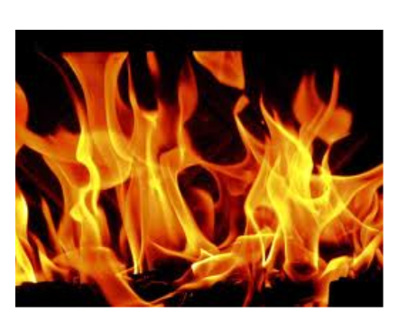
What is fire?
Fire is a chemical reaction that releases light and heat
Fire requires fuel, oxygen and heat to burn
Different types of fuel could be coal, oil and wood
Flames are the part of a fire that we can see and they can be different colours
A candle flame typically burns at 1000 degrees Celsius (for you to compare: on a hot day in England it can be 25-30 degrees Celsius)
Fire can be very dangerous and can easily burn or blister your skin so we need to be very careful

Slide 3
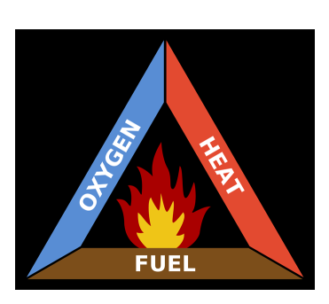
The Fire Triangle
A fire/flame needs 3 things:
Fuel
Heat
Oxygen
If we remove one or more of the above then the flame/fire will go out or be extinguished.

Slide 4

Observing a flame
WARNING! Adult supervision needed.
Watch the video of a candle flame.
If you want to do this at home, please get adult help and supervision.

Slide 5
Irreversible changes
Burning is an example of an irreversible change.
This means that you cannot get things back to how they originally were.
The candle started to melt and change shape and the wick is now blackened. If the candle continued to burn, eventually there would be no solid wax left so the flame would go out (be extinguished).
When you bake or cook something, the ingredients combine with the heat and make a new product. You cannot get all the separate ingredients back to how they originally were. This would also be an irreversible change.
Can you think of any other examples of irreversible changes?

Slide 6
Your task
Design your own poster to do with the fire triangle, flames and burning.
You can do this assignment on google docs and ‘turn in’ your work
Or
You can do your poster on paper, take a photograph and upload it to the assignment before ‘turning in’ your work.

