Slide 1
Ice
Wednesday 27th January 2021

Slide 2
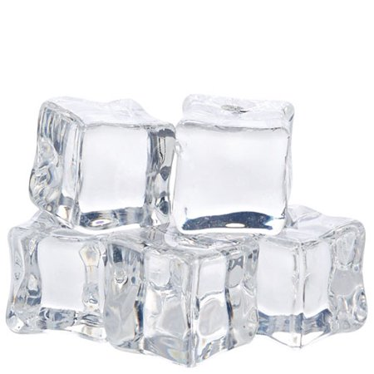
What is ice?
Last week you learnt about solids, liquids and gases.
Ice is a solid as it:
has a fixed shape
is not compressible
cannot flow

Slide 3
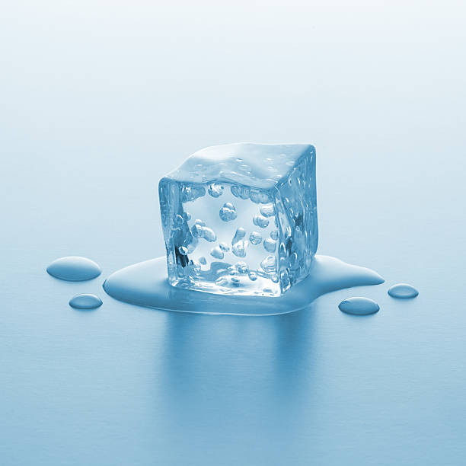
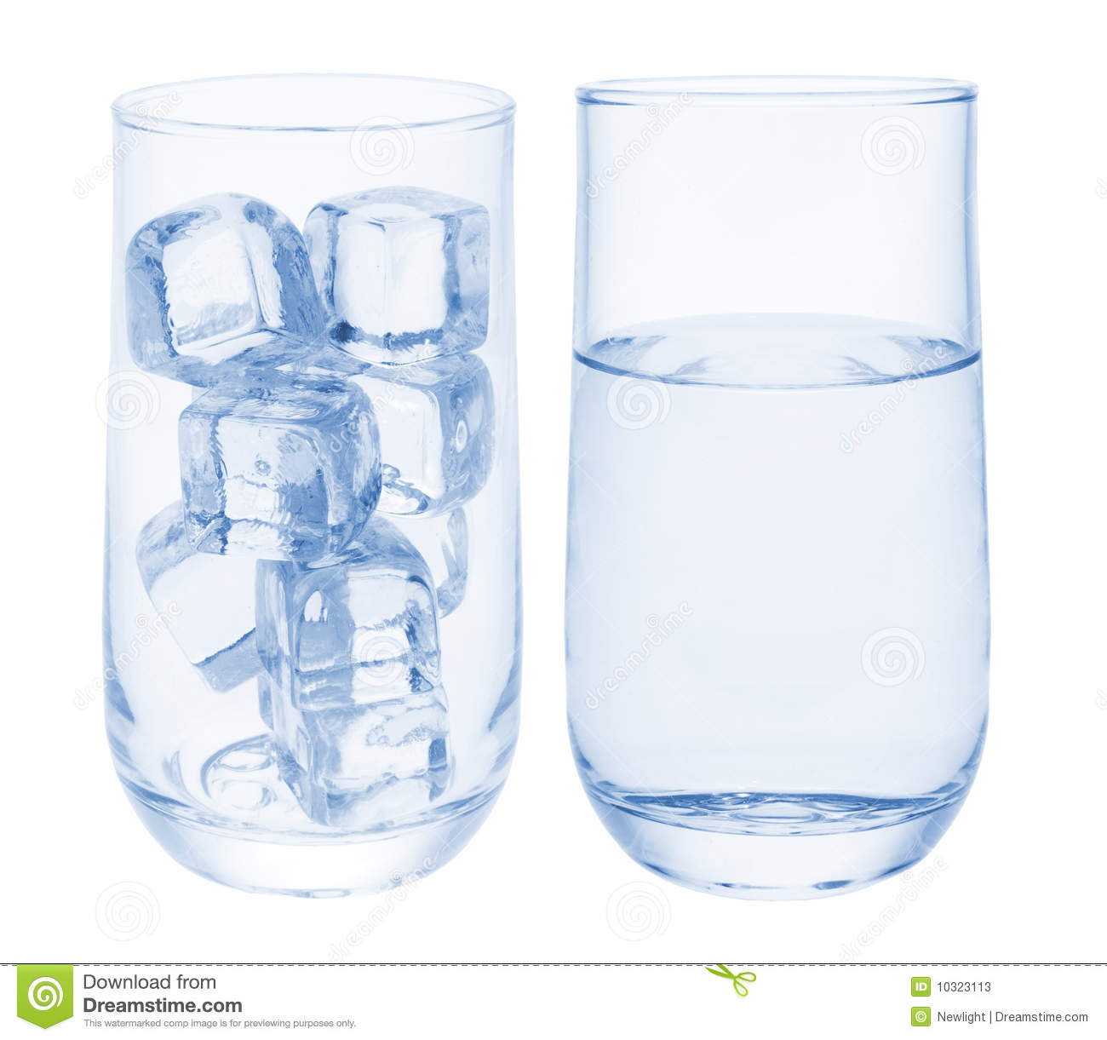
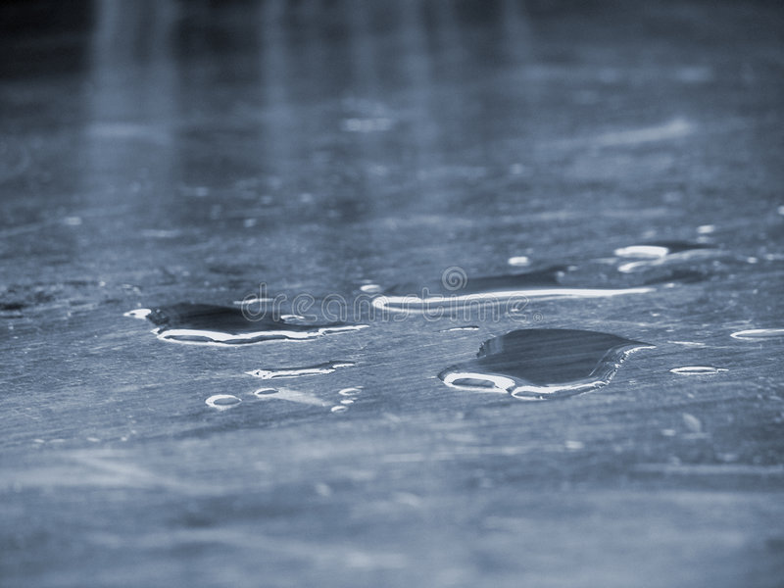
Changes with ice
Ice can change state easily.
When ice is in contact with heat, it melts. It changes to a liquid (water) as it can flow and fill the bottom of a container.
The red arrow shows heat has caused the change from a solid to a liquid.

Slide 4
Changes with ice continued
Following on from the last slide, we can then freeze the water which will then form ice.
The liquid water will change to solid ice as it has a fixed shape.
The blue arrow shows cooling or freezing has caused the change from a liquid to a solid.

Slide 5
Reversible changes
Ice and water is an example of a reversible change.
This means that we can cause something to change state but we can also get it back to its original state.
We can melt ice to form water but we can freeze the water to form ice again.
melt
freeze

Slide 6
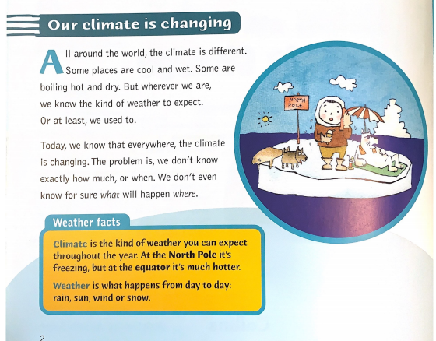

Slide 7
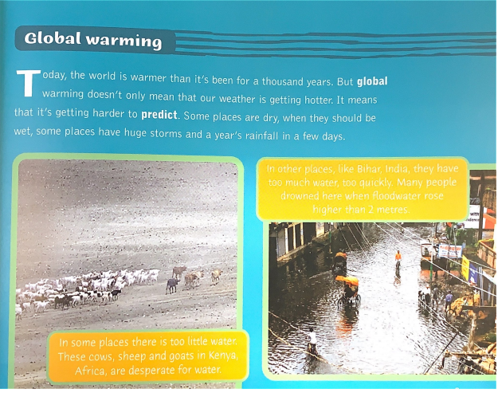

Slide 8
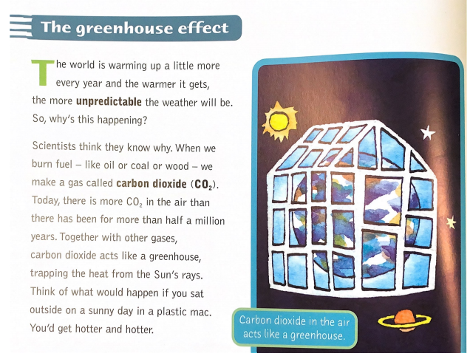

Slide 9
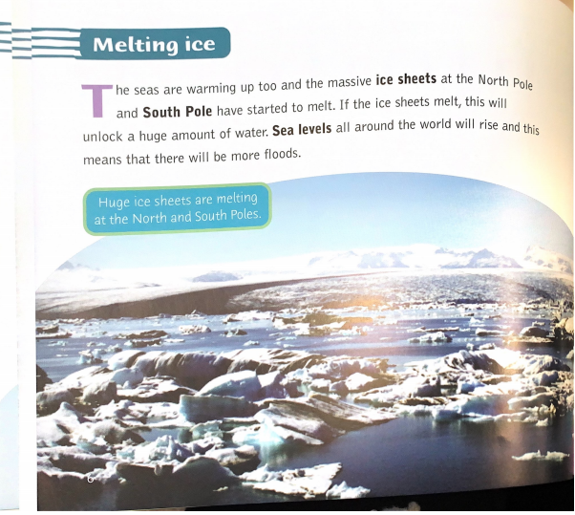
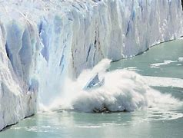
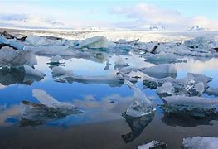

Slide 10
How can we help?
We can try to help control greenhouse gases and global warming by:
Recycling materials you use at home
Using less plastics and using reusable shopping bags
Have a compost heap
Not wasting paper
Turning off electrical appliances at the plug socket when they’re not being used
Turning off lights when you leave the room
Turning the tap off when you brush your teeth
Having a quick shower rather than a bath every night
Cycle, walk or run instead of using the car all of the time
Maybe you can think of more!

Slide 11
Ice experiment 1
Find a small container or an ice cube tray
Put some water in the container/ice cube tray and place it in the freezer
How long does it take for the water to turn to ice? (liquid to solid)
You might want to take some photographs to send us and/or write about this in a google docs to send to us.

Slide 12
Ice experiment 2
Take your ice out of the freezer
Place it on/in something (eg. plate or bowl) and put it somewhere in your house
How long does it take for the ice to turn to water?(solid to liquid)
You may want to experiment with using different places in your house (hot/cold) and compare the melting times.
You might want to take some photographs to send us and/or write about this in a google docs to send to us.

Slide 13
Extra experiment *Adult supervision needed*
If you want to, you could do this with adult help.
What happens when you boil the kettle?
What happens to the water?
What is released?
Think about the changes of state from last week’s science lessons.

Slide 14
‘Turn in’ your assignment on google classroom
Tell us about your science experiments.
You can send us the photographs and/or write about your science experiments and the timings on a google doc.
Think about your learning last week to do with the properties of solids, liquids and gases and use this with your experiments.

