Slide 1
Bangladesh, Asia

Slide 2
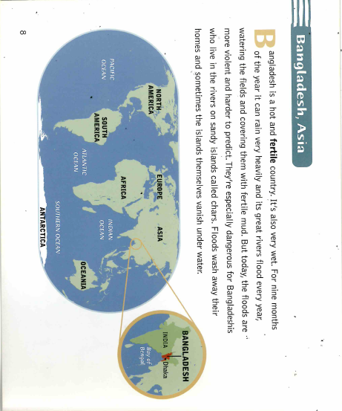

Slide 3
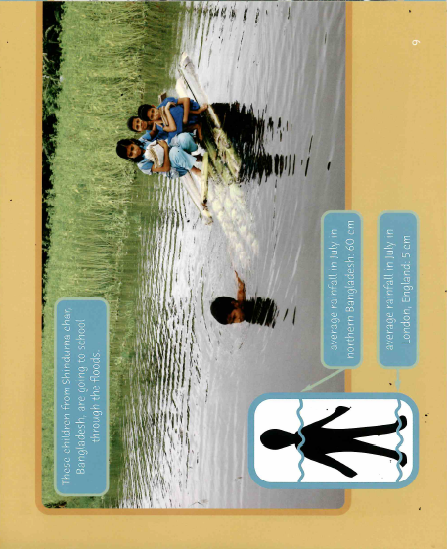

Slide 4
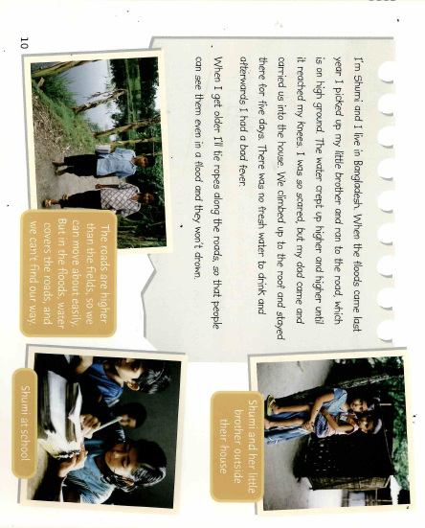

Slide 5


