Slide 1
Haiti, Caribbean

Slide 2
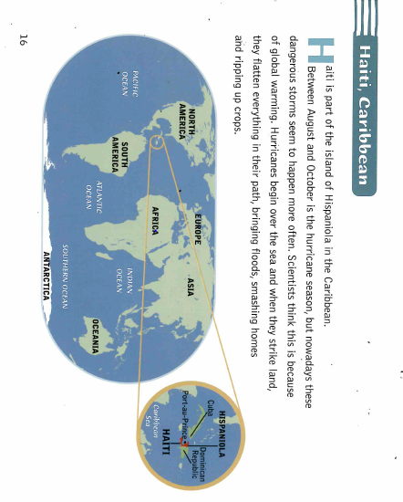

Slide 3
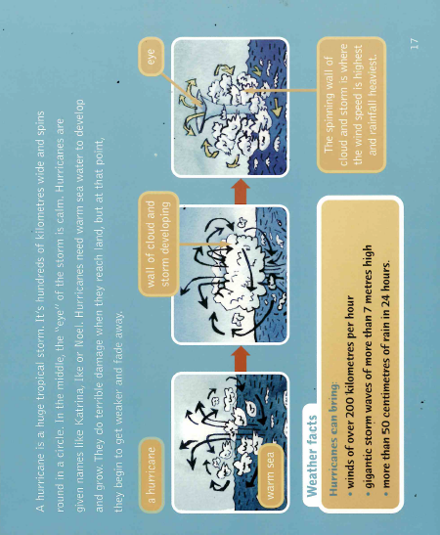

Slide 4
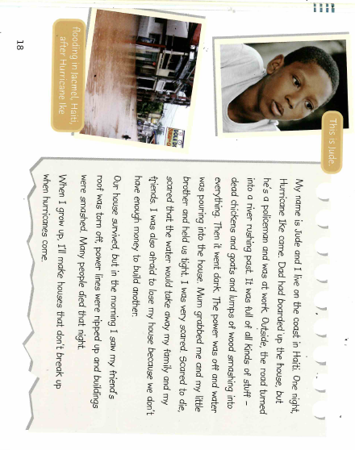

Slide 5


