Slide 1
WALT: write instructions
(for making a water filter system)
English - Friday 26th February 2021

Slide 2

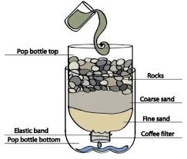
Yesterday’s work
English
In our English session yesterday, you looked at features of instruction texts and imperative verbs.
Topic
In our topic session yesterday, you made your own water filter system to clean dirty water.

Slide 3
Today’s task
Your job today is to write a set of instructions for making your water filter system to clean dirty water.

Slide 4
WILF (What I’m looking for)
How to heading
List of equipment (using bullet points)
A series of steps (your instructions)
Imperative (bossy) verbs
Time conjunctions/adverbials
A clear layout/organisation
Present tense

Slide 5

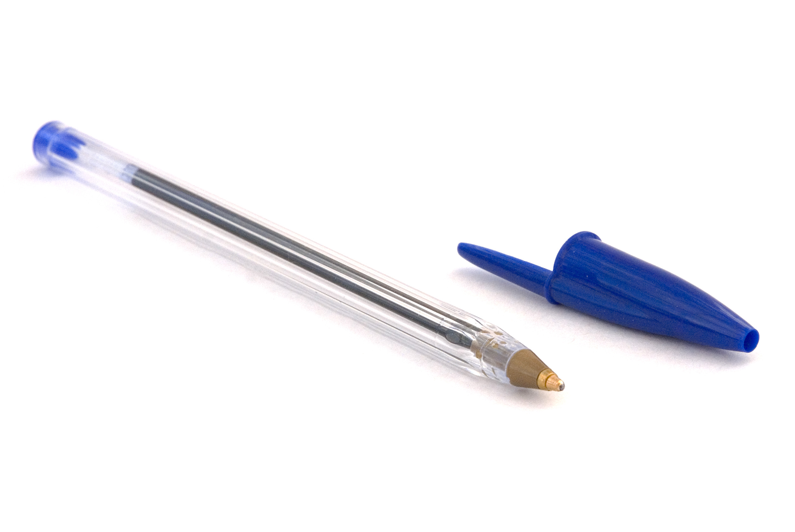

options
You can write your instructions on paper using your beautifully joined handwriting.
You can type your instructions into a google doc.
After that, you could even record yourself giving the instructions verbally before ‘turning in’ your work on google classroom.

