Slide 1
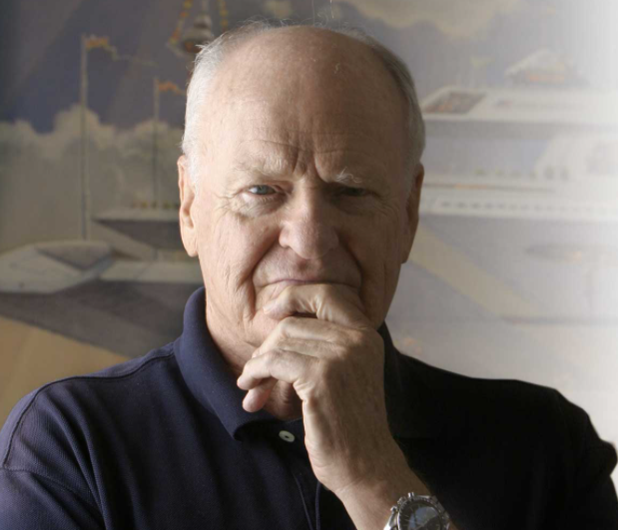
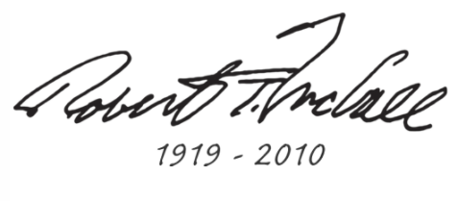

Slide 2
Lesson 3 & 4
L.O: To use Robert T McCall’s Space-inspired artwork and style as a stimulus for a finished, new piece of work.
Outcome: You will make your own completed artwork, using the ideas for the details and background that you collected and practised last week.

Slide 3
Ok, so by now you have got a good idea about who Robert T McCall was, why he was so interested in making art about Space, and how he developed his ideas into amazing and inspiring artworks.
You have collected ideas and saved them (hopefully) like a sketchbook. First of all, look through them and start thinking about what your finished piece is going to be about and how you imagine it is going to look. Remember, the choice for you here is like space itself... limitless!

Slide 4
Step 1- The Background
Today, we would like you to concentrate on your background. If you were in school, we would be giving you big paper (such as A3), and you would be using paint to create the background for your work. However, because you are at home, use the materials that are available to you, make that choice yourselves.
Look back at your practice ideas from last week.
Cover the whole paper today, ready for tomorrow.

Slide 5
Step 2- What’s in the picture?
Yesterday you created your background. Today is where you add the details for your finished piece. You need to draw/ make/ paint these (using the practice ideas from last week).
You are going to add these details using collage- that means you will make them on paper, cut them out very accurately, and carefully stick them in place onto your background.
Remember- to create depth here, some details will be bigger (closer to the viewer) and some much further away (smaller). Consider this carefully as this will create the sense of immense area and distance, which is vital when making Space-inspired artwork.

Slide 6
Ta-Da!
This is as much instruction you need now, because the end product is entirely up to you.
We are really looking forward to seeing how you respond to this task and what you decide to produce.
ENJOY!!!
Upload a photo of your finished work when it is ready and send it in...

Slide 7
Music while you work (always good)
Spotify- “Space and Science”
Spotify- “Ambient Celestial Music”
David Bowie- Space Oddity
David Bowie- Ziggy Stardust
Gustav Holst- The Planets
2001. A Space Odyssey
Star Trek theme music
Star Wars theme music

