Slide 1
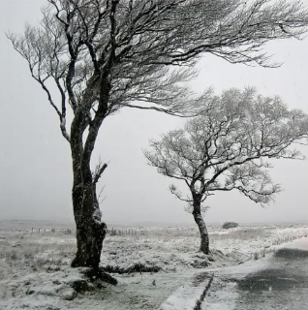
Add some descriptive words

Slide 2
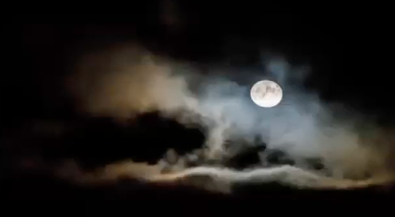
Add some descriptive words

Slide 3
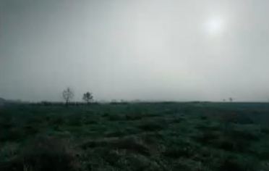
Add some descriptive words

Slide 4
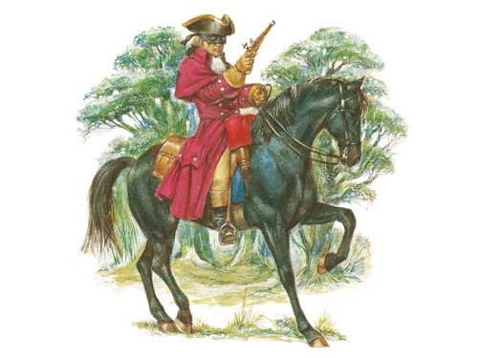
Describe his appearance
Describe what he’s doing
smart
Urgently galloped
Coat of claret velvet
Well dressed
Skillfully raced

