Slide 1
What makes something pure?
Worksheet
Science
Miss Couves
Notes:
Silent - 5 seconds
Full face intro (welcome, introduce self, introduce lesson)

Slide 2
What do the particles in wood look like?
Questions to ask:
Is the substance a solid, a liquid or a gas?
Should the particles touch?
Should the particles be ordered?
Should the particles be moving fast?

Slide 3
What do the particles in oil look like?
Questions to ask:
Is the substance a solid, a liquid or a gas?
Should the particles touch?
Should the particles be ordered?
Should the particles be moving fast?

Slide 4
What do the particles in helium look like?
Questions to ask:
Is the substance a solid, a liquid or a gas?
Should the particles touch?
Should the particles be ordered?
Should the particles be moving fast?

Slide 5
How do the particles in oil behave?
Option 1
Option 2
They are touching and vibrating on the spot.
They are touching but can slide past each other.
Option 3
Option 3
Option 4
Option 4
They are not touching and move very quickly in all directions.
They are touching but not moving at all.

Slide 6
How do the particles in wood behave?
Option 1
Option 2
They are touching and vibrating on the spot.
They are touching but can slide past each other.
Option 3
Option 3
Option 4
Option 4
They are not touching and move very quickly in all directions.
They are touching but not moving at all.

Slide 7
How do the particles in helium behave?
Option 1
Option 2
They are touching and vibrating on the spot.
They are touching but can slide past each other.
Option 3
Option 3
Option 4
Option 4
They are not touching and move very quickly in all directions.
They are touching but not moving at all.

Slide 8

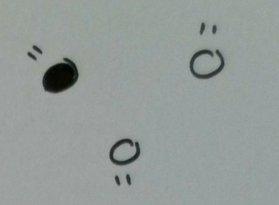
Which substance is pure and which is impure?
Helium
Air

Slide 9
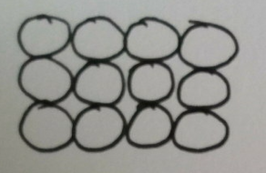
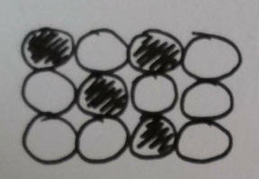
Which substance is pure and which is impure?
Gold
Rose gold

