Slide 1
What makes something a mixture?
Worksheet
Science
Miss Couves

Slide 2
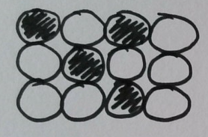
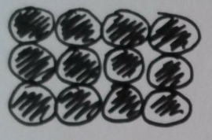
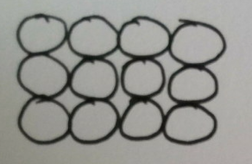
Pure metal or alloy?

Slide 3
Is this a formulation?
When making a cake you always use the same amount of sugar, butter, flour and eggs.

Slide 4
Is this a formulation?
When making washing up mixture I always use the same amount of washing up liquid and water.

Slide 5
What is a formulation?
What is a formulation?
Why is a cake a formulation?
What would happen if you change the amount of each substance in a formulation?
Does the amount of each substance need to be the same as each other?

Slide 6
My recipe gives me the ingredients for 1 cake, I want to make 4, what should I do?
Option 1
Option 2
Use the same amount of each ingredient.
Use 4 times as much of each ingredient.
Option 3
Option 3
Option 4
Option 4
Use 4 times as much sugar and butter but the same amount of flour and eggs.
Use 2 times as much of each ingredient.

Slide 7
My instructions give me the substances for 1 pot of paint, I want to make half a pot, what should I do?
Option 1
Option 2
Use the same amount of each substance.
Use 2 times as much of each substance.
Option 3
Option 3
Option 4
Option 4
Use half the amount of colour dye but the same amount of water.
Use half as much of each substance.

Slide 8
Complete this table
Cup number | Spoonfuls of squash | Spoonfuls of water | Colour | Taste
1 | 1 | 5
2 | 2 | 10
3 | 3 | 15
4 | 5 | 1

Slide 9
Method:
Cup number | Spoonfuls of squash | Spoonfuls of water
1 | 1 | 5
2 | 2 | 10
3 | 3 | 15
4 | 5 | 1
Use a dessert spoon to measure out amounts of squash and water into the cups as shown in the table.
Put the cups next to each other and compare the colour of the mixtures.
Taste a small amount of mixture to compare how each of the mixtures taste.

Slide 10
Conclusions:
What do you notice about the colour of 1, 2 and 3 compared to number 4?
What do you notice about the taste of 1, 2 and 3 compared to number 4?
Why do you think this is the case?
If you use squash that is ‘double concentrate’, what will you have to do differently?

