Slide 1
How can we separate mixtures into pure substances?
Worksheet
Science
Miss Couves

Slide 2
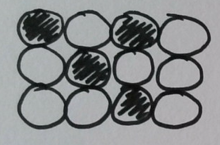
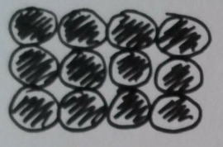
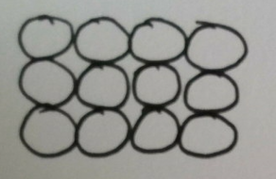
Pure metal or alloy?

Slide 3
Separating solids:
Why was the mixture of sand and iron impure?
Why was the sand sample at the end pure?
Why could we use a magnet to separate sand and iron?

Slide 4
Separating a solid from a liquid:
Why was the mixture of sand and water impure?
Why could pasta be removed from the water using a sieve?
Why could sand not be removed from the water using a sieve?
Why was filter paper better for removing sand from water?
Why was the sieve better for removing pasta from water?

Slide 5
How can we separate our salt and water?
Option 1
Option 2
Using a magnet.
Using a sieve.
Option 3
Option 3
Option 4
Option 4
Using filter paper.
None of these methods.

Slide 6
Separating dissolved solids:
Why was the mixture of salt and water impure?
Why could we not use filtration to separate the salt and water?
Why could we use evaporation to separate the salt and water?

Slide 7
How can we separate our sugar and water?
Option 1
Option 2
Using a magnet.
Using a sieve.
Option 3
Option 3
Option 4
Option 4
Using filter paper.
Evaporation.

Slide 8
How can we separate our iron and wood chips?
Option 1
Option 2
Using a magnet.
Using a sieve.
Option 3
Option 3
Option 4
Option 4
Using filter paper.
Evaporation.

Slide 9
How can we separate our pebbles and water?
Option 1
Option 2
Using a magnet.
Using a sieve.
Option 3
Option 3
Option 4
Option 4
Using filter paper.
Evaporation.

