Slide 1
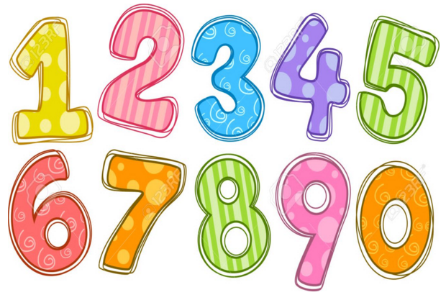
Maths Gym
Home Learning 2 LA

Slide 2
Have a go at these adding questions.
Draw your dots to help you!
Day 1
4 + 5 =
3 + 4 =
7 + 2 =

Slide 3
Have a go at these adding questions.
Draw your dots to help you!
Day 2
6 + 7 =
9 + 2 =
5 + 5 =

Slide 4
Have a go at these adding questions.
Draw your dots to help you!
Day 3
6 + 4 =
7 + 5 =
4 + 3 =

Slide 5
Have a go at these adding questions.
Draw your dots to help you!
Day 4
6 + 7 =
7 + 8 =
8 + 9 =

Slide 6
Have a go at these adding questions.
Draw your dots to help you!
Day 5
2 + 6 =
3 + 8 =
5 + 7 =

