Slide 1
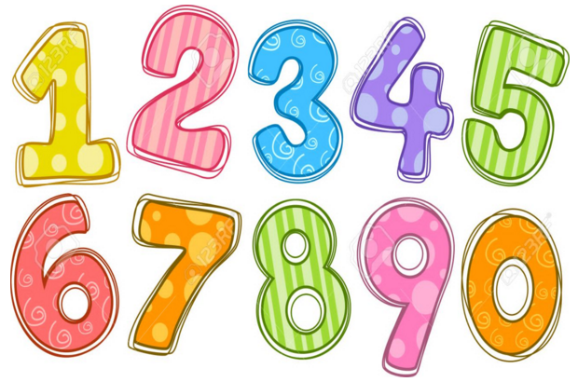
Maths Gym
Home Learning 1

Slide 2
19 + 3 = 22
30 – 10 = 20
Half of 12= 6
Double 3 = 6
2 x 10 = 20
10, 20
Example
4
5
9
4 + 5 = 9
5 + 4 = 9
9 - 5 = 4
9 - 4 = 5

Slide 3
35 + 14 =
37 – 15 =
Half of 8=
Double 13 =
7 x 10 =
Day 1
14
6
20
_____ + _____ =
_____ + _____ =
_____ - _____ =
_____ - _____ =

Slide 4
45 + 20 =
24 – 12 =
Half of 10=
Double 11 =
9 x 5 =
Day 2
7
13
20
_____ + _____ =
_____ + _____ =
_____ - _____ =
_____ - _____ =

Slide 5
34 + 17 =
48 – 11 =
Half of 22=
Double 7 =
8 x 10 =
Day 3
1
19
20
_____ + _____ =
_____ + _____ =
_____ - _____ =
_____ - _____ =

Slide 6
35 + 22 =
47 – 15 =
Half of 10=
Double 6 =
6 x 2 =
Day 4
7
13
20
_____ + _____ =
_____ + _____ =
_____ - _____ =
_____ - _____ =

Slide 7
11 + 23 =
27 – 12 =
Half of 24=
Double 10 =
8 x 5 =
Day 5
17
3
20
_____ + _____ =
_____ + _____ =
_____ - _____ =
_____ - _____ =

