Slide 1
Mathematics
Naming and describing 3-D shapes
Miss Mitchell

Slide 2
Lesson agenda
3-D shapes
Talk task
Independent task
Quiz

Slide 3


You will need…
Pencil
Paper
Items in your home. Please ask a parent or carer before touching any items.

Slide 4
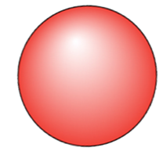

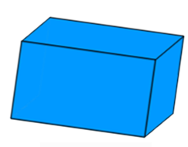

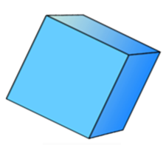
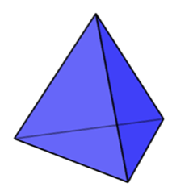
Cone
Cuboid
Sphere
Cylinder
Cube
Pyramid

Slide 5
Talk task
Find 5 or more 3-D objects in your home.
The ______________ (name of object/thing) is an example of a ___________________ (name of 3-D shape).
cube
cuboid
pyramid
cone
cylinder
sphere

Slide 6
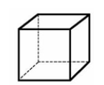


Cube
Sphere
Cuboid

Slide 7
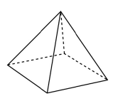
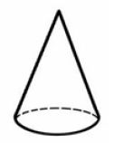
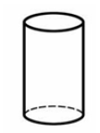
Square based pyramid
Cone
Cylinder

Slide 8
Independent task
Choose the shapes from below to match the descriptions.
I have one curved surface I have 0 edges. I have 0 vertices. What shape am I?
I have 6 faces. All of my faces are 4-sided. I have 8 vertices. What shape am I?
How many vertices does a square based pyramid have?
I have 3 faces, 0 vertices and 2 edges. What shape am I?
Which shape has the most edges?

Slide 9


Pause to complete your task
Carry on once you’re finished

Slide 10
Answers
Sphere
Cube or cuboid
5 vertices
Cylinder
Cube or cuboid

