Slide 1
Mathematics
Identifying 2-D shapes on the surfaces of 3-D shapes.
Miss Mitchell

Slide 2
Lesson agenda
Properties of shapes
Talk task
Independent task
Quiz

Slide 3


You will need…
Pencil
Paper

Slide 4
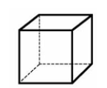
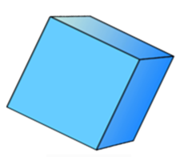
A cube has:
6 faces
12 edges
8 vertices
Now, can you describe the cube without using the terms ‘edges’, ‘vertices’ or ‘faces’?

Slide 5
A cube has:
6 faces
12 edges
8 vertices
Now, can you describe the cube without using the terms ‘edges’, ‘vertices’ or ‘faces’?
The cube has 6 squares.

Slide 6
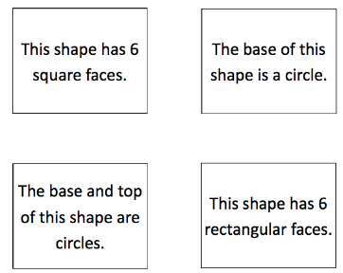
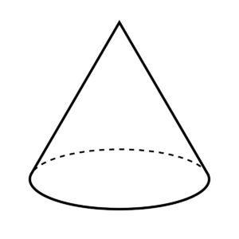
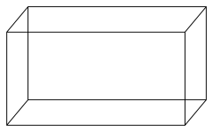
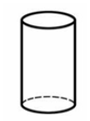

Talk task
Say it out loud:
This card says ___________ so it matches the _______________.

Slide 8

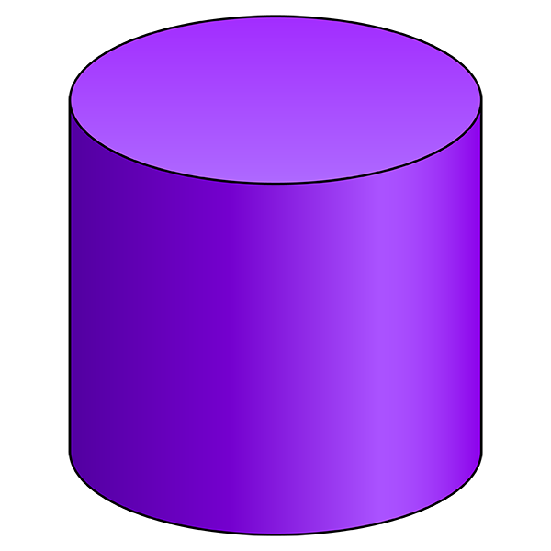
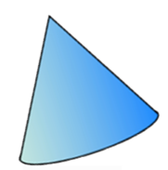
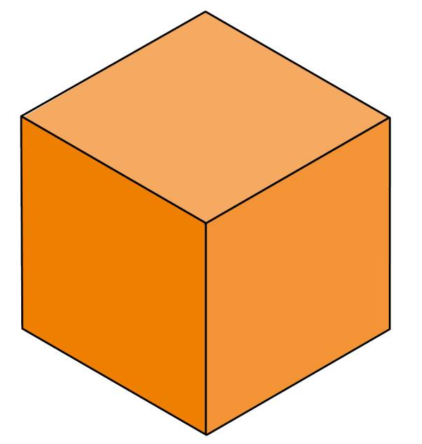
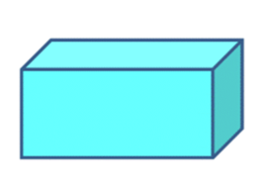
This is the shadow of a 3-D shape.
What shape or shapes might it belong to? How do you know?
Choose from the options below:

Slide 9
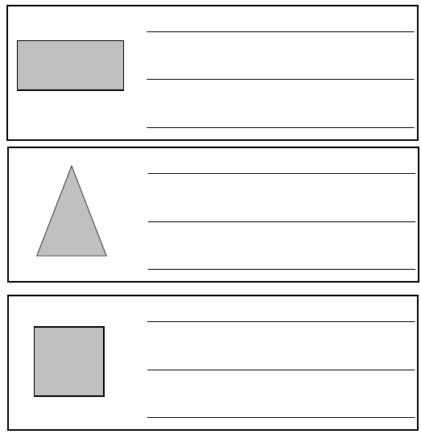
Independent task
What 3-D shape might these shadows belong to? Explain why.
Could any of the shadows belong to more than one shape? Which ones?

Slide 10


Pause to complete your task
Carry on once you’re finished

Slide 11
Answers
Questions | Answers
1 | A cuboid because a cuboid has 6 rectangular faces
2 | A pyramid, square-based pyramid or a triangular prism because it has triangular faces
3 | A cube or a cuboid because a cube has 6 square faces and a cuboid has 2 square (rectangular) faces

