Slide 1
Mathematics
Identifying right angles in shapes
Miss Mitchell

Slide 2
Lesson agenda
Right angles
Talk task
Independent task
Quiz

Slide 3


You will need…
Pencil
Paper
Items in your home. Please ask a parent or carer before touching any items.

Slide 4
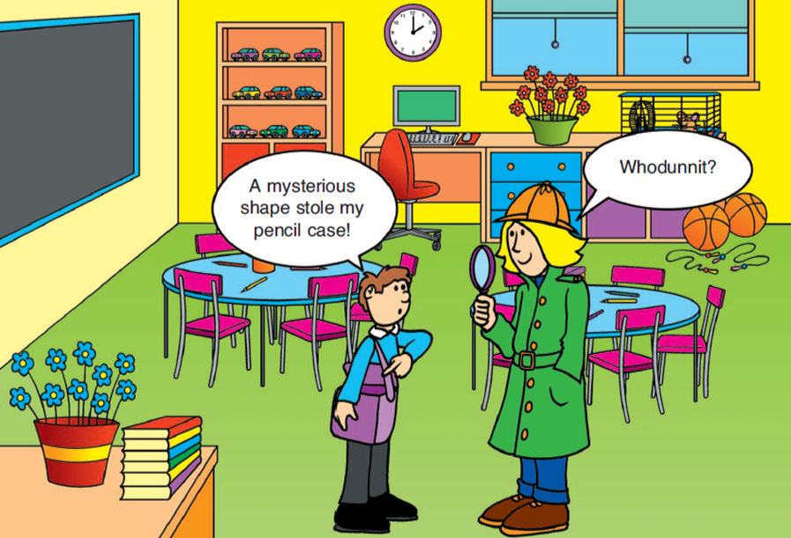

Slide 5


Slide 6


Slide 7
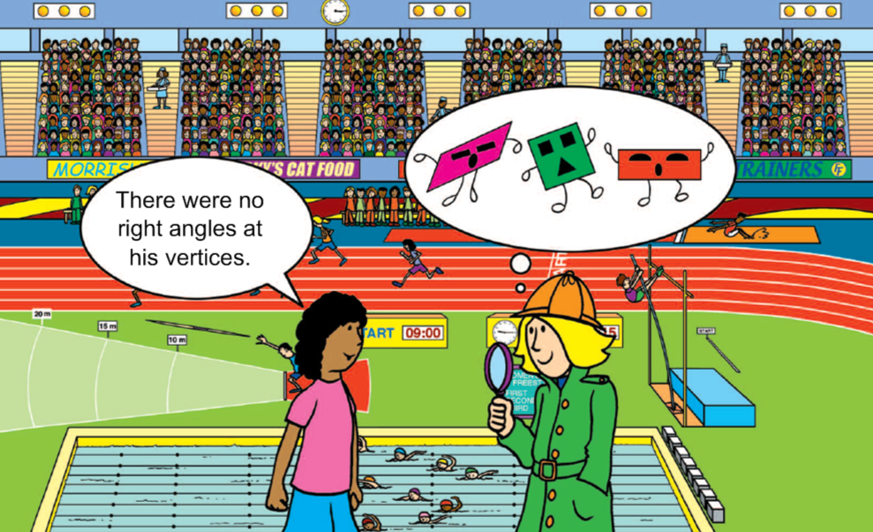

Slide 8

Right angle

Slide 9



A right angle is a turn of 90 degrees.
Quarter to and quarter past are examples of right angles.

Slide 10
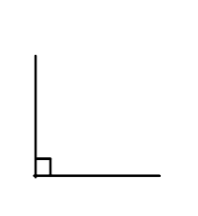
They can be found where two lines meet, which makes an ‘L’ shape!
A right angle can usually be found in the corner of a rectangle or square

Slide 11

Talk task
Find 5 examples of right angles in your house!
Say it out loud:
This is a right angle because __________________.
This is not a right angle because _______________.

Slide 12

How many right angles does the square have?

Slide 13
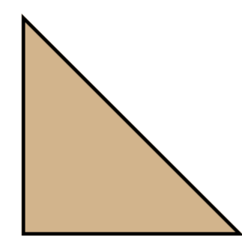
How many right angles does this triangle have?

Slide 14

How many right angles does the pentagon have?
Does it have any?

Slide 15

Independent task
Look at the shapes and identify whether they have right angles.

Slide 16


Pause to complete your task
Carry on once you’re finished

Slide 17
Answers
Only the square and rectangle have right angles!

