Slide 1
Mathematics
Recognising lines of symmetry within 2-D shapes
Miss Mitchell

Slide 2
Lesson agenda
Lines of symmetry
Talk task
Independent task
Quiz

Slide 3


You will need…
Pencil
Paper
Scissors

Slide 4
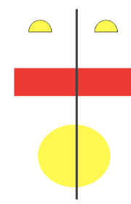
What is symmetry?
Something is symmetrical when it is identical on both sides
A shape or pattern has symmetry if a mirror line can be drawn on it to show that both sides are exactly the same!

Slide 5
Is there a line of symmetry? How could we check?

Slide 6

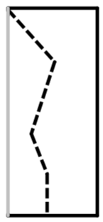
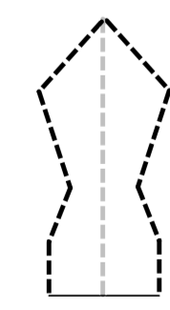
Talk task
1. Fold a piece of paper
2. Cut out a shape (without cutting across the fold).
3. Open the shape so that you can see the line of symmetry.

Slide 7

Where are the lines of symmetry?
How many are there?

Slide 9

Where are the lines of symmetry?
How many are there?

Slide 11
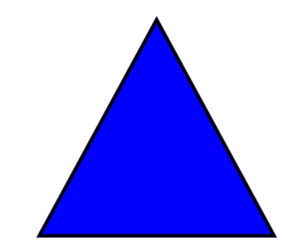
Where are the lines of symmetry?
How many are there?

Slide 13
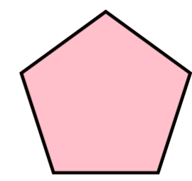
Where are the lines of symmetry?
How many are there?

Slide 15
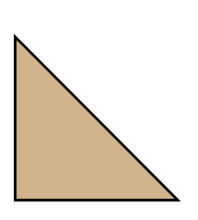
Where are the lines of symmetry?
How many are there?

Slide 17
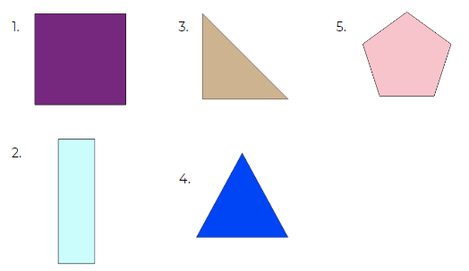
Independent task
For each shape can you tell me:
What it is called
How many sides it has
How many vertices it has
How many lines of symmetry

Slide 18


Pause to complete your task
Carry on once you’re finished

Slide 19
Answers
Number | Name | Sides | Vertices | Lines of symmetry
1 | Square | 4 | 4 | 4
2 | Rectangle | 4 | 4 | 2
3 | Right angle triangle | 3 | 3 | 1
4 | Equilateral triangle | 3 | 3 | 3
5 | Pentagon | 5 | 5 | 1

