Slide 1
Mathematics
Describing and creating shape patterns
Miss Mitchell

Slide 2
Lesson agenda
Shape patterns
Talk task
Independent task
Quiz

Slide 3


You will need…
Pencil
Paper

Slide 4


A pattern has a repeated design or recurring sequence
What shapes are in the pattern?
What is the pattern?
What shape will be next in the pattern?

Slide 5


A pattern has a repeated design or recurring sequence
What shapes are in the pattern?
What is the pattern?
What shape will be next in the pattern?

Slide 6
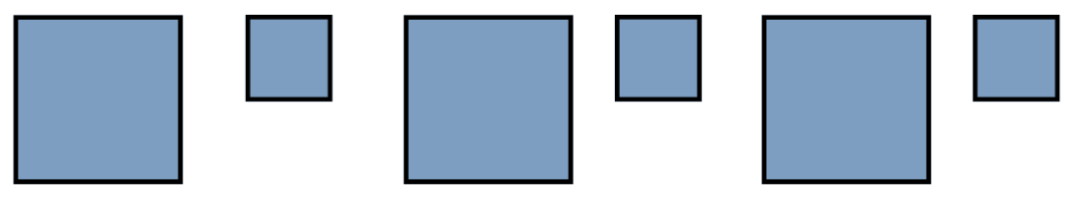

A pattern has a repeated design or recurring sequence
What shapes are in the pattern?
What is the pattern?
What shape will be next in the pattern?

Slide 7



Talk task
Say it out loud:
The pattern is ___________ so the next shape in the pattern is ____________.

Slide 8


Can you remember the name of these shapes?
What would the next 3 shapes in the pattern be?

Slide 9




Slide 10
Independent task
Can you create your own shape pattern that:
Includes 3 different shapes?
Has pentagon in it?
Only has 1 shape?

Slide 11


Pause to complete your task
Carry on once you’re finished

Slide 12
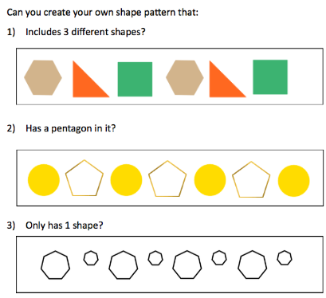
Answers
Here is an example of my patterns but your answers may be different.
Includes 3 different shapes?
Has pentagon in it?
Only has 1 shape?

