Slide 1
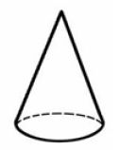
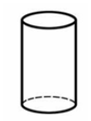
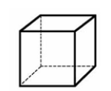
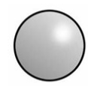

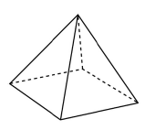
Choose the shapes from below to match the descriptions.
I have one curved surface I have 0 edges. I have 0 vertices. What shape am I?
I have 6 faces. All of my faces are 4-sided. I have 8 vertices. What shape am I?
Notes:
Why do we use standard units? Why not non standard units?

Slide 2
Choose the shapes from below to match the descriptions.
How many vertices does a square based pyramid have?
I have 3 faces, 0 vertices and 2 edges. What shape am I?
Which shape has the most edges?
Notes:
Why do we use standard units? Why not non standard units?

