Slide 1
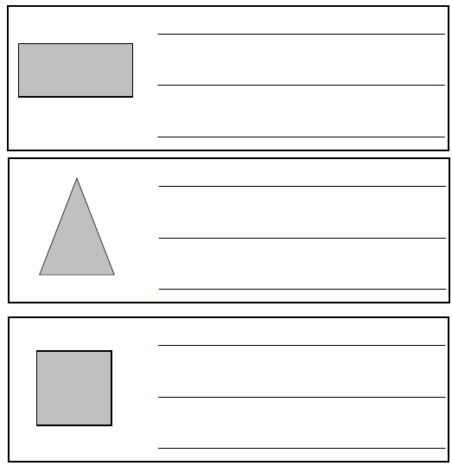
Question 1
What 3-D shape might these shadows belong to? Explain why.
Could any of the shadows belong to more than one shape? Which ones?
Notes:
Why do we use standard units? Why not non standard units?

