Slide 1
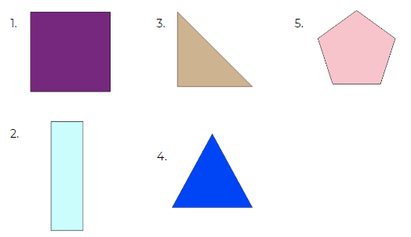
Question 1
For each shape can you tell me:
What it is called
How many sides it has
How many vertices it has
How many lines of symmetry
Notes:
Why do we use standard units? Why not non standard units?

