Slide 1
Who lives in a house like this?
Summer 1 project
Week 2 – Castles

Slide 2
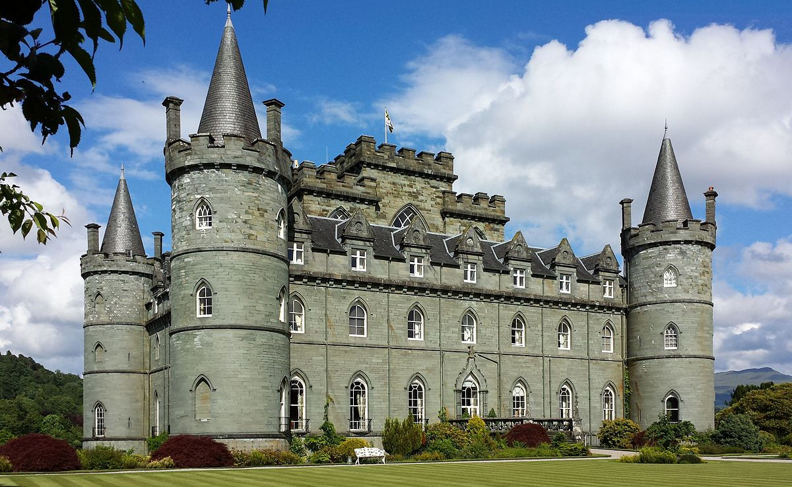
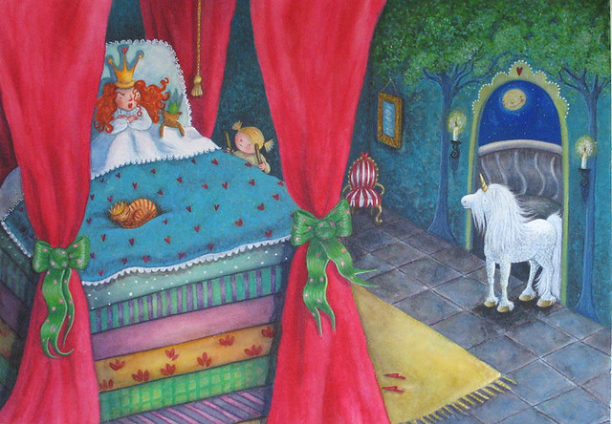
Day 1 –the princess and the pea
This week we have a fairy tale to go alongside our new type of building.
This fairy tale is all about a princess – can you think, where do princess usually live?
That’s right – in a castle! This week we are learning all about castles.
Do you have The Princess and the Pea at home? If so, go and find it!
If not, don’t worry. Here is a lovely version you can watch on YouTube. See if you can follow the words at the bottom of the screen as it is read.
https://www.youtube.com/watch?v=ZJ0EKqAECPs

Slide 3
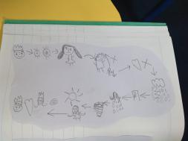
Princess and the pea story map
Do you remember how to make a story map? We have practiced for different fairy tales before. Why don’t you have a go at doing one for The Princess and the Pea?
They look at a bit like this and tell the story through pictures.
Remember to use an arrow to show a new part of the story.
You can add lots of labels and captions too.

Slide 4
Day 2 – suffixes
Can you have a look at the Princess and the Pea story powerpoint? As you click through the slides, see if you can spot the words that end in the ‘ed’ suffix. Can you remember what happens to a word when it has the ‘ed’ suffix on the end?
Well done! It means it happened in the past. Sometimes when we say the word like ‘walked’ it sounds like there is a ‘t’ at the end . But we are clever and know that it is actually the ‘ed’ suffix.
Make a list of all the words you find in the story with the ‘ed’ suffix.
If you like you could have a go at writing some sentences with the ‘ed’ suffix! There are some pictures with the resources to help you think of one.

Slide 5
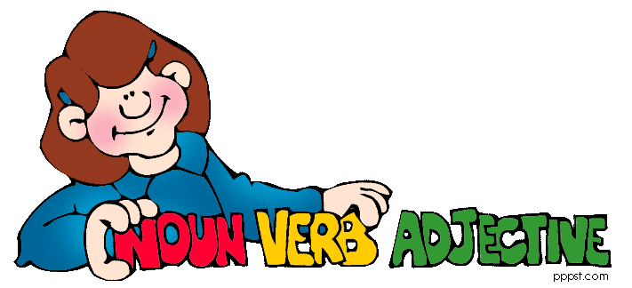
Day 3 – the princess and the pea poem
Read the Princess and the Pea poem
There are two special jobs for you to do with this poem
One is to see if you can find the different sounds – sh, igh, th and ea and colour them in different colours
Another is to find the adjectives, verbs and nouns.
Remember – an adjective is a describing word, a verb is a busy doing word and a noun is a naming word ☺

Slide 6
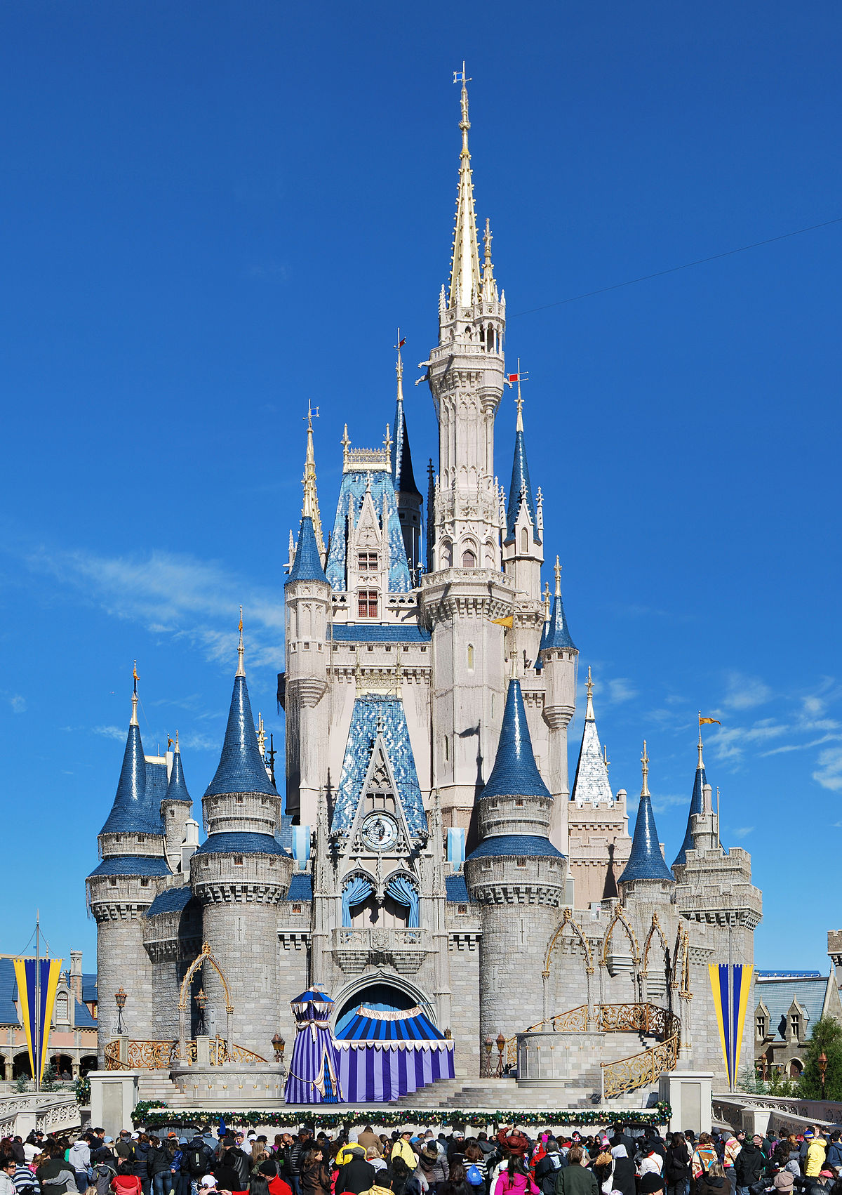
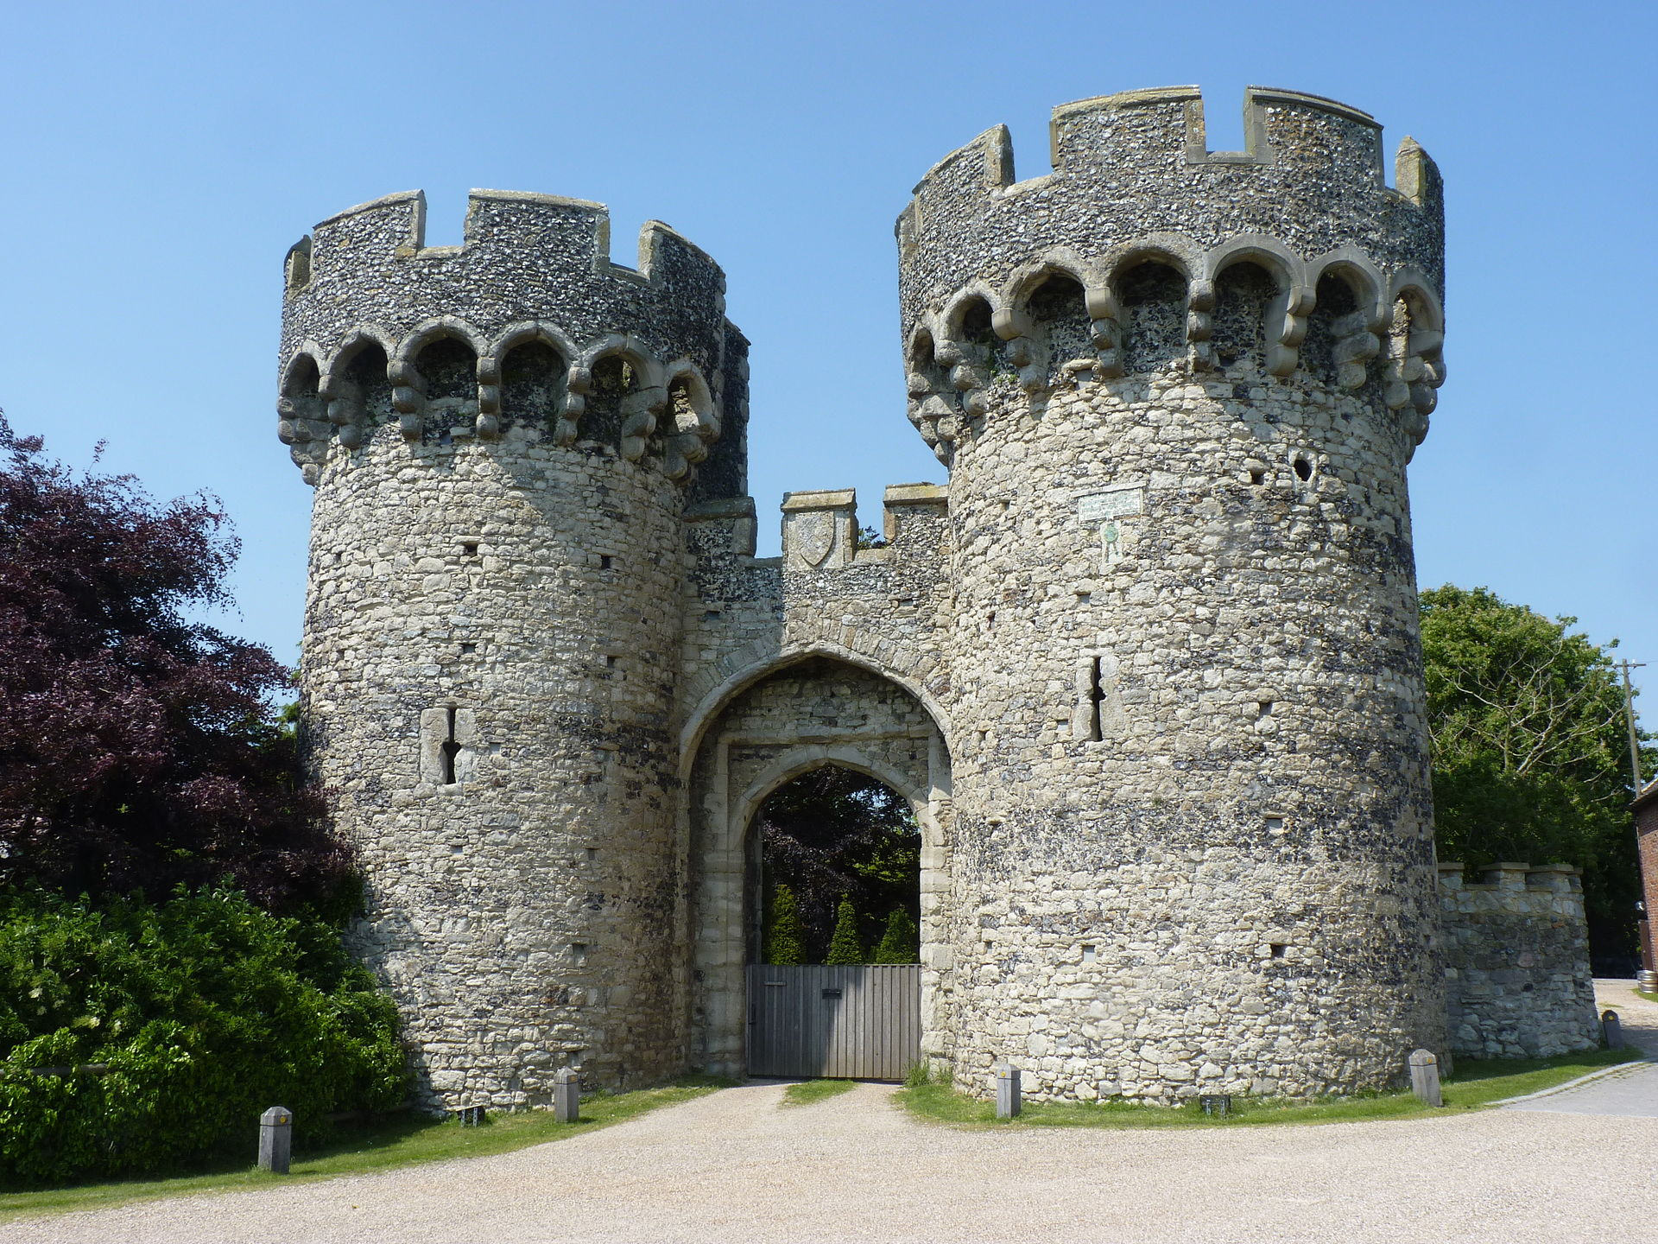
Day 4 - castles
Have a little think about castles – what do you already know about them? Like we do with our talking partners in class could you have a little chat with your grown up about things you already know? Perhaps you have built a sand castle at the beach before, what did you make sure it had?
Do we have a castle in our town? What is it like? Could you do some research?
Where else do you know there a castle? Are there any other stories or films with a castle in them?
Have a look at the castles information powerpoint. Can you learn something new about castles that you didn’t know before?
Have you learnt some new words? What do they mean?

Slide 7
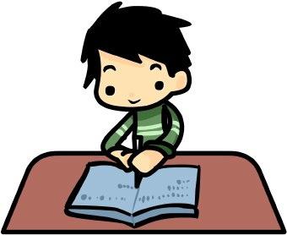
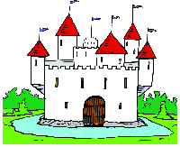
Day 4/5 castle activities
There are now lots of different jobs you can choose to do about castles ☺
Create a little poster all about castles
Label a castle
Castle and knights cutting and sticking to match the labels
Create a castle with junk modelling or lego
Alphabetical ordering castle words
Knights and castles wordsearch
Write some speech bubbles for the Princess and the Pea

Slide 8
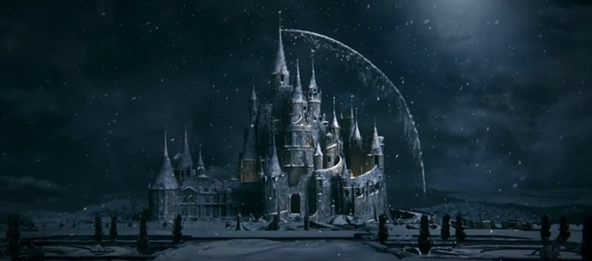
Are you feeling creative?
Why not have a little look at this clip with some gorgeous images of a castle
https://www.literacyshedblog.com/blog/beauty-and-the-beast-teaser-trailer#
Can you describe walking towards the castle in the snow and how you would feel as you approach the castle, before going inside and seeing the cobwebbed interior?
If you’re feeling particularly creative, could you carry on the story from where it stops.. ? If you do write a story we would love to read or hear them!

