Slide 1
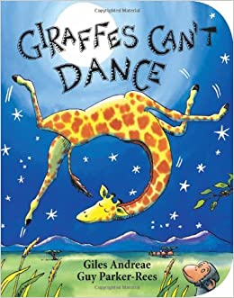
Giraffes can’t dance
Week 1

Slide 2
Day 1
Look at the power point called ‘ What Animals do you know? ’which of these animals do you know?
Watch Giraffes can’t dance or look at the power point version of the story.
Did you spot any rhyming words?
https://www.youtube.com/watch?v=o0wweS8P-tY

Slide 3

Day 2
Have a read of the story today what punctuation can you see?
Can you write these sentences in your neat handwriting and add the correct punctuation?
How did you learn to dance
He raised his head and looked at the moon
Why can’t I dance

Slide 4

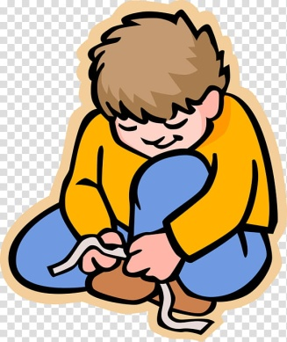
Day 3
Gerald couldn’t dance to start with but then learnt how to do.
What can’t you do now but would like to do in the future?
Here are some ideas ....
Drive a car
Write a sentence
Do an addition calculation
Have a job – what would you like to be?
Tie my shoe laces.
You might be able to do some of these already!!

Slide 5
Day 4
This is Gerald’s diary ....
I woke up this morning and I felt butterflies in my tummy. I just knew that it was the day of the dance. I am just so useless at dancing! My knees go all funny and my arms just fling about. All the other animals dance so perfectly and I just wish that I could dance like them. I can’t help it that I have such lanky legs and knobbly knees, I was just born that way. I wonder if anyone will help me dance? That would be so kind if they did…

Slide 6
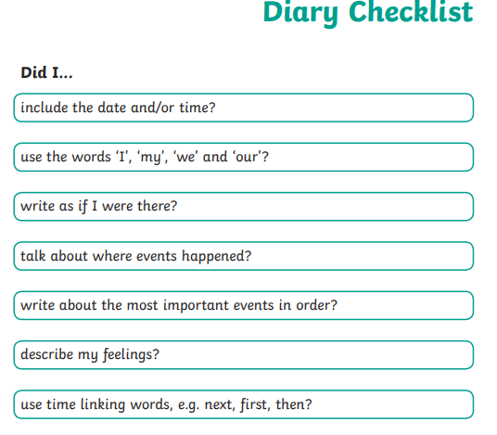
Day 4 continued
Can you carry on his diary?
What did he do next?
Remember the check
list for a diary....

Slide 7
Day 5
Comprehension
There is a copy to print out.
What will you learn about
giraffes?

