Slide 1

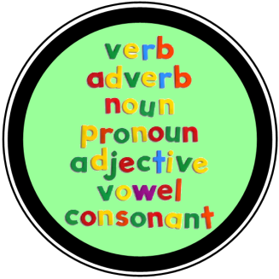

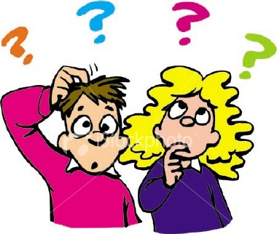
SPaG
Year 1

Slide 2
? ! or .
Gerald can dance
Why can’t I dance
YES I’m dancing

Slide 3
? ! or .
How did you learn to dance
He raised his head and looked at the moon
Why can’t I dance

