Slide 1
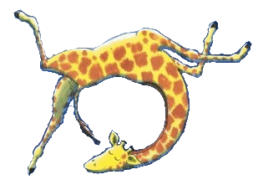
Gerald’s Diary
The day of the dance
I woke up this morning and I felt butterflies in my tummy. I just knew that it was the day of the dance. I am just so useless at dancing! My knees go all funny and my arms just fling about. All the other animals dance so perfectly and I just wish that I could dance like them. I can’t help it that I have such lanky legs and knobbly knees, I was just born that way. I wonder if anyone will help me dance? That would be so kind if they did…

