Slide 1
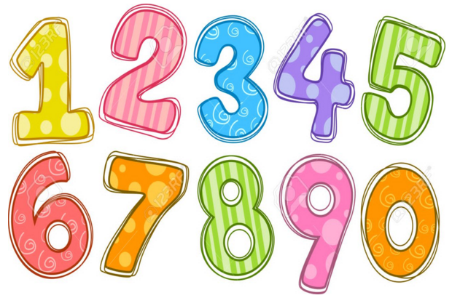
Maths Gym
Week 1

Slide 2
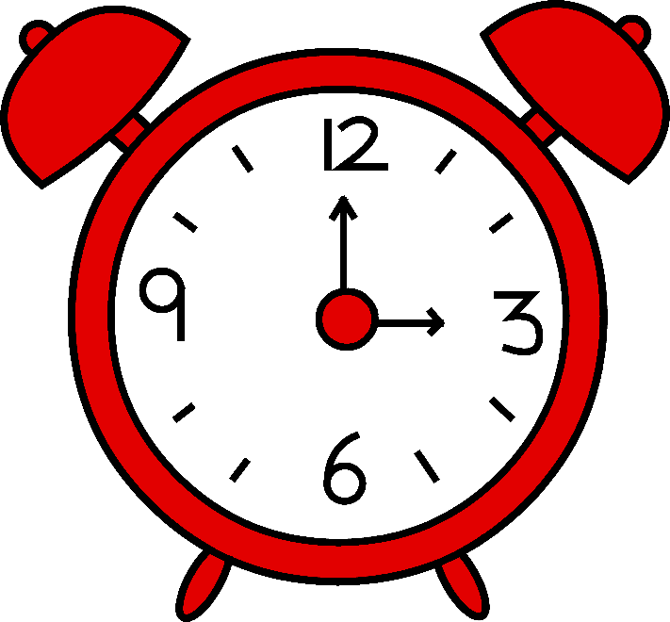
Activity 1
What time is it?
Can we make different o’clock times?
https://www.topmarks.co.uk/time/teaching-clock

Slide 3
Activity 2
What time is it?
Use your mini clock.
Can you show me..
1 o’clock?
4 o’clock?
6 o’clock?
11 o’clock?
Half past 2?
Half past 3?
Words to help
o’clock
half past

Slide 4
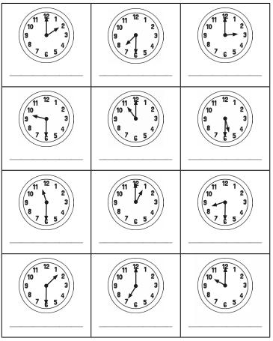
Activity 3
What time is it?
Words to help
o’clock
half past
1
2
3
4
5
6
7
8
9
10
11
12

Slide 5
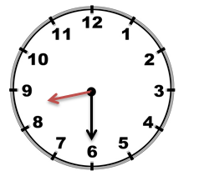
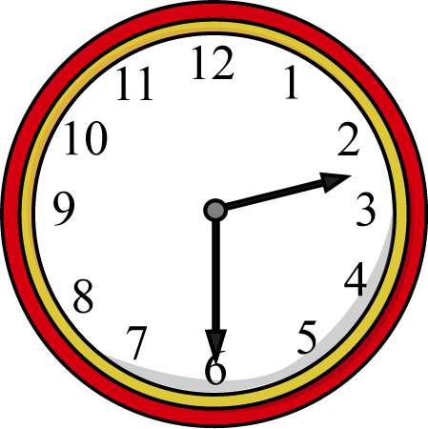
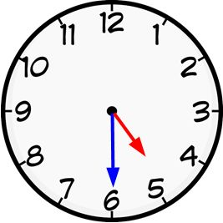
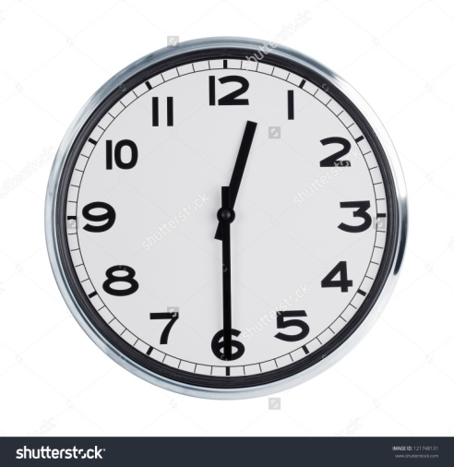
What is the time Mr Wolf?
Activity 4

Slide 6
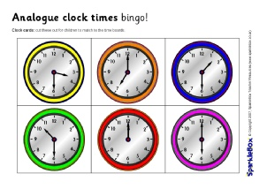
Activity 5
Telling the Time

