Slide 1
Islands

Slide 2
Learning Intention:
We are learning to identify the human and physical features of an Island.
Success Criteria:
I can explain the difference between a human and physical feature
I can sort the features and place them under the correct heading

Slide 3
What is a human feature?

Slide 4

Human feature:
A human feature is something man - made or it was made by a human being e.g. buildings

Slide 5
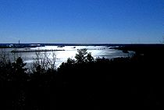
What is a physical feature?
A physical feature is something which is natural – it happens naturally
E.g. land, water within a land, soil

Slide 6
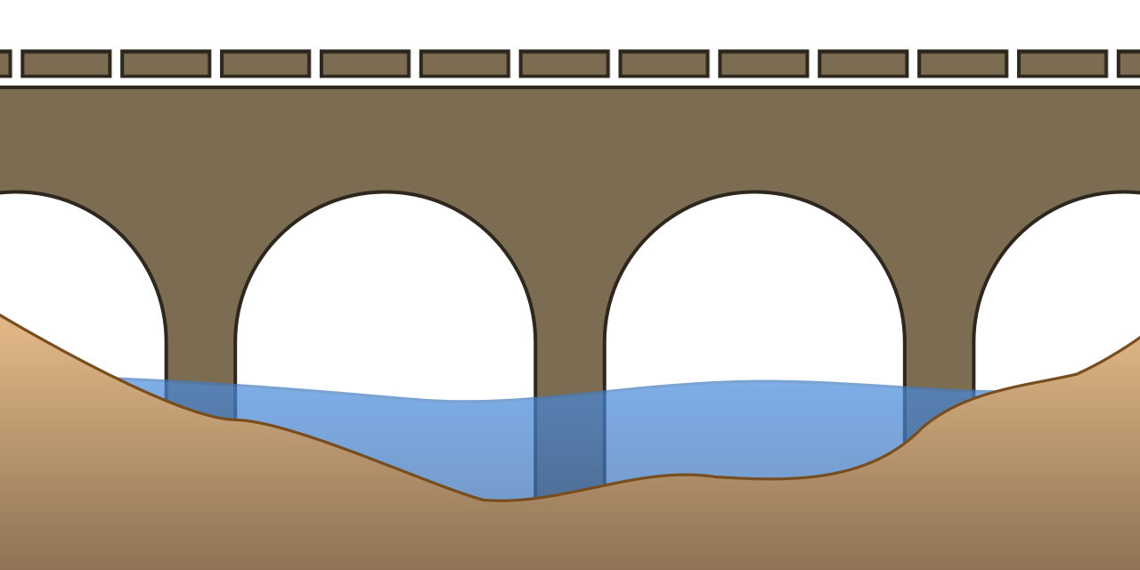
What kind of feature would a bridge be?
Human
Or
Physical

Slide 7
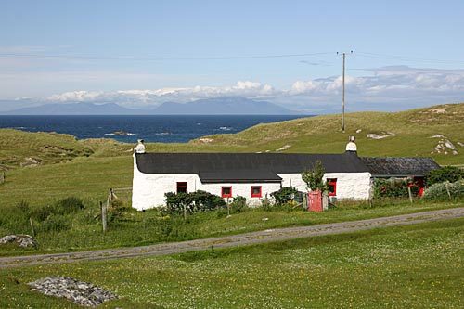
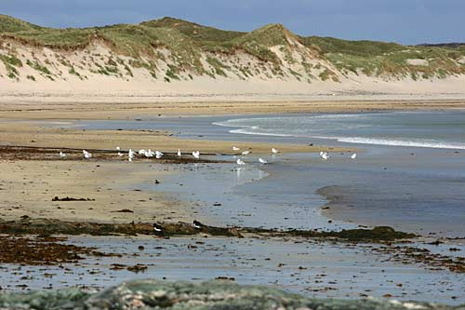
Can you sort the following?
Which is human feature and which is physical feature?
Village house The beach

Slide 8
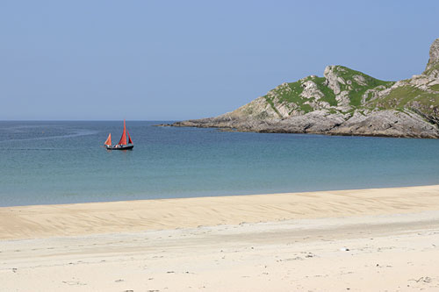
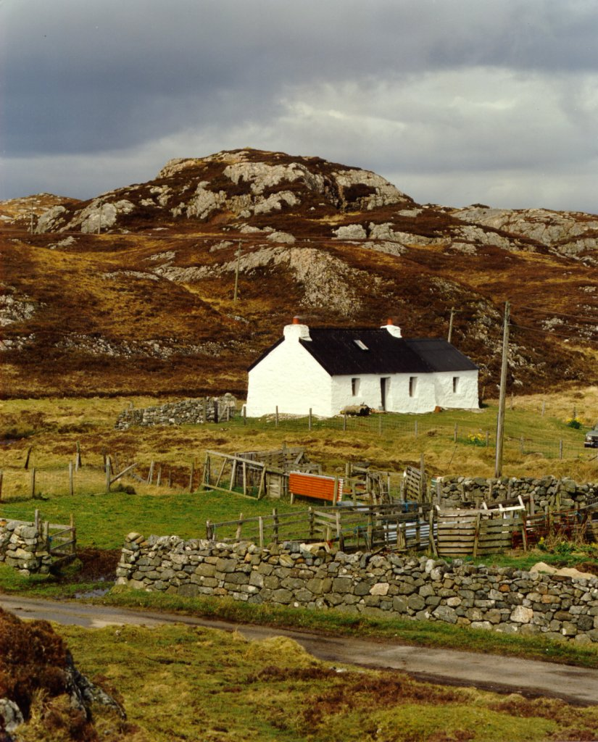
Which is human feature and which is physical feature?
The bay The farmhouse

Slide 9
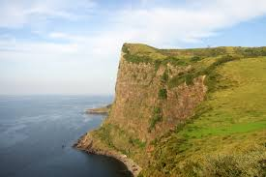
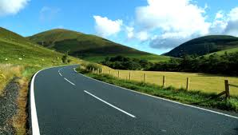
Which is human feature and which is physical feature?
Cliff Road

Slide 10
What about these?
Post office?
Hills
Loch?
Holiday house?

