Slide 2
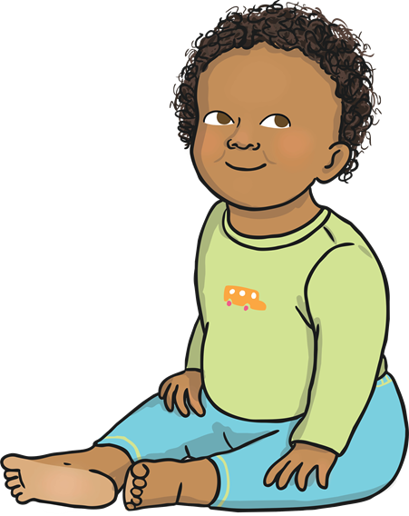
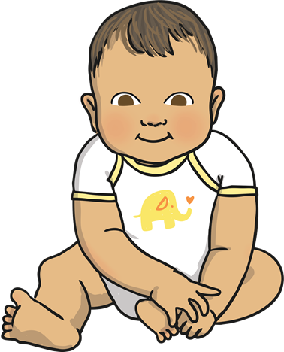
A New Baby
A baby being born is a very happy time. People celebrate it in lots of ways.
Has a baby been born in your family?
How did you celebrate it?
Talk About It

Slide 3

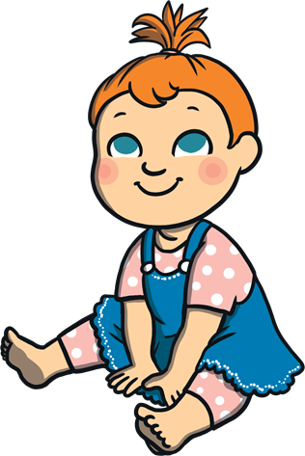
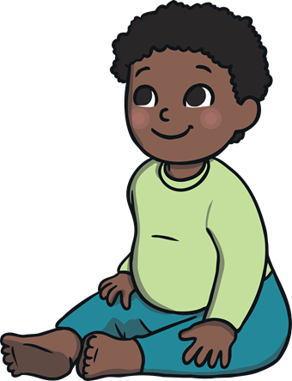
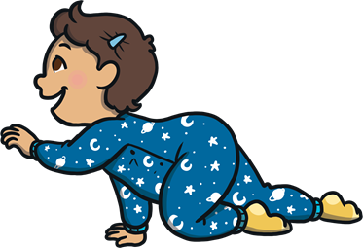
Religious Celebrations
Different religions have special ways of celebrating the birth of a baby. Some Hindu and Muslim babies have their heads shaved. Jewish babies have special events where their names are revealed to everyone.
Talk About It
Do you know anyone who belongs to a religion?

Slide 4
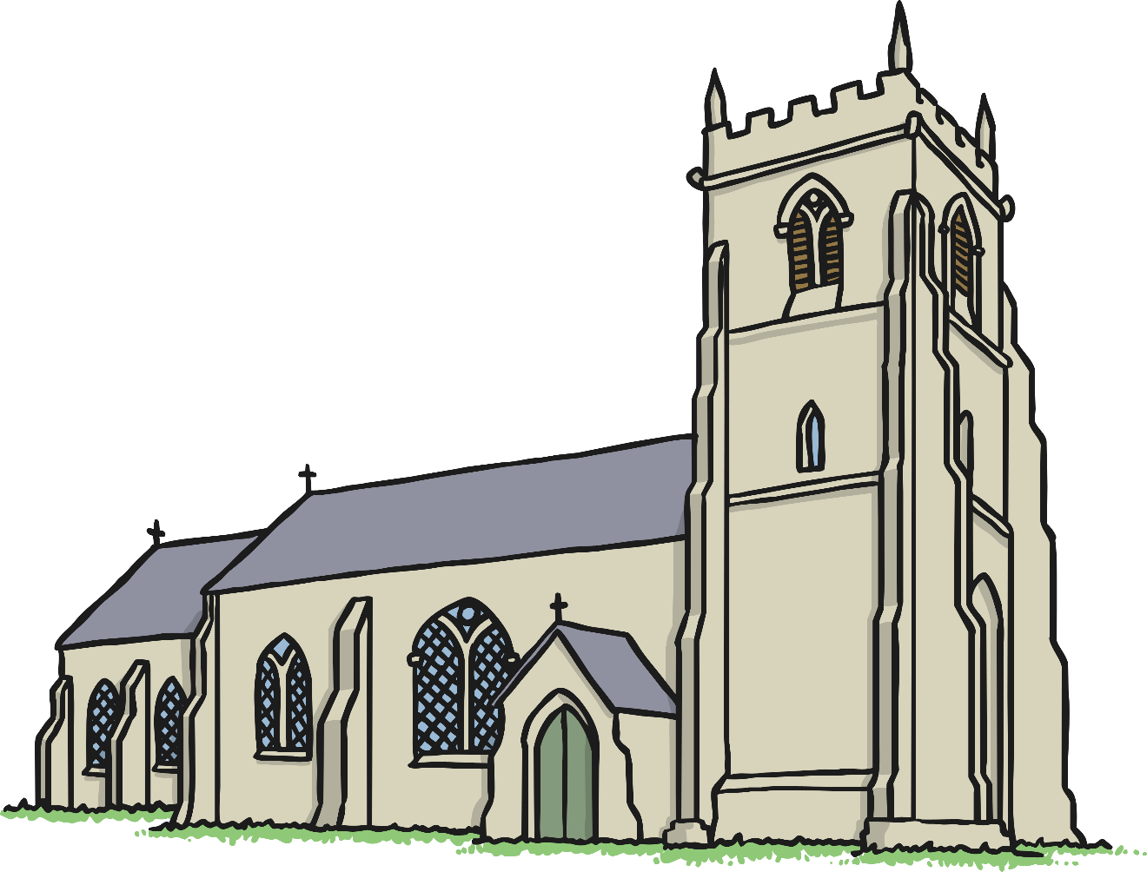
Christianity
Today we are going to learn about a special celebration from the Christian religion.
Christians are people who go to church. Their special
book is called the Bible and Jesus is an important
person to them.

Slide 5

Christening
A christening is when a baby is welcomed into the Christian faith. The baby’s parents and friends all go to a church service.
A person who leads a church is sometimes called a priest or a vicar.
At the start of the christening, the
vicar will welcome people to the
church and then read something from
the Bible.

Slide 6
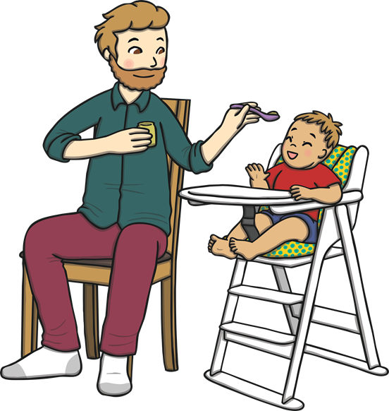
Godparents
Then, the parents and the baby will go and stand by the vicar along with some other people. They are called godparents.
Godparents are friends or family chosen by the baby’s parents. They make a promise to help the baby learn more about being a Christian.

Slide 7


The Sign of the Cross
Sometimes in a christening, the vicar will
dip their hand in some oil. They will then
move their hand in the shape of a cross
over the baby’s head.
The cross is special to Christians because they believe Jesus died on a cross.

Slide 8

The Font
Lots of churches have a font, which has water in it. The vicar will hold the baby’s
head over the font and then sprinkle the
baby with water.
The vicar will say the words: ‘I baptise
you in the name of the Father, and of
the Son and of the Holy Spirit.’
Talk About It
How do you think the baby feels when the water
is sprinkled?

Slide 9
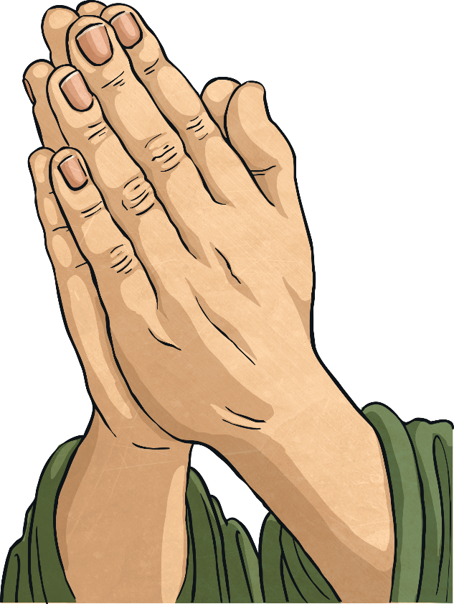
Prayers
Praying is talking to God. During the
christening, special prayers are said for
the baby.
Talk About It
If you were going to say a prayer for a baby, what
would you say?

Slide 10

A Candle
Sometimes at a christening, a special candle is lit. The vicar will say to the baby ‘Shine as a light in the world to the glory of God’.
A candle brings light to dark places. Can you think of ways that bad times could be made better, just like the light makes darkness go away?
Talk About It

Slide 11
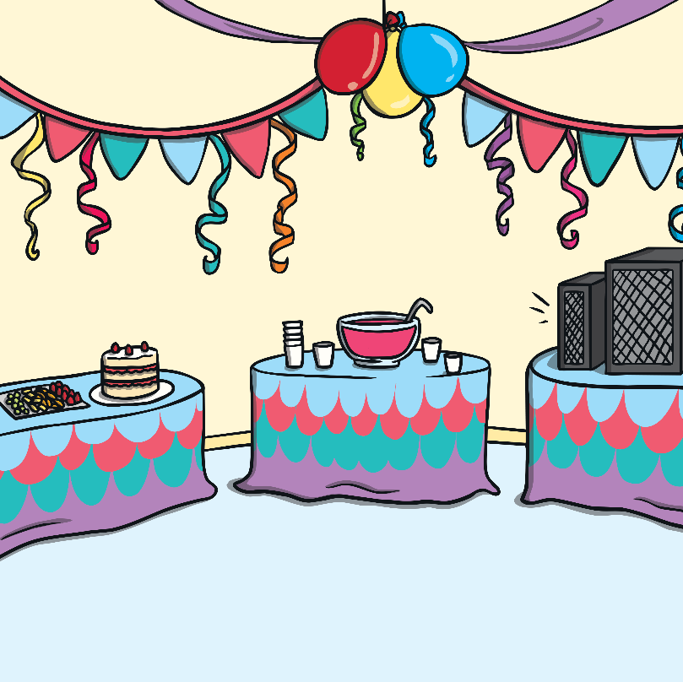

A Party
After the christening, family and friends might have a special meal or a party.
It is a very happy time.
Talk About It
What special food would you have at a party?

