Slide 2

Escape the Recycling Centre
You are on a school visit to the Recycling Centre.
The trucks arrive full of all kinds of items that need to be sorted on the huge conveyor belts. Some can be recycled, some cannot.
You and your best friend are excited to see what happens in the first stage of the recycling process. There is so much to see! You wait around for a bit too long and don’t notice that the rest of the class have moved onto the next stage. The enormous door slams shut! You’re trapped in the sorting room.
You notice a keypad beside the door. If you knew the code, you could open the door.
You must solve the clues to work out the code. Good luck!

Slide 3
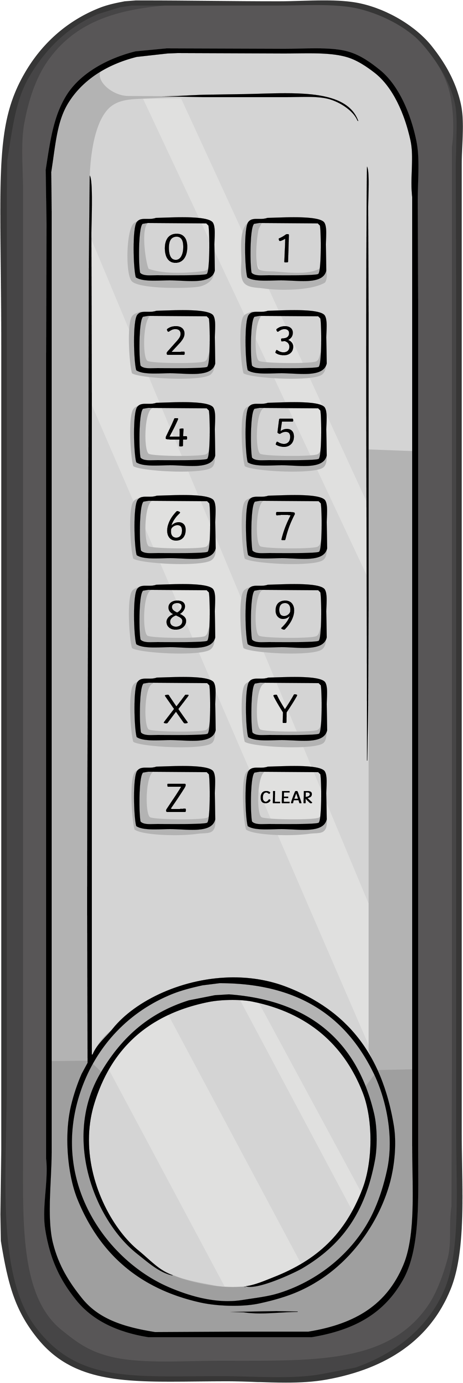
Escape the Recycling Centre
The Rules
You can work in small groups.
When you find a clue, work together to solve the puzzle.
Write your answer down on your answer sheet.
Once you have discovered the number for the keypad, check it with your teacher to discover if you can escape the Recycling Centre!

Slide 4
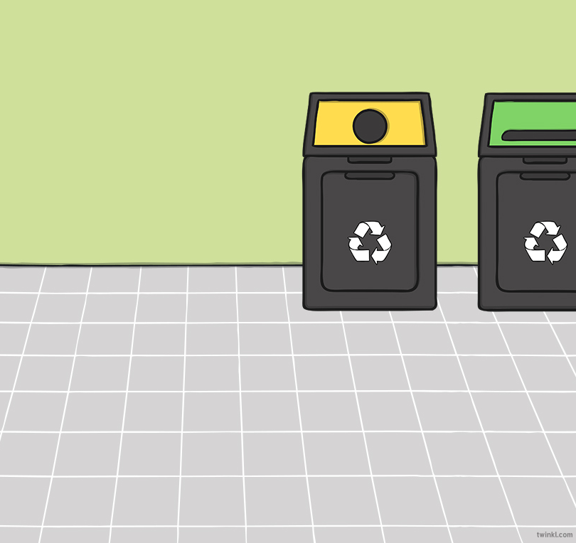
Escape the Recycling Centre
Answers to the Clues

Slide 5

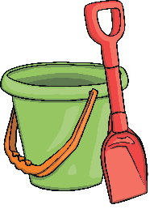

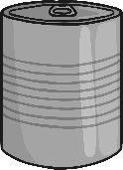
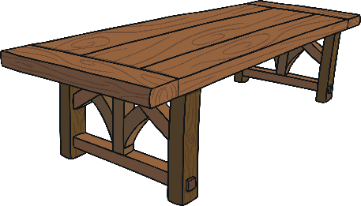



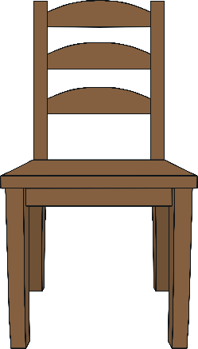

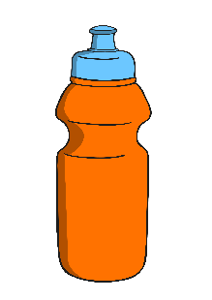


Escape the Recycling Centre – Clue 1
How many of these objects are made from glass?
There are three objects made from glass so the first digit on the keypad is three.
3

Slide 6
Escape the Recycling Centre – Clue 2
We can see through windows. This means windows are
We get this material from trees.
This word means light cannot pass through an object.
t | r | a | n | s | p | a | r | e | n | t
w | o | o | d
o | p | a | q | u | e
The letters in the shaded squares spell two.
The second digit on the keypad is two.
2

Slide 7


Escape the Recycling Centre – Clue 3
Statement | True | False
Plastic is always transparent.
Glass is waterproof.
Fabric is always rough.
Rock is a natural material.
Wood is hard.
Wool is soft.
There are four statements which are true.
The third digit on the keypad is four.
4

Slide 8
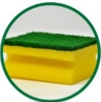










Escape the Recycling Centre – Clue 4
Waterproof
Absorbent
There are eight objects which are waterproof.
The fourth digit on the keypad is eight.
8

Slide 9

Escape the Recycling Centre – Clue 5
How many of Sam’s sentences about materials are correct?
1. The walls of a house could be made from tissue paper.
2. Fabric would be a good material to make a coat from.
3. A teapot could be made from wax.
4. A pillow made from metal would be soft.
Only one of Sam’s sentences about materials is correct.
The fifth digit on the keypad is one.
1

Slide 10


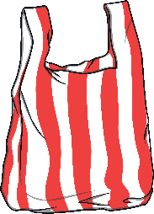


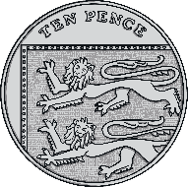




Escape the Recycling Centre – Clue 6
scissors
toothbrush
wooden ruler
pencil
plastic bag
ten pence coin
a door key
plastic straw
shampoo bottle
plastic cup or beaker
The group with the most objects is plastic. There are five objects made from plastic. The sixth digit on the keypad is five.
5

Slide 11

Escape the Recycling Centre
Now you’ve solved all the clues, it’s time to enter the code into the keypad and escape the recycling centre!
Digit
1
Digit
2
Digit
3
Digit
4
Digit
5
Digit
6
3
2
4
8
1
5

