Slide 1
oy

Slide 2

boy

Slide 3
toys

Slide 4

annoy

Slide 5

floy

Slide 6
enjoy

Slide 7
destroy

Slide 8
scroy

Slide 9

employ

Slide 10
disploy

Slide 11
Where in the word?
The oy phoneme comes at the end of words (unless there is a suffix at the end like –ed, -s, ing):
joy destroy

Slide 12
Let’s segment to spell

Slide 13
t
oy
s

Slide 14
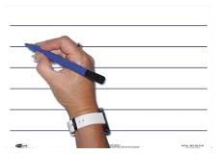
Whiteboards ready!
Look at the pictures and write the words

Slide 15
toys

Slide 16
annoy

Slide 17
destroy

Slide 18
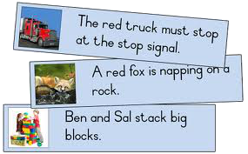
Let’s read
sentences

Slide 19

Can you annoy a boy?

Slide 20

Will a royal enjoy eating an oyster?

Slide 21
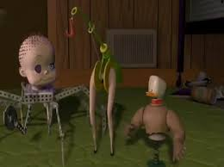
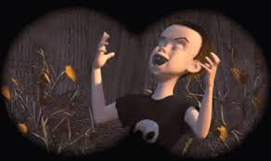
Will it be annoying if a boy destroys a toy?

