Slide 1
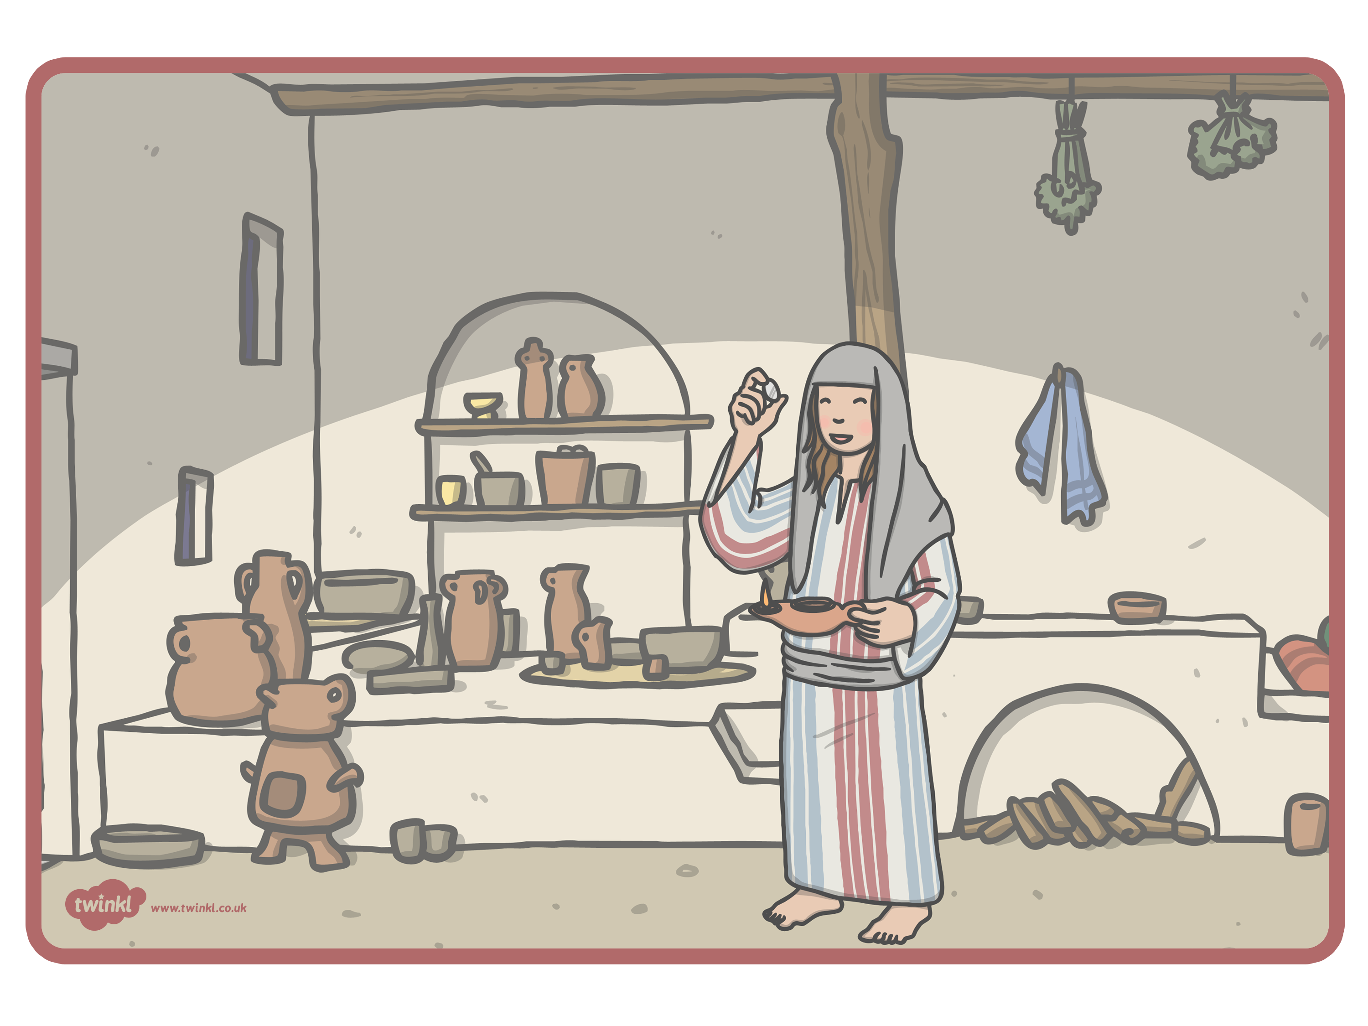
The Lost Coin Parable

Slide 2
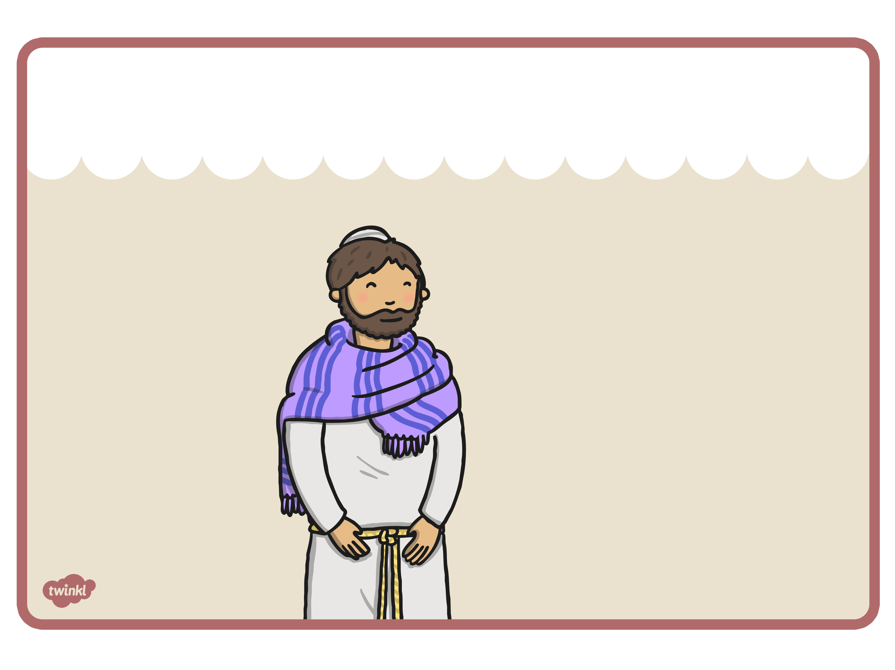
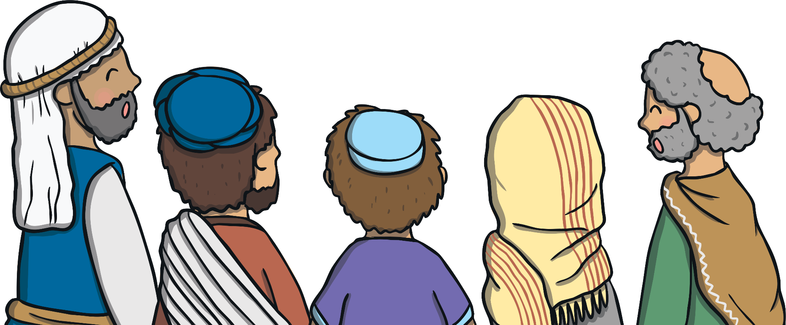
A crowd of people were all gathering around Jesus. The Pharisees and teachers of the law said, “This man welcomes sinners and eats with them.” Jesus heard them and told them this parable.

Slide 3
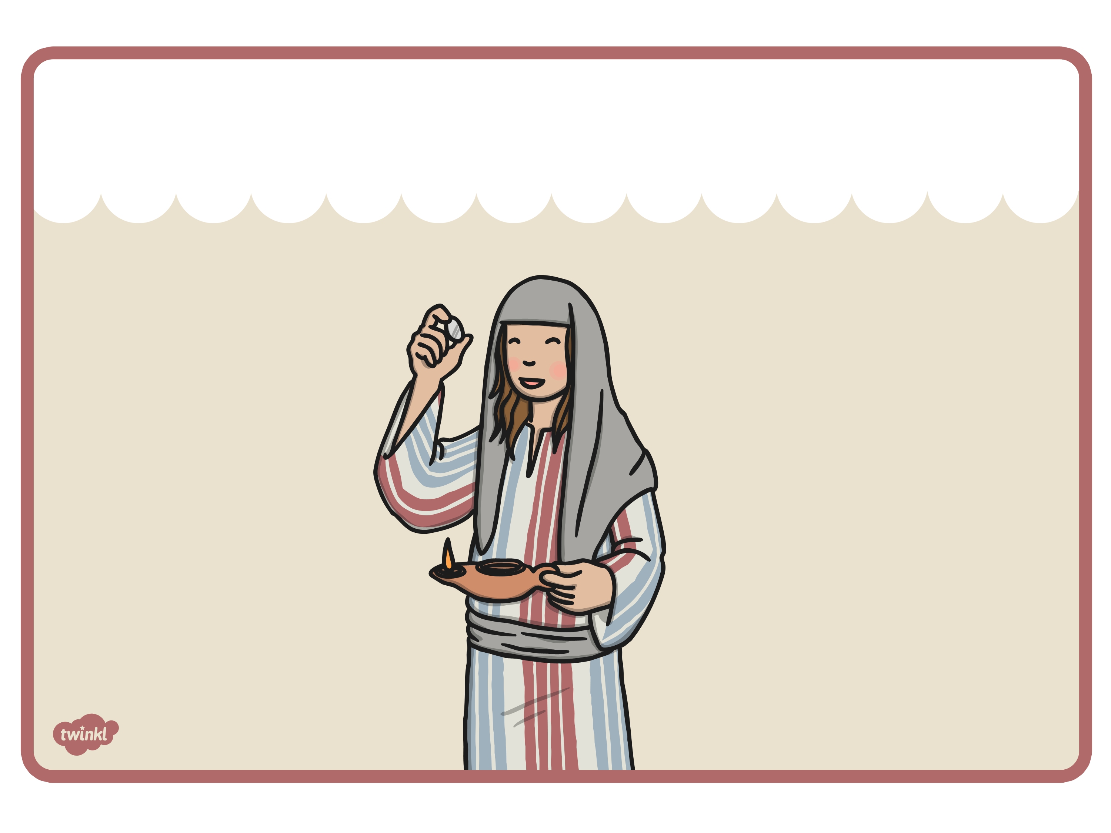
Once upon a time there was a woman who had ten silver coins. These coins were very important to her so she made sure to keep them safe.

Slide 4
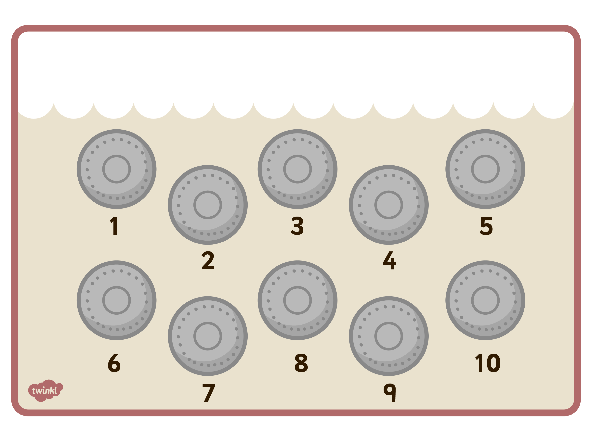
Sometimes, the woman would count all her coins just to make sure they were still all there.

Slide 5
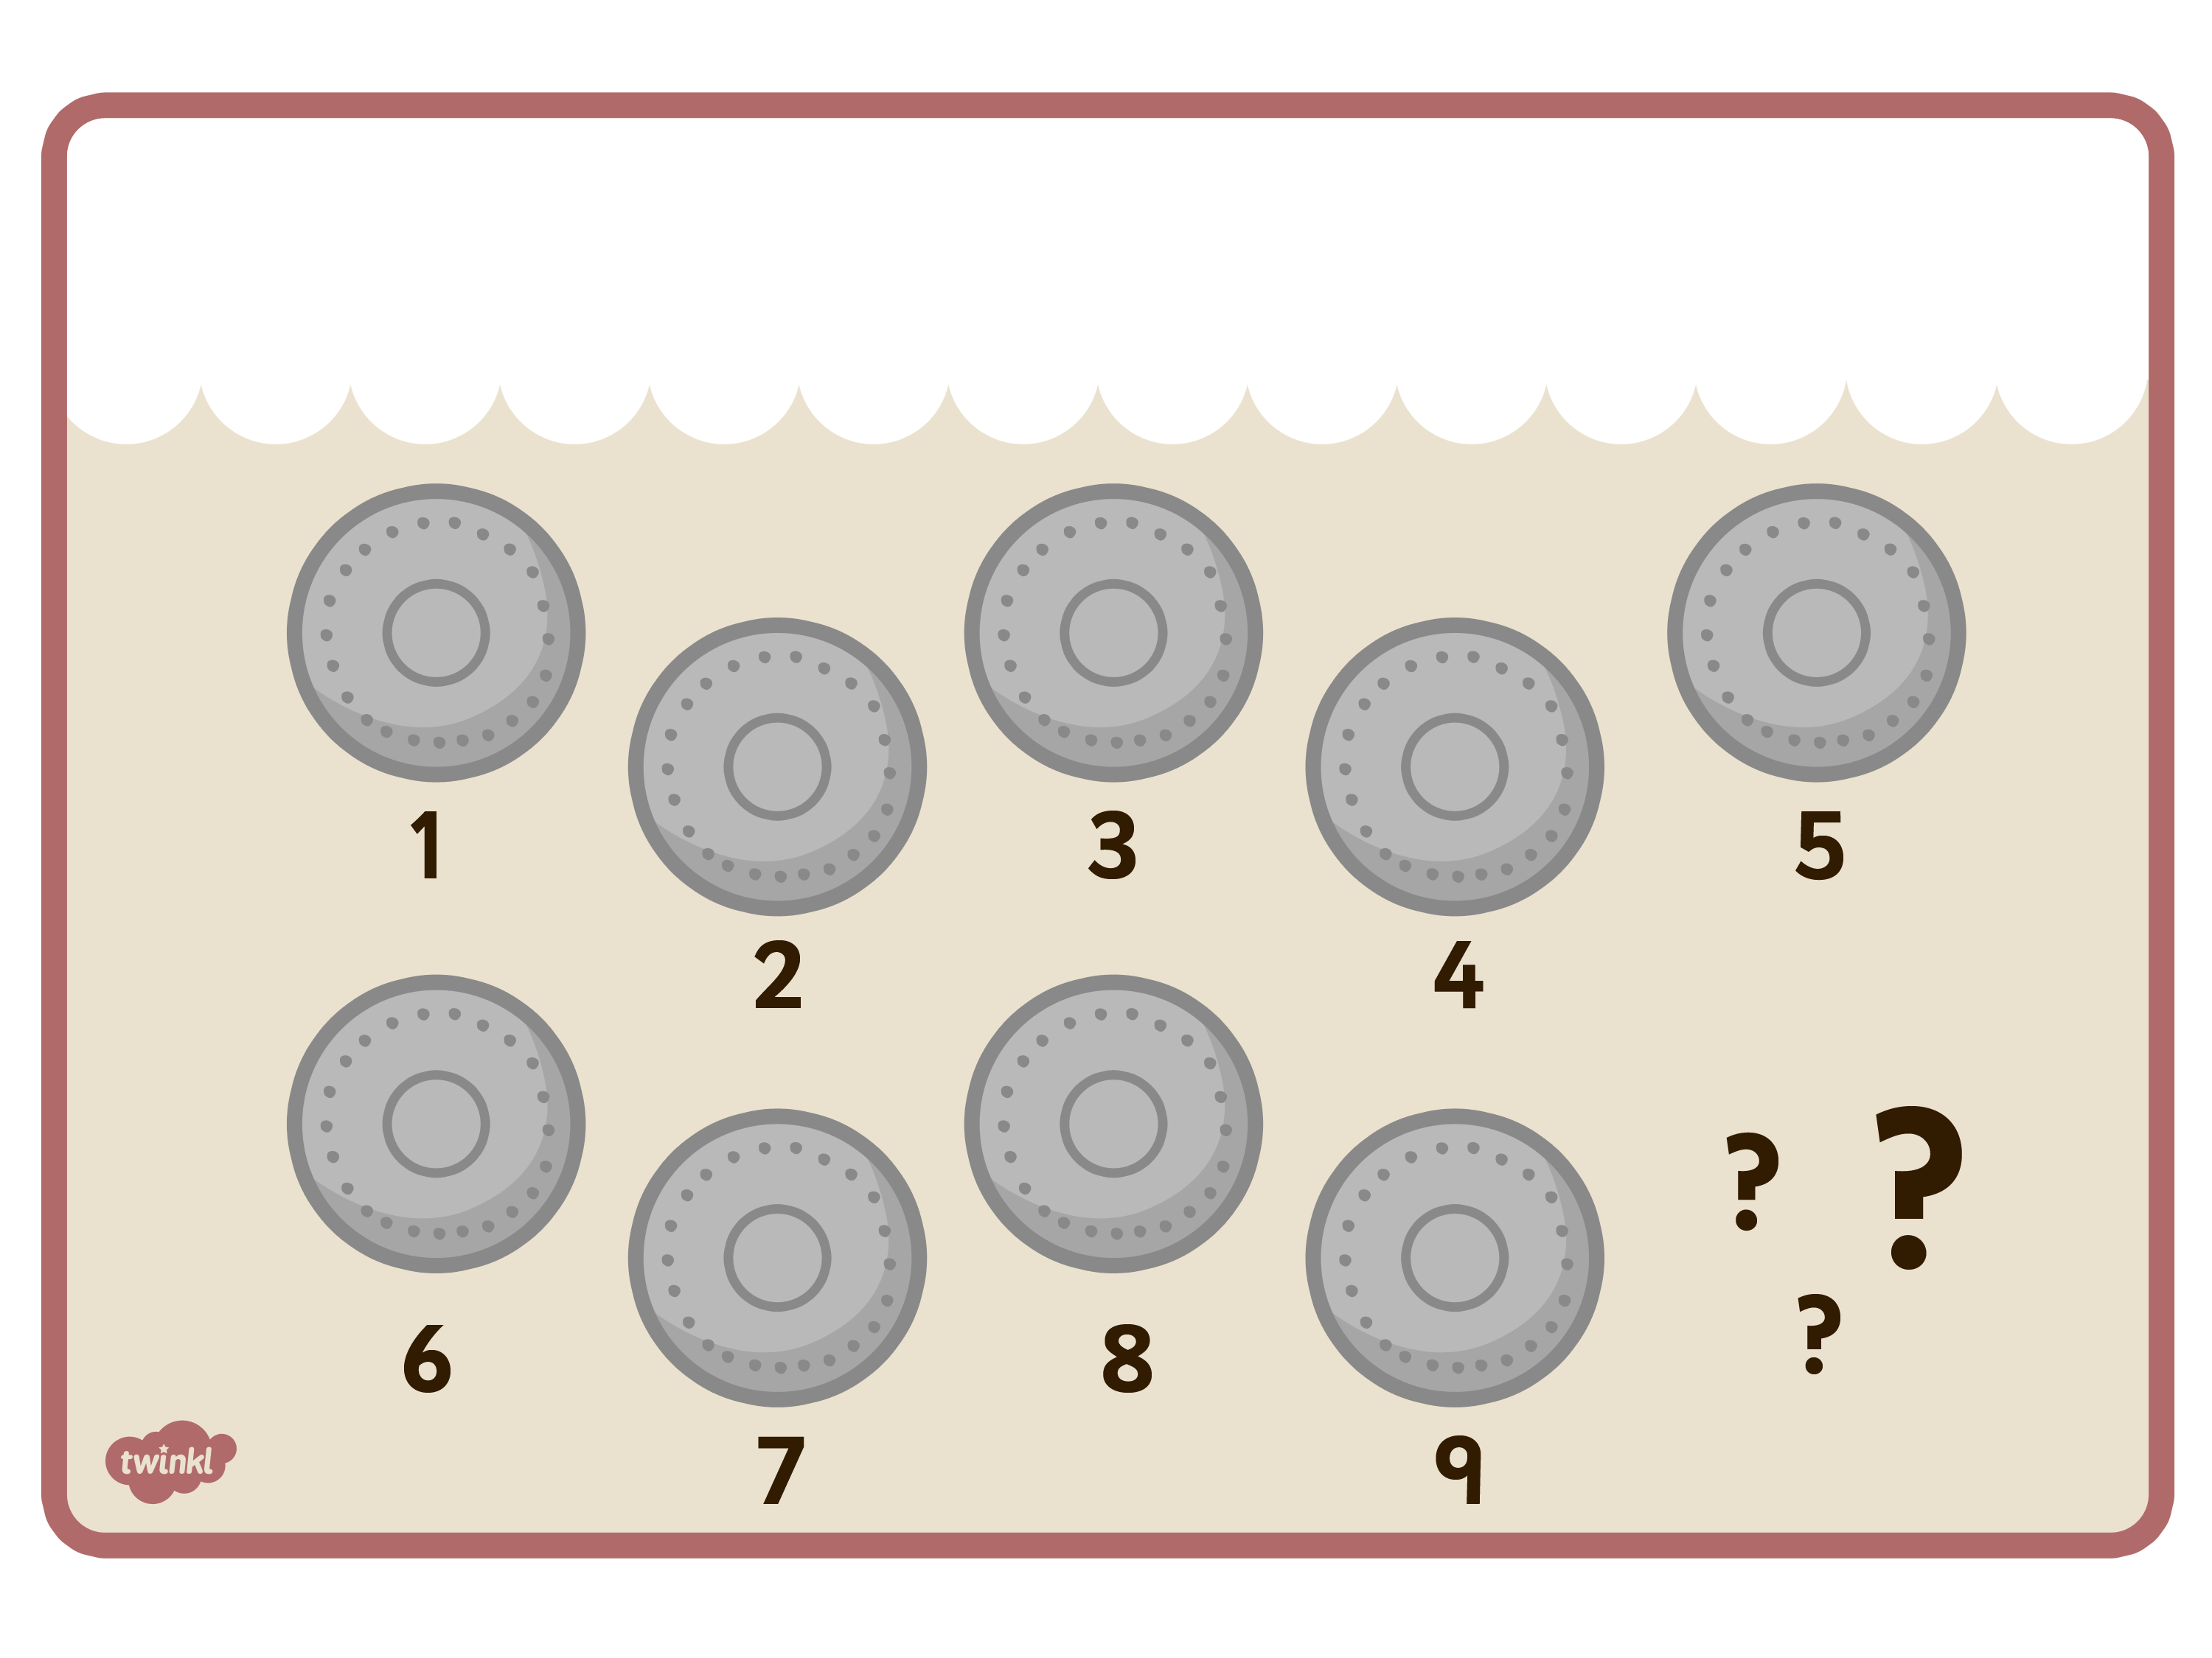
One day, she was counting her coins when she realised one was missing.

Slide 6
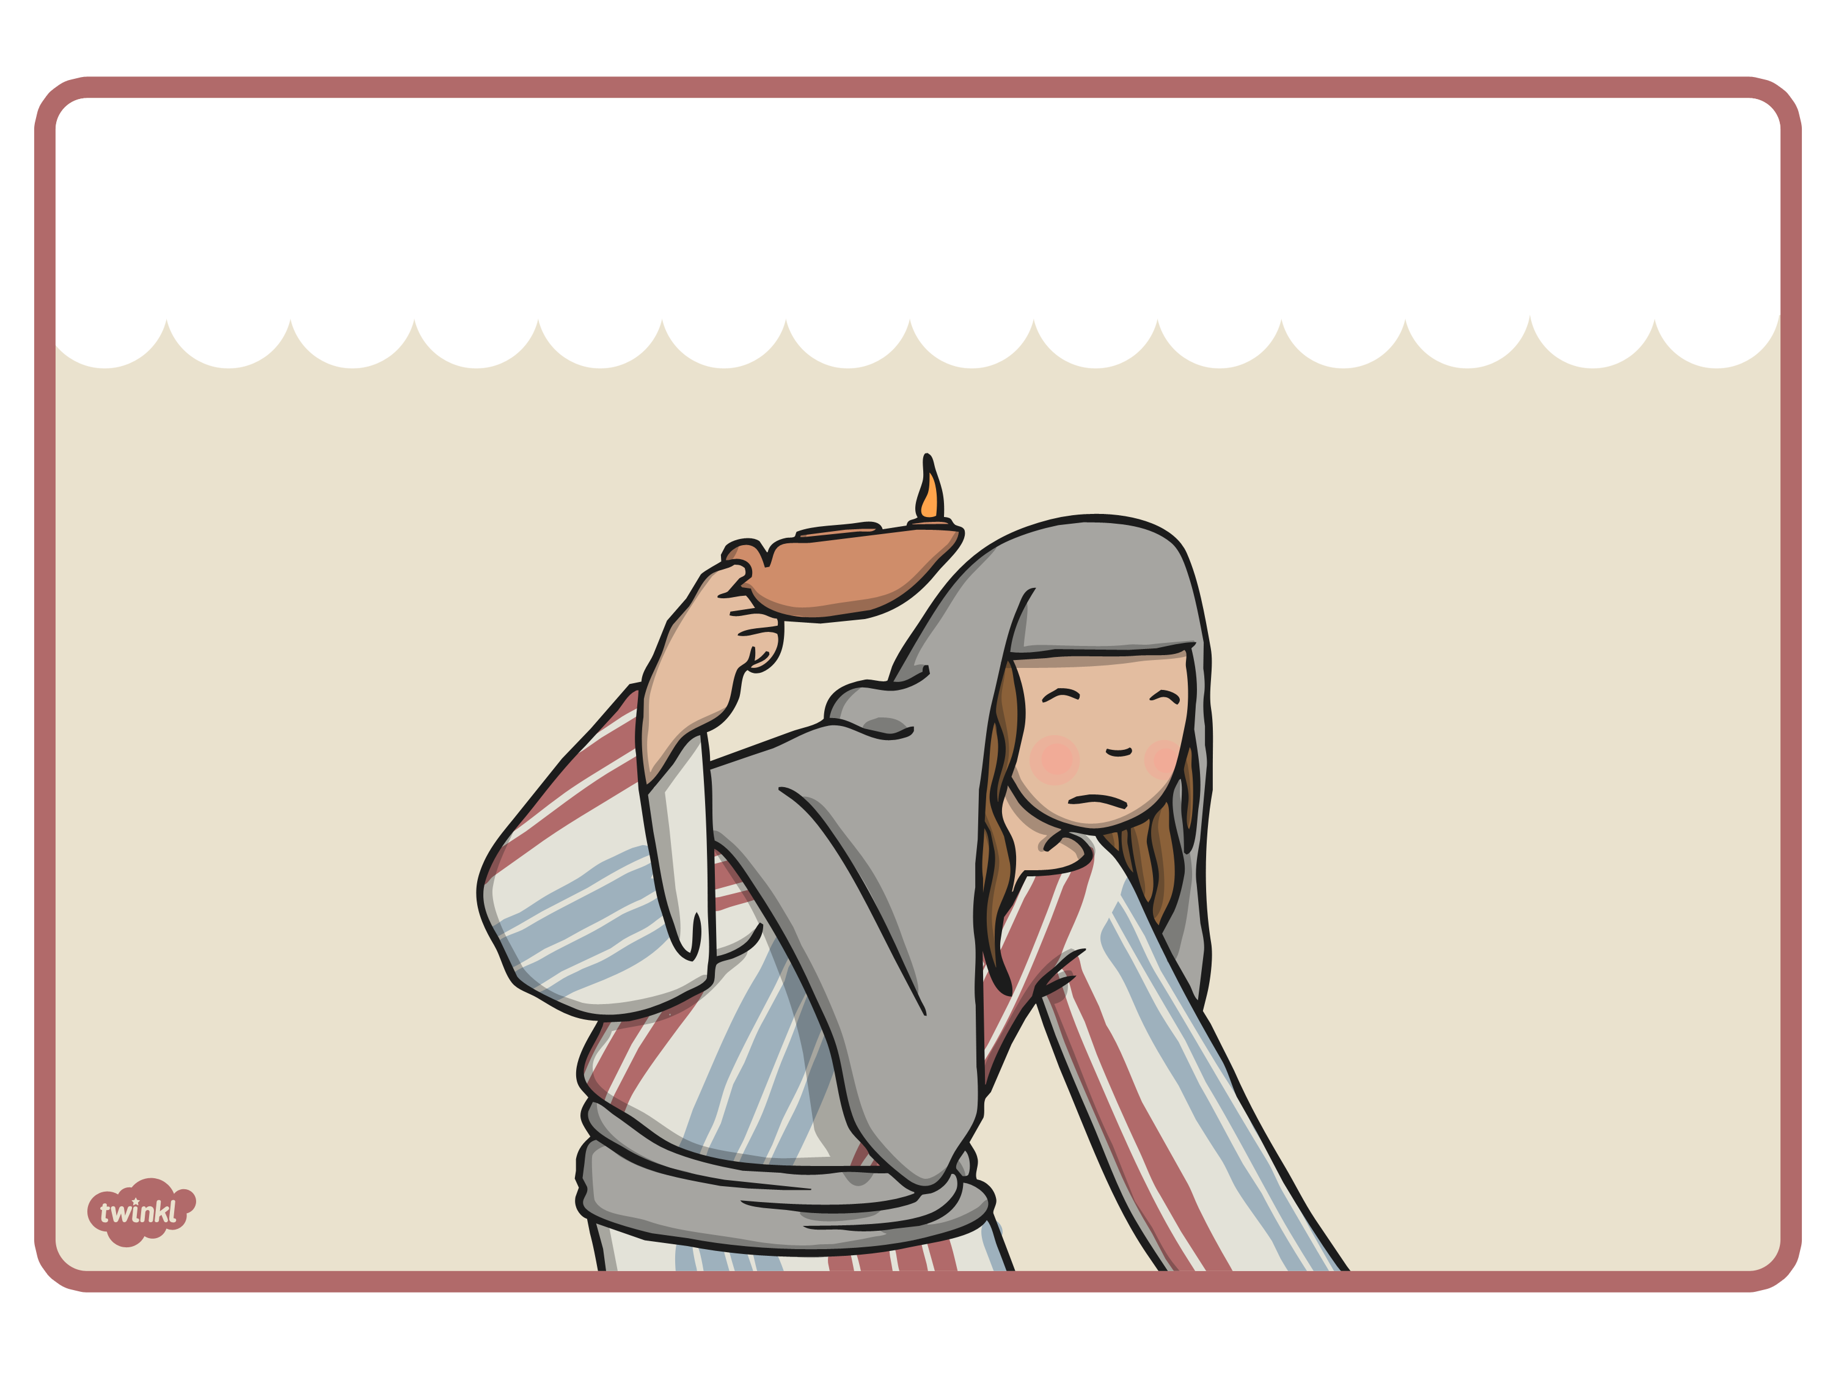
The woman lit her lamp and began to search her house for the missing coin. She knew it must be there somewhere.

Slide 7
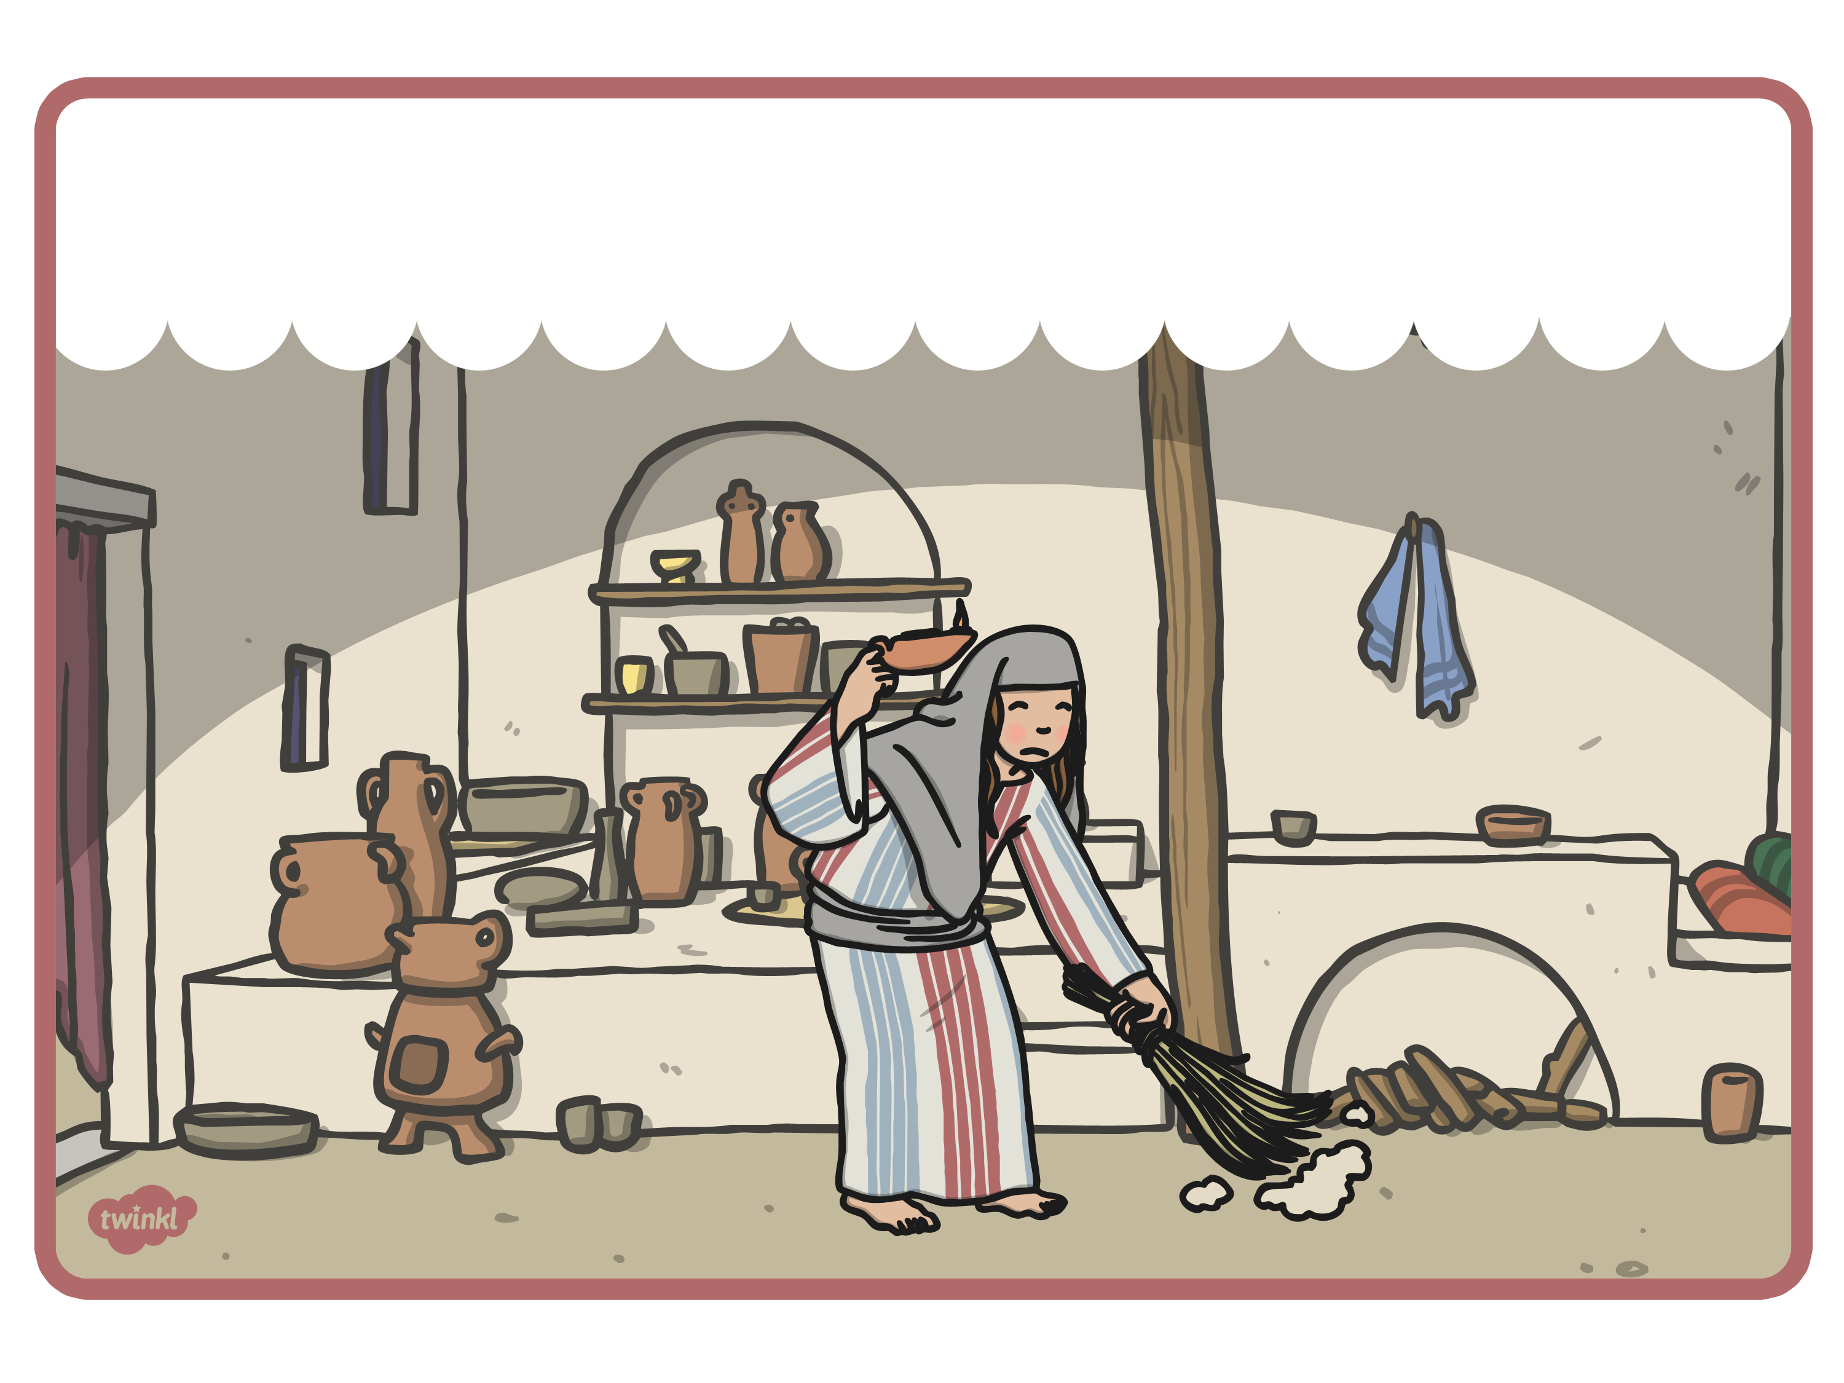
She swept the kitchen, front room and bathroom with her broom but still couldn’t find the coin.

Slide 8
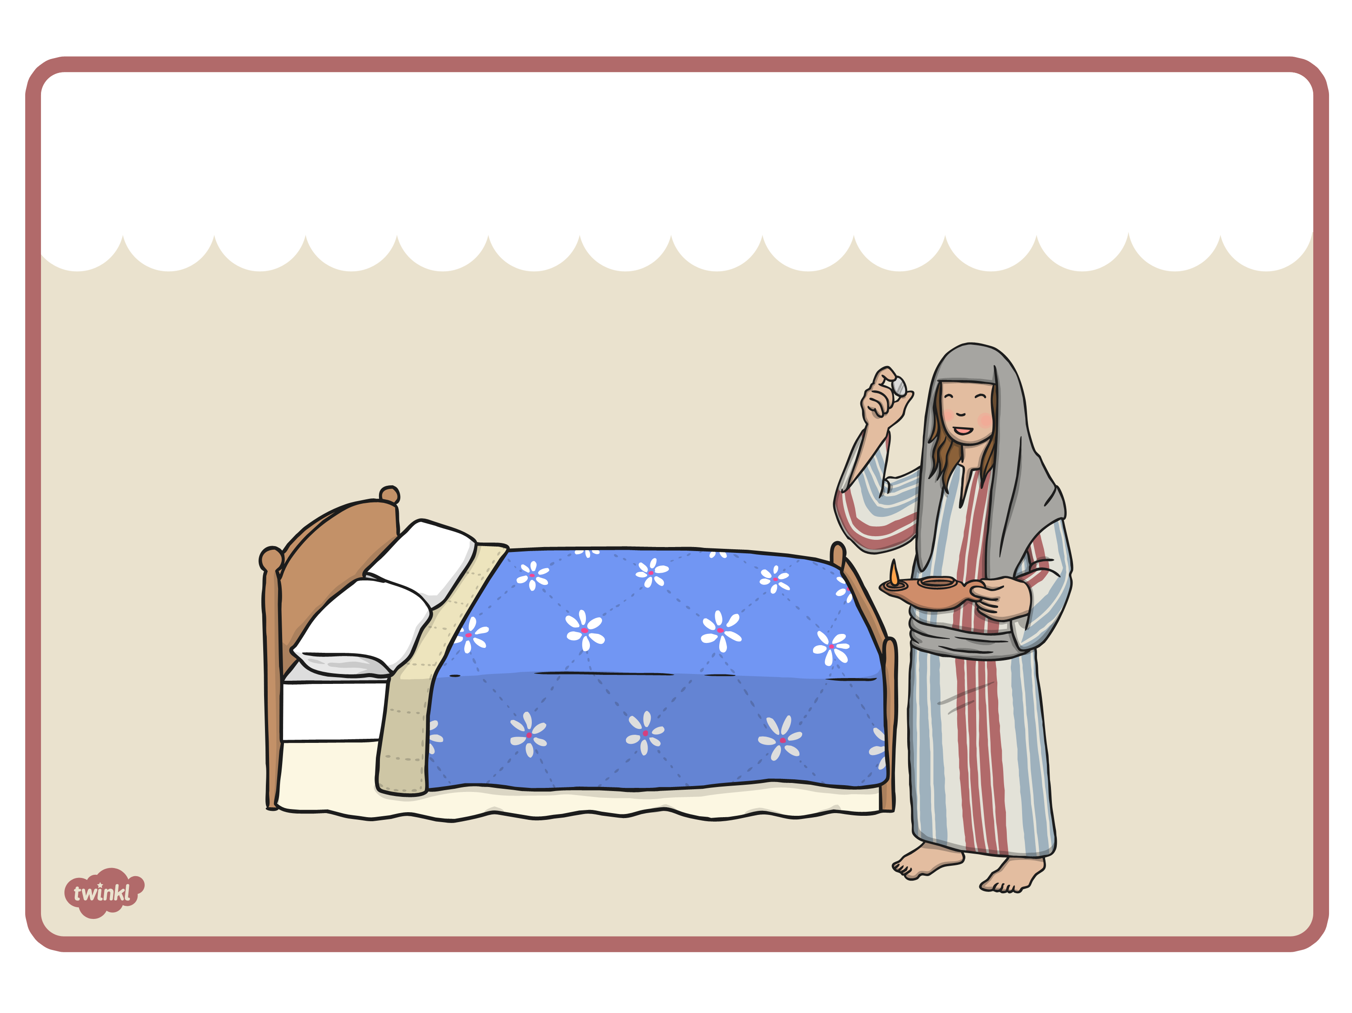
The woman went to her bedroom and began to sweep up as it was dusty. Under her bed was the missing coin!

Slide 9
She counted up all the coins again to make sure they were all there.

Slide 10
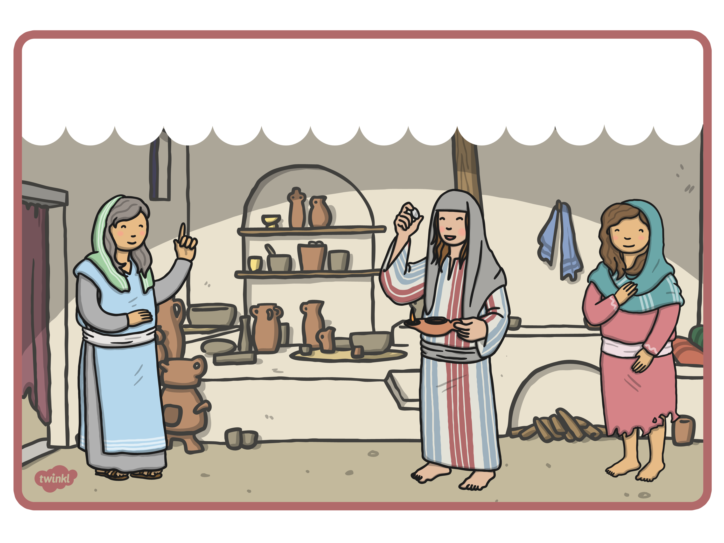
The woman was so happy that she invited her friends and neighbours round to celebrate finding the missing coin.

Slide 11
Jesus said that when a person decided to be close to God, there was a celebration in heaven.

