Slide 1
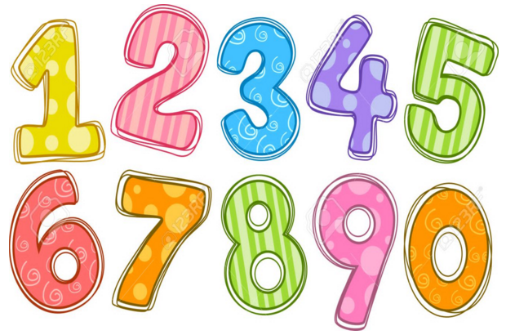
Maths Gym
Home Learning Week 1

Slide 2
19 + 3 = 22
30 – 10 = 20
Half of 12= 6
Double 3 = 6
2 x 10 = 20
10, 20
Example
4
5
9
4 + 5 = 9
5 + 4 = 9
9 - 5 = 4
9 - 4 = 5

Slide 3
19 + 3 =
30 – 10 =
Half of 12=
Double 3 =
2 x 10 =
Day 1
9
1
10
_____ + _____ =
_____ + _____ =
_____ - _____ =
_____ - _____ =

Slide 4
25 + 20 =
24 – 11 =
Half of 14=
Double 5 =
3 x 5 =
Day 2
5
3
8
_____ + _____ =
_____ + _____ =
_____ - _____ =
_____ - _____ =

Slide 5
31 + 20 =
28 – 15 =
Half of 16=
Double 6 =
5 x 10 =
Day 3
12
7
5
_____ + _____ =
_____ + _____ =
_____ - _____ =
_____ - _____ =

Slide 6
35 + 12 =
37 – 5 =
Half of 20=
Double 8 =
6 x 5 =
Day 4
6
3
9
_____ + _____ =
_____ + _____ =
_____ - _____ =
_____ - _____ =

Slide 7
31 + 20 =
28 – 15 =
Half of 18=
Double 9 =
7 x 5 =
Day 5
7
3
10
_____ + _____ =
_____ + _____ =
_____ - _____ =
_____ - _____ =

