Slide 1
To Recognise, Name and Describe 3-D Shapes
Mathematics
Miss Charlton

Slide 2
Lesson agenda
Learn the vocabulary of shape properties
Use the language to describe 3-D shapes
Independent Task
End of Lesson Quiz
Notes:
Let’s check what we’re going to do today…

Slide 3
You will need…
Today is an explorative task so you will just need your mathematical language and the shape pictures provided!

Slide 4

Star words
curved
flat
face
surface
vertices

Slide 5
Let’s sing the 3-D shape song…
With you parents’ permission, head over to your worksheet and watch the ‘Singing Walrus 3-D Shape Song’ video. See if you can sing along!

Slide 6
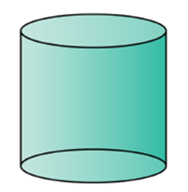
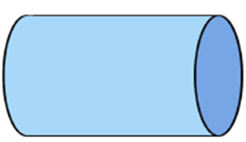
Let’s explore the properties
cylinder
surface
surface

Slide 7
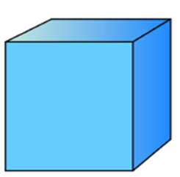
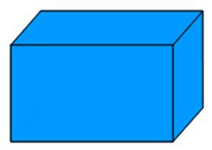
Let’s explore the properties
cube
cuboid
vertices
faces

Slide 8
What’s the same and what’s different?
cube
cuboid

Slide 9
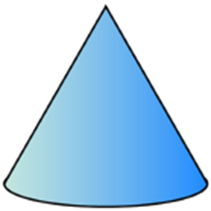
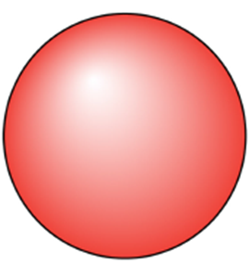
Let’s explore the properties
cone
sphere

Slide 10

Let’s explore the properties
pyramid

Slide 11
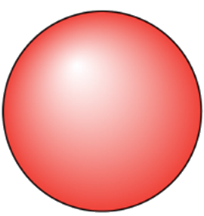
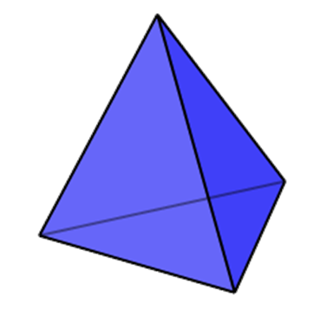
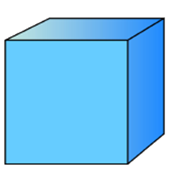
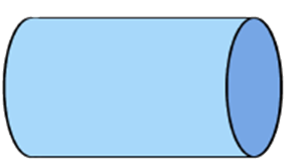
Independent task
Explore the shape. Which of these would be good for building a tower? Why?
Which wouldn’t work so well? Why?
Source: Mathematics Mastery

Slide 12


Pause to complete your task
Resume once you’re finished

Slide 13


Answers

