Slide 1
To describe and classify 3-D shapes
Mathematics
Miss Charlton
Notes:
We are starting a new unit today, all about shapes!

Slide 2
Lesson agenda
Describe 3-D shapes
Classify 3-D shapes into 2 groups
Independent Task
End of Lesson Quiz
Notes:
Let’s check what we’re going to do today…

Slide 3
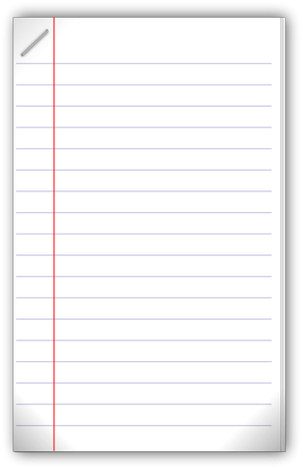

You will need…
Item 3
(if drawing your own shapes)
Item 1
Item 2
pencil
paper
Scissors & ruler

Slide 4
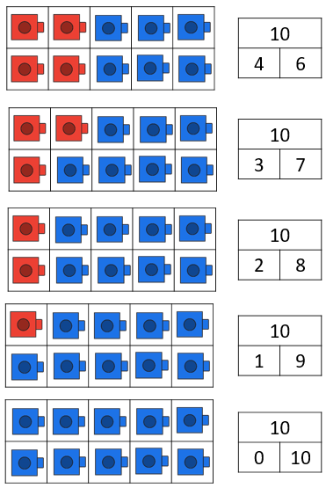
Brain Teaser
Source: Mathematics Mastery
Notes:
Let’s get ourselves warmed up with a brain teaser

Slide 5

Star words
face
vertices
edge
Notes:
These are the words you’ll need for the lesson today and future lessons

Slide 6
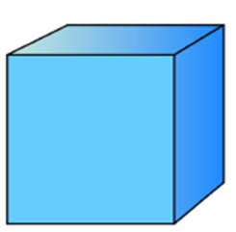
What do we know?
The cube is a type of cuboid.
It has six faces.
Its faces are square.
It has eight vertices.
What are we missing?
Let’s explore
cube
Source: Mathematics Mastery
Notes:
Last lesson we began learning about the properties of shape (or their features, ways to spot them)
We’re going to learn about these in more detail and then use our knowledge to compare it with other shapes

Slide 7
Let’s explore
cube
Ah! The edges!
Hmmmm, what is an edge?
Source: Mathematics Mastery
Notes:
An edge is where two faces meet
Let’s count them

Slide 8
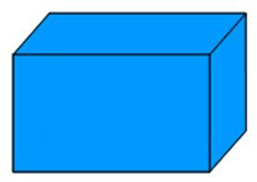
Your turn!
The cuboid has 6 faces.
Its faces are square and rectangle shapes.
It has 8 vertices.
It has 12 edges.
cuboid
Source: Mathematics Mastery
Notes:
Try these and then let’s check together. You could use something like a shoe box to help you count!

Slide 9
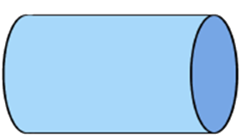
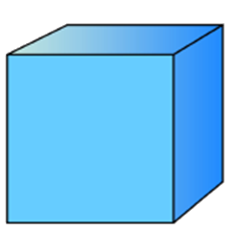
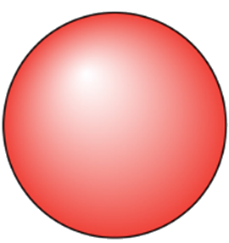
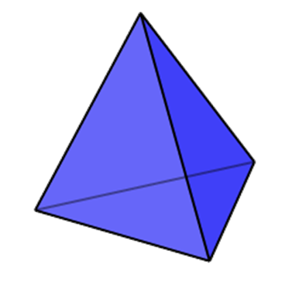
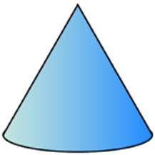
Let’s get classifying!
is a cuboid
is not a cuboid
Source: Mathematics Mastery
Notes:
Now we’re going to use our knowledge of the properties of shapes to sort them into groups, or classify them. We now know the properties of a cuboid really well so let’s sort the shapes… talk through different features while shapes move

Slide 10
Independent task
has a curved surface
has no curved surface
Notes:
Now it’s your turn to classify the shapes, just like we did, with your knowledge of their properties. You can use the pictures provided or you can draw your own groups and shapes.

Slide 11


Pause to complete your task
Carry on once you’re finished

Slide 12
Answers
has a curved surface
has no curved surface
Source: Mathematics Mastery
Notes:
How did you get on? Did you use your key vocabulary to say how you were classifying the shapes?

