Slide 1
To identify 2-D shapes
Mathematics
Miss Charlton
Notes:
We are starting a new unit today, all about shapes!

Slide 2
Lesson agenda
Identify and name 2-D shapes
Identify the key properties of 2-D shapes
Independent Task
Notes:
Let’s check what we’re going to do today…

Slide 3


You will need…
Item 1
Item 2
Item 3
(if drawing your own shapes)
pencil
paper
Scissors & ruler

Slide 4

Star words
side
vertices
curved
straight
Notes:
These are the words you’ll need for the lesson today and future lessons

Slide 5
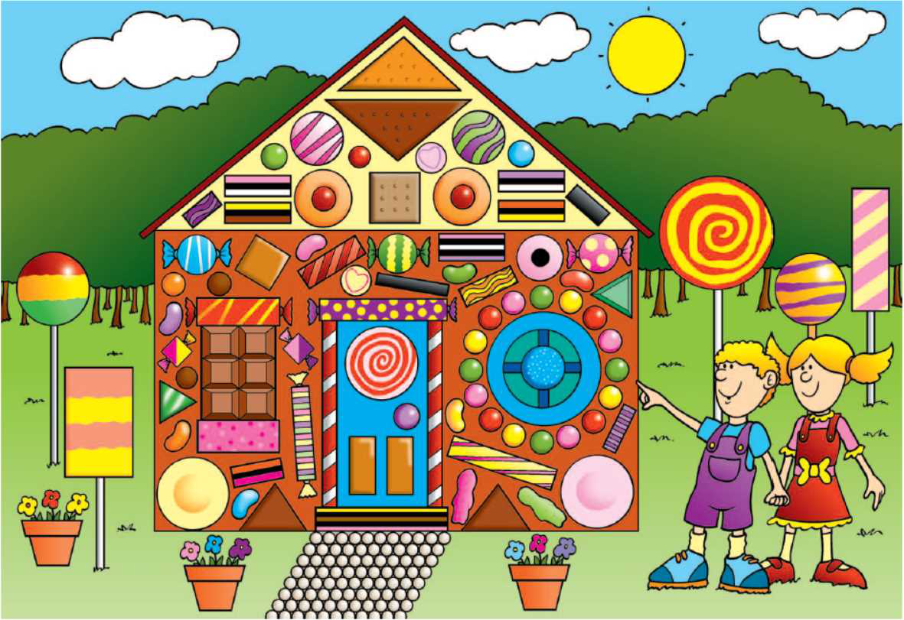
Can you spot any shapes?
How many circles one the roof?
Source: Mathematics Mastery
Notes:
Look at our big picture! Those treats are making me so hungry! Can you spot any shapes? TTYP what can you see? Point various shapes out and ask chn to point. How many circles can you see in the roof? Pause the video and tell you talk partner all of the different shapes that you can see.

Slide 6
Let’s explore
What does a shape need to have to be a rectangle?
Four vertices
4 straight sides
2 sides longer than the other 2
Can also be called an oblong.
Source: Mathematics Mastery
Notes:
What do you notice?
4 straight sides, 4 vertices or corners, 2 sides longer than the other 2.
Rectangle, or oblong

Slide 7
Let’s explore
What does a shape need to have to be a square?
Four straight sides
Four vertices
Sides of equal length
Source: Mathematics Mastery
Notes:
What do you notice?
4 straight sides, 4 vertices or corners. A square is a special type of rectangle which has all sides of equal length. Can you see that they are all the same shape, all a square but different sizes and in different positions.

Slide 8
Let’s explore
What does a shape need to have to be a triangle?
Three straight sides
Three vertices
Source: Mathematics Mastery
Notes:
What do you notice? 3 straight sides and 3 vertices
Can you see that they are all the same shape, all a triangle but different sizes and in different positions.

Slide 9
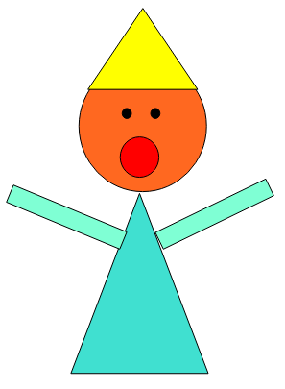
Independent task
Can you make a picture using different 2-D shapes?
Source: Mathematics Mastery
Notes:
Have fun cutting out the shapes and creating different picture with them. You could create people, houses, maybe even animals! Use the shapes provided or draw your own. Make sure you name the shapes that you are drawing and cutting out.

Slide 11


Pause to complete your task
Carry on once you’re finished

