Slide 1
To describe and classify 2-D shapes
Mathematics
Miss Charlton

Slide 2
Lesson agenda
Describe 2-D shapes
Classify 2-D shapes into 2 groups
Independent Task
End of Lesson Quiz
Notes:
Let’s check what we’re going to do today…

Slide 3


You will need…
Item 1
Item 2
Item 3
(if drawing your own shapes)
pencil
paper
Scissors & ruler

Slide 4
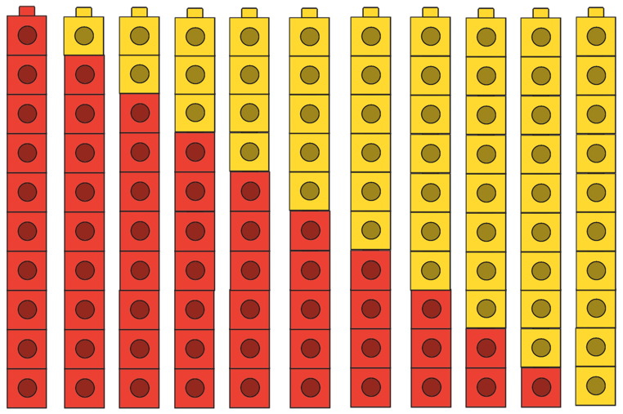
Brain Teaser
Can you write the number bonds to 10?
Source: Mathematics Mastery
Notes:
Let’s get ourselves warmed up with a brain teaser
Can you figure out the number bonds to ten?

Slide 5
10 + 0
9 + 1
8 + 2
7 + 3
6 + 4
5 + 5
4 + 6
3 + 7
2 + 8
1 + 9
0 + 10
Source: Mathematics Mastery
Notes:
How did you get on?

Slide 6

Star words
vertex
vertices
straight
oblong
Notes:
These are the words you’ll need for the lesson today and future lessons
Refer to oblong being another name for a rectangle

Slide 7
Let’s recap
What’s the same?
What’s different?
What does a shape need to have to be a rectangle?
Four straight sides
Four vertices
Two sides longer than the other two
Source: Mathematics Mastery
Notes:
What do you notice?
4 straight sides, 4 vertices or corners, 2 sides longer than the other 2.
Rectangle, or oblong. What’s the same/ different? Draw attention to being different colours and sizes and positioning but all same shape

Slide 8
Let’s explore
What’s the same?
What’s different?
What does a shape need to have to be a square?
Four straight sides
Four vertices
Sides of equal length
Source: Mathematics Mastery
Notes:
What do you notice?
4 straight sides, 4 vertices or corners. A square is a special type of rectangle which has all sides of equal length. Can you see that they are all the same shape, all a square but different sizes and in different positions.

Slide 9
Let’s explore
What’s the same?
What’s different?
What does a shape need to have to be a triangle?
Three straight sides
Three vertices
Source: Mathematics Mastery
Notes:
What do you notice? 3 straight sides and 3 vertices
Can you see that they are all the same shape, all a triangle but different sizes and in different positions.

Slide 10
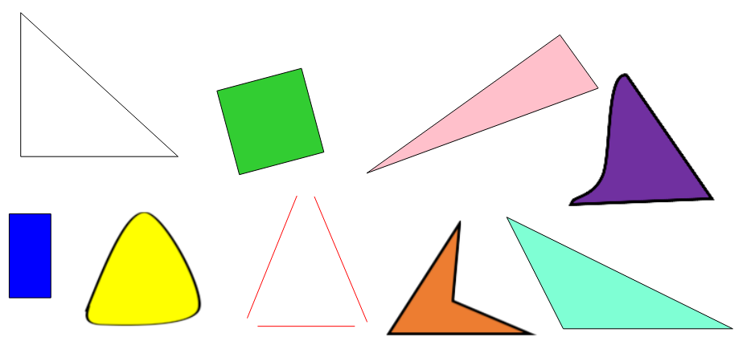
Which of these are triangles?
Source: Mathematics Mastery
Notes:
And how do you know? Three straight sides and 3 vertices.

Slide 11
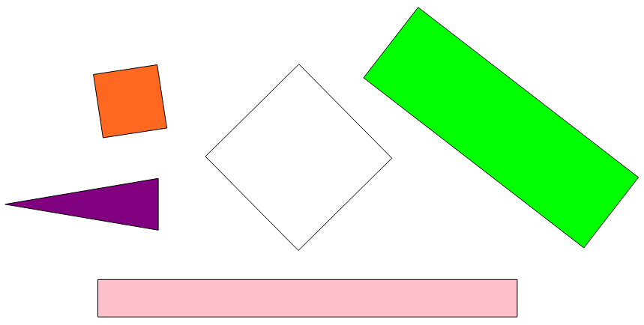
Which of these are oblongs?
Source: Mathematics Mastery
Notes:
And how do you know? four straight sides and 4 vertices. And 2 sides longer than the other two

Slide 12
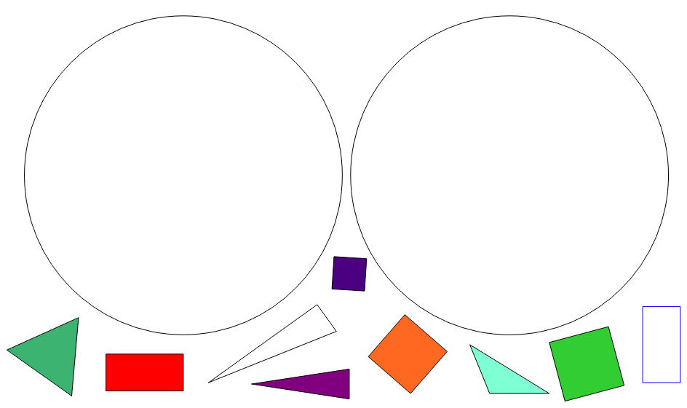
Independent task
is a triangle
is not a triangle
Source: Mathematics Mastery
Notes:
sort/classify the shapes depending on their properties. Use the shapes provided or draw your own! Like this…
Make sure you explain how you know e.g this green shape has got three straight sides and 3 vertices which are the properties of a triangle

Slide 13


Pause to complete your task
Carry on once you’re finished

Slide 14



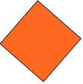




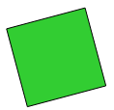
Answers
is a triangle
is not a triangle
Source: Mathematics Mastery
Notes:
sort/classify the shapes depending on their properties. Use the shapes provided or draw your own! Like this…
Make sure you explain how you know e.g this green shape has got three straight sides and 3 vertices which are the properties of a triangle

