Slide 1
To use the language of position
Mathematics
Miss Charlton

Slide 2
Lesson agenda
Learn the language of position
Follow instructions using the language of position
Independent Task

Slide 3


You will need…
Item 3
(if drawing your own shapes)
Item 1
Item 2
Pencil
Paper
Colouring crayons

Slide 4
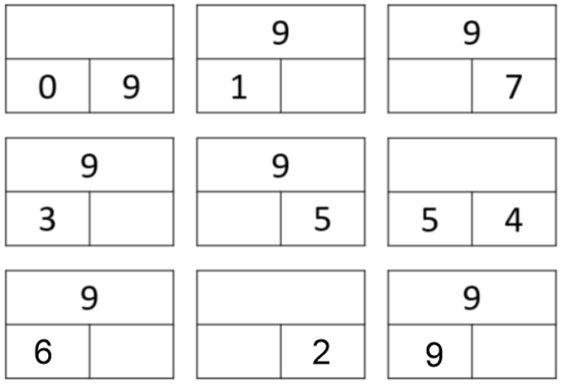


Brain Teaser
What are the missing numbers?

Slide 5
Brain Teaser
9
8
2
9
6
4
9
3
7
0

Slide 6

Star words
left
right
between
above

Slide 7
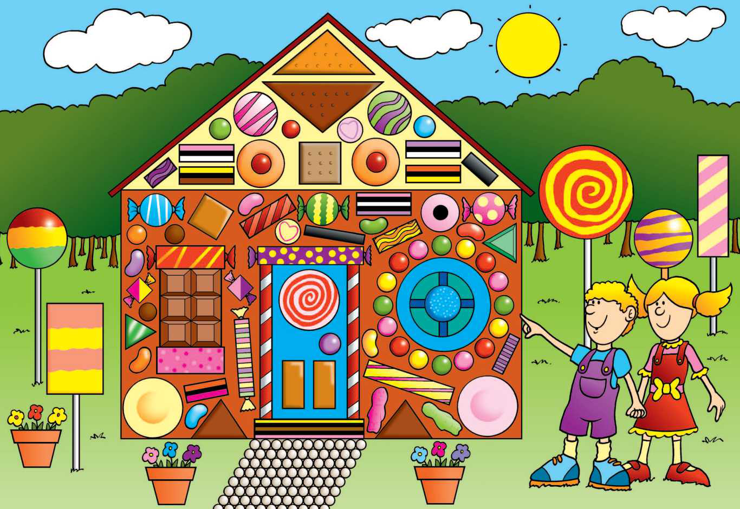
next to
in front
on top of
Under
Between
above

Slide 8
next to
in front of
on top of
under
between
above
Let’s explore
The triangle roof is...
The rectangle house is...

Slide 9
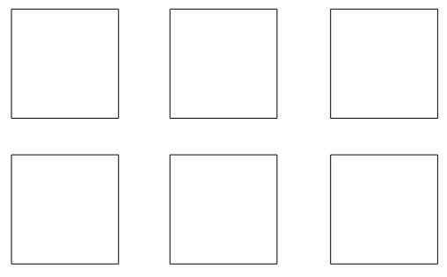
Blue is above yellow and left of green.
Orange is above red.
Purple is below green.
9

Slide 10
Independent task
Blue is between yellow and green.
Orange is below yellow.
Purple is to the right of both red and orange.
10

Slide 11

Pause to complete your task
Carry on once you’re finished

Slide 12
Answers
Blue is between yellow and green.
Orange is below yellow.
Purple is to the right of both red and orange.
12

