Slide 1
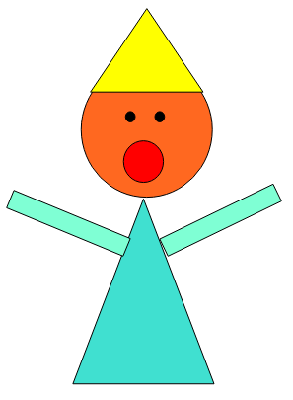
Independent task
Can you make a picture using different 2-D shapes?

