Slide 1
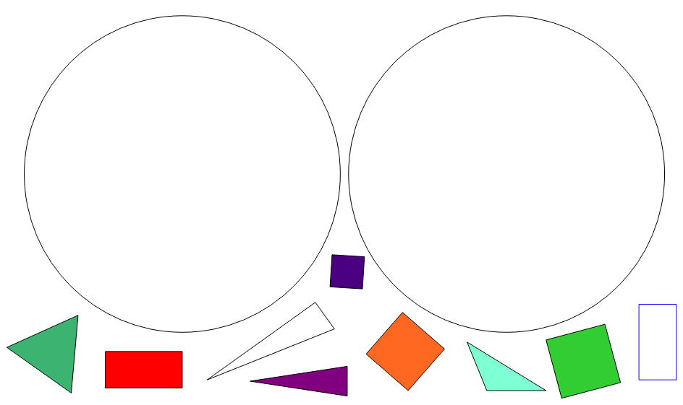
Independent task
Can you add any more 2D shapes that you know?
Is a triangle
Is not a triangle

Slide 2








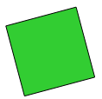
Answers
is a triangle
is not a triangle

