Slide 1
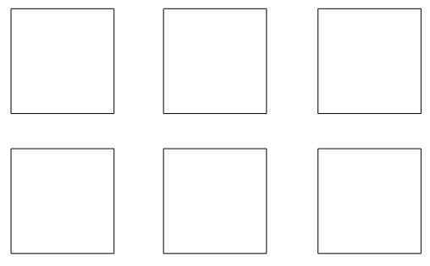
Independent task
Blue is between yellow and green.
Orange is below yellow.
Purple is to the right of both red and orange.
1

Slide 2
Answers
Blue is between yellow and green.
Orange is below yellow.
Purple is to the right of both red and orange.
2

