Slide 1
Phonics

Slide 2

Phase 2
Letters and Sounds

Slide 3
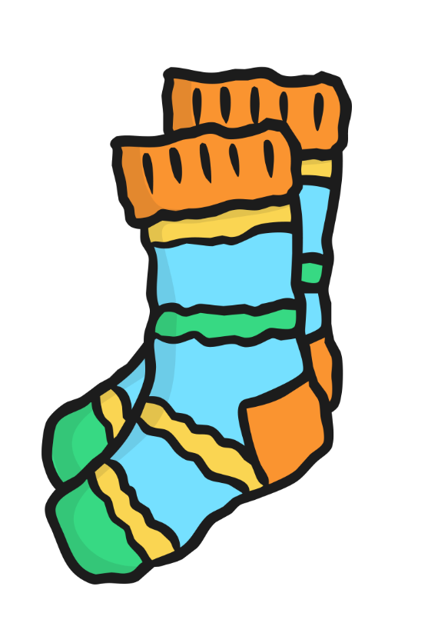
s

Slide 4

a

Slide 5
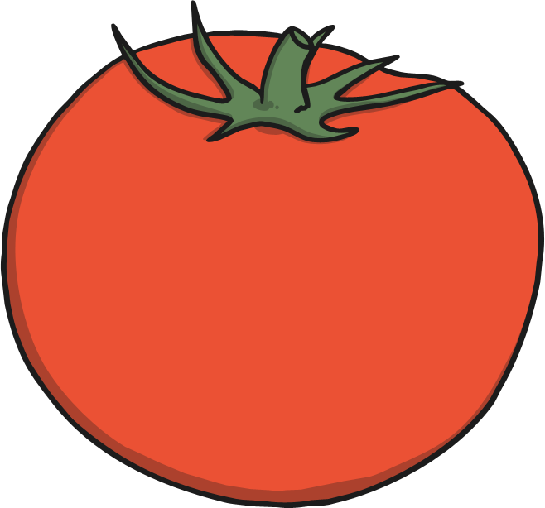
t

Slide 6

p

Slide 7

i

Slide 8
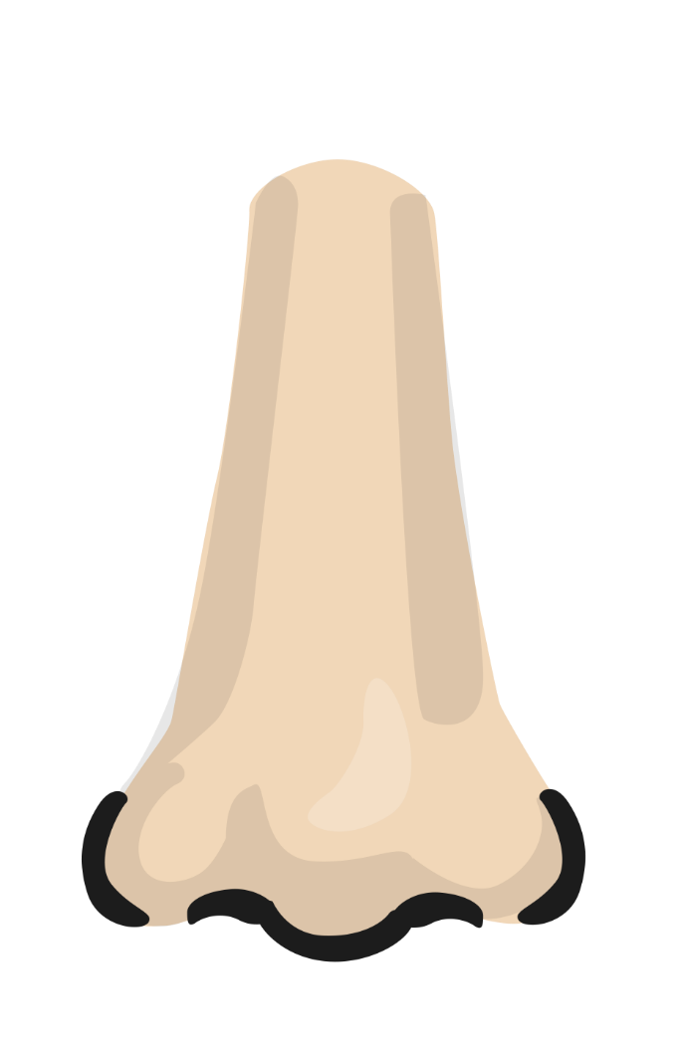
n

Slide 9
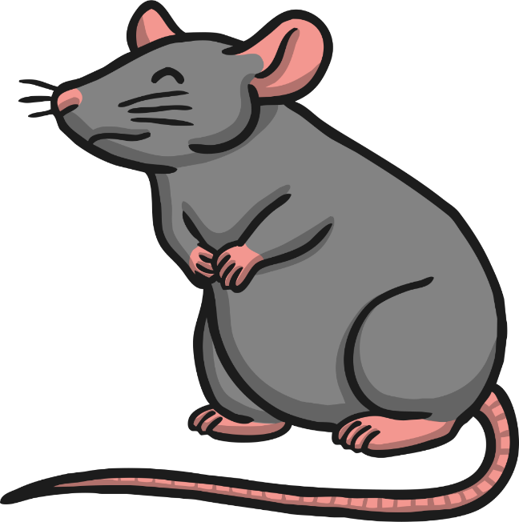
m

Slide 10
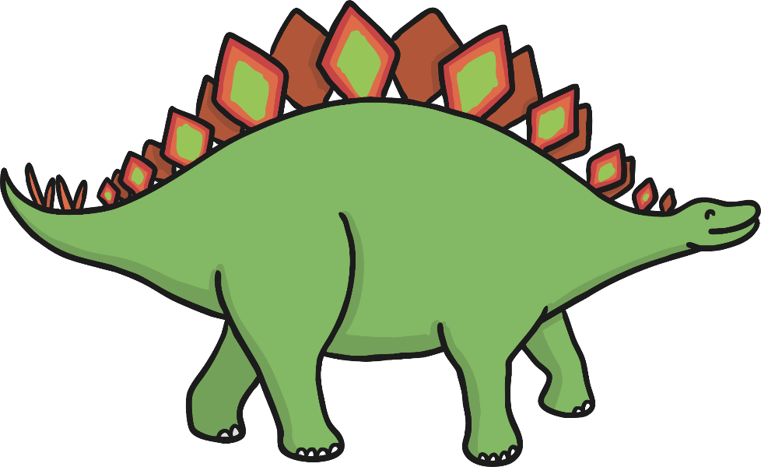
d

Slide 11
g

Slide 12
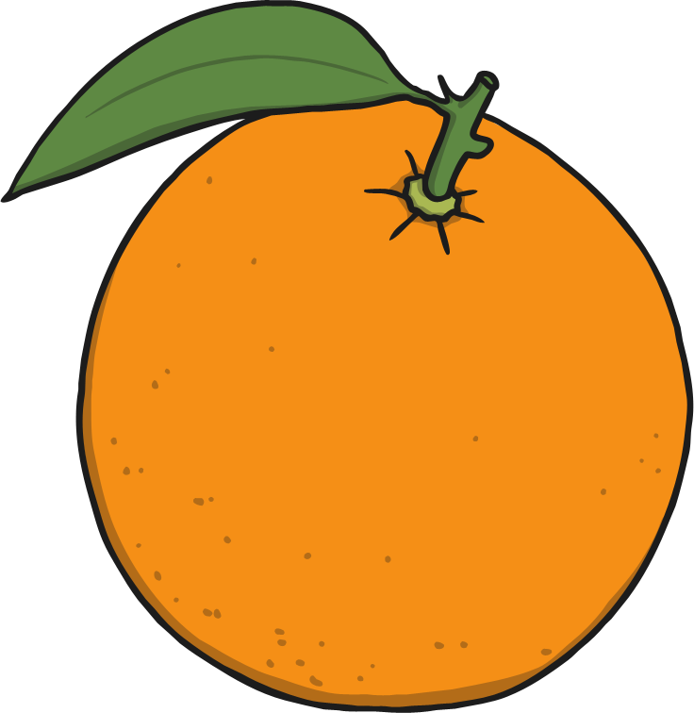
o

Slide 13
c

Slide 14
k

Slide 15

ck

Slide 16

e

Slide 17

u

Slide 18

r

Slide 19

h

Slide 20
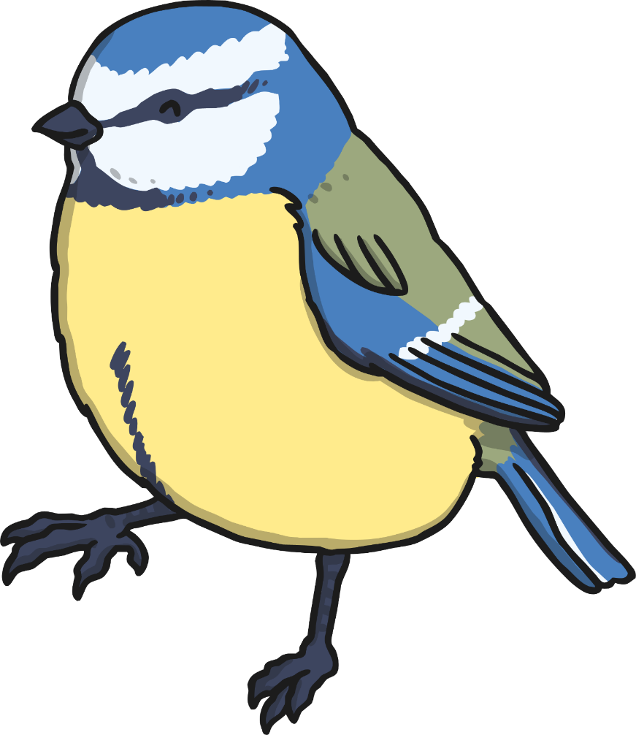
b

Slide 21

f

Slide 22

ff

Slide 23

l

Slide 24

ll

Slide 25

ss

Slide 26
Phase 3
Letters and Sounds

Slide 27

j

Slide 28

v

Slide 29
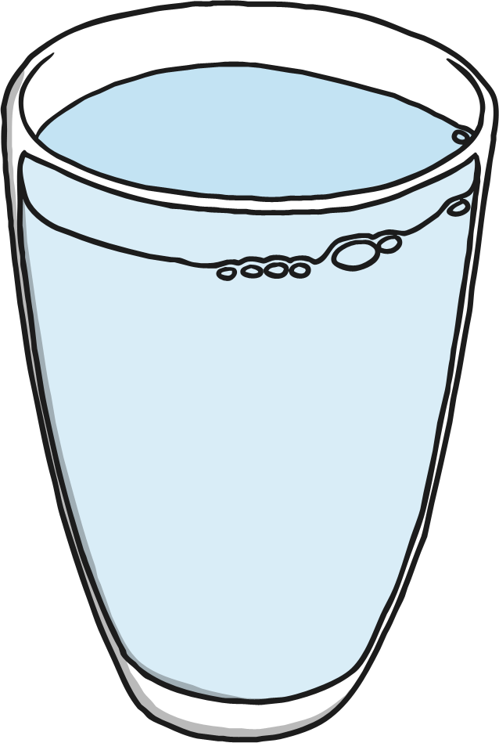
w

Slide 30
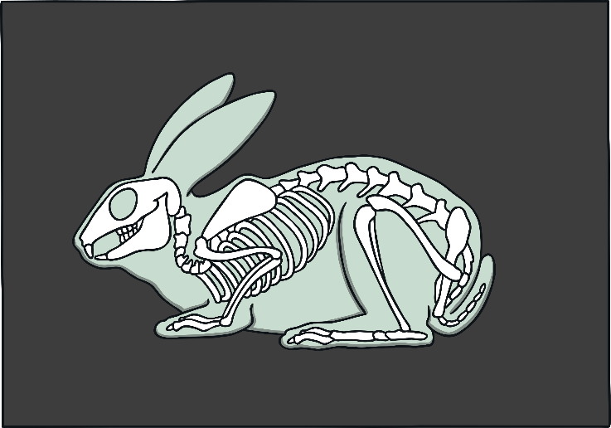
x

Slide 31
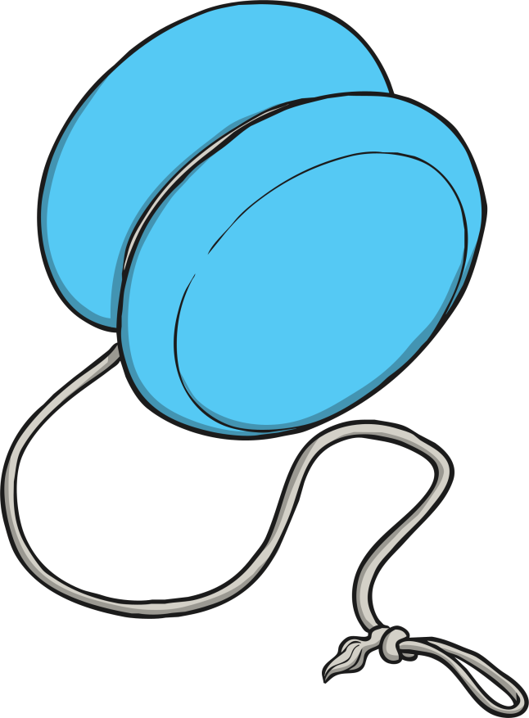
y

Slide 32
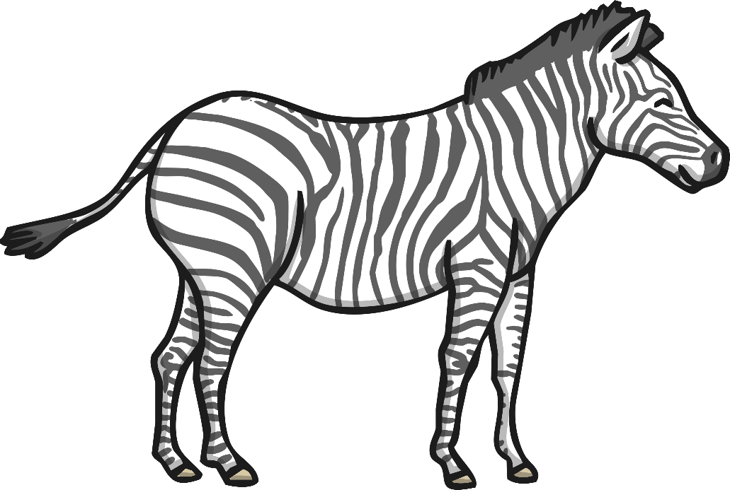
z

Slide 33

zz

Slide 34
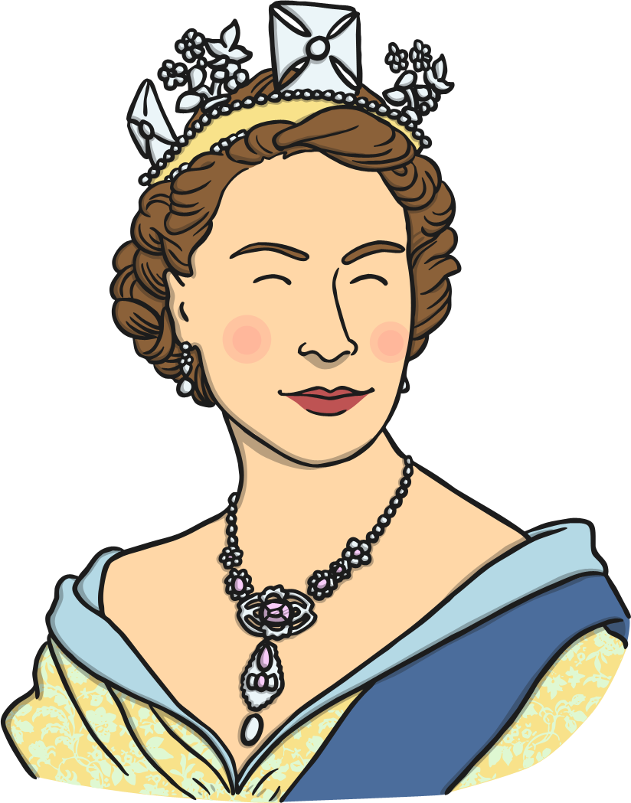
qu

Slide 35

ch

Slide 36

sh

Slide 37

th

Slide 38
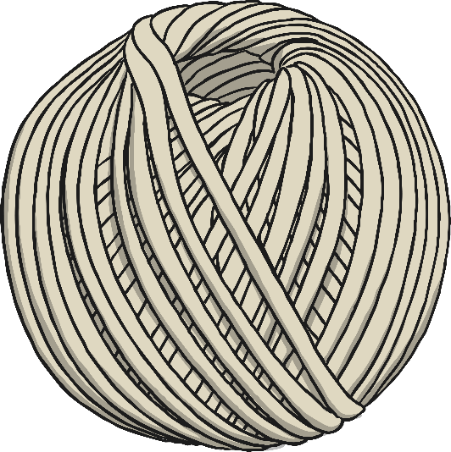
ng

Slide 39

ai

Slide 40

ee

Slide 41

igh

Slide 42

oa

Slide 43

oo

Slide 44

oo

Slide 45
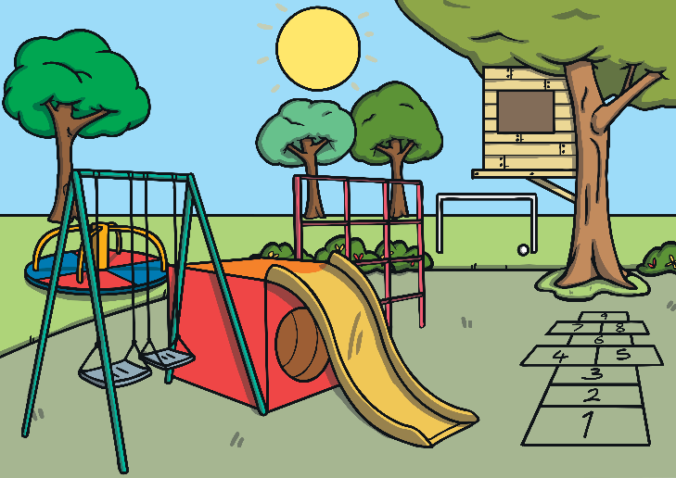
ar

Slide 46

or

Slide 47

ur

Slide 48

ow

Slide 49

oi

Slide 50

ear

Slide 51

er

Slide 52
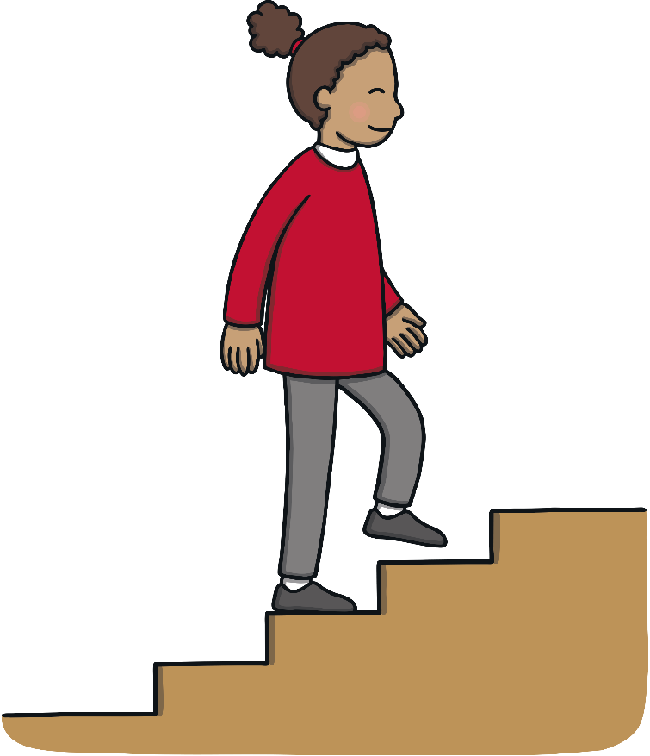
air

Slide 53
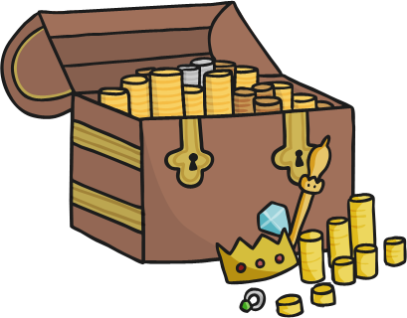
ure

Slide 54
Phase 5
Letters and Sounds

Slide 55


ay
Play Sound

Slide 56

ou
Play Sound

Slide 57

ie
Play Sound

Slide 58

ea
Play Sound

Slide 59
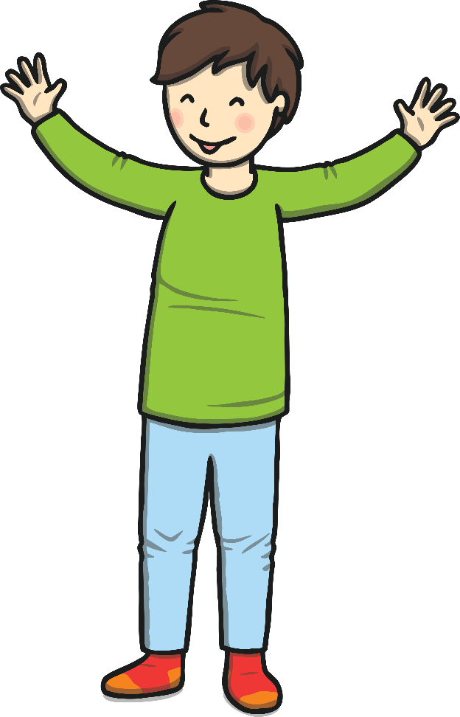
oy
Play Sound

Slide 60

ir
Play Sound

Slide 61

ue
Play Sound

Slide 62

ue
Play Sound

Slide 63
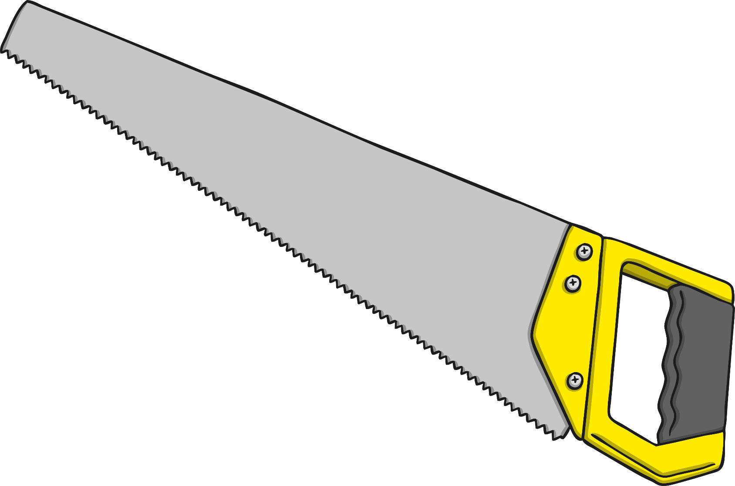
aw
Play Sound

Slide 64

wh
Play Sound

Slide 65

ph
Play Sound

Slide 66

ew
Play Sound

Slide 67

ew
Play Sound

Slide 68

oe
Play Sound

Slide 69
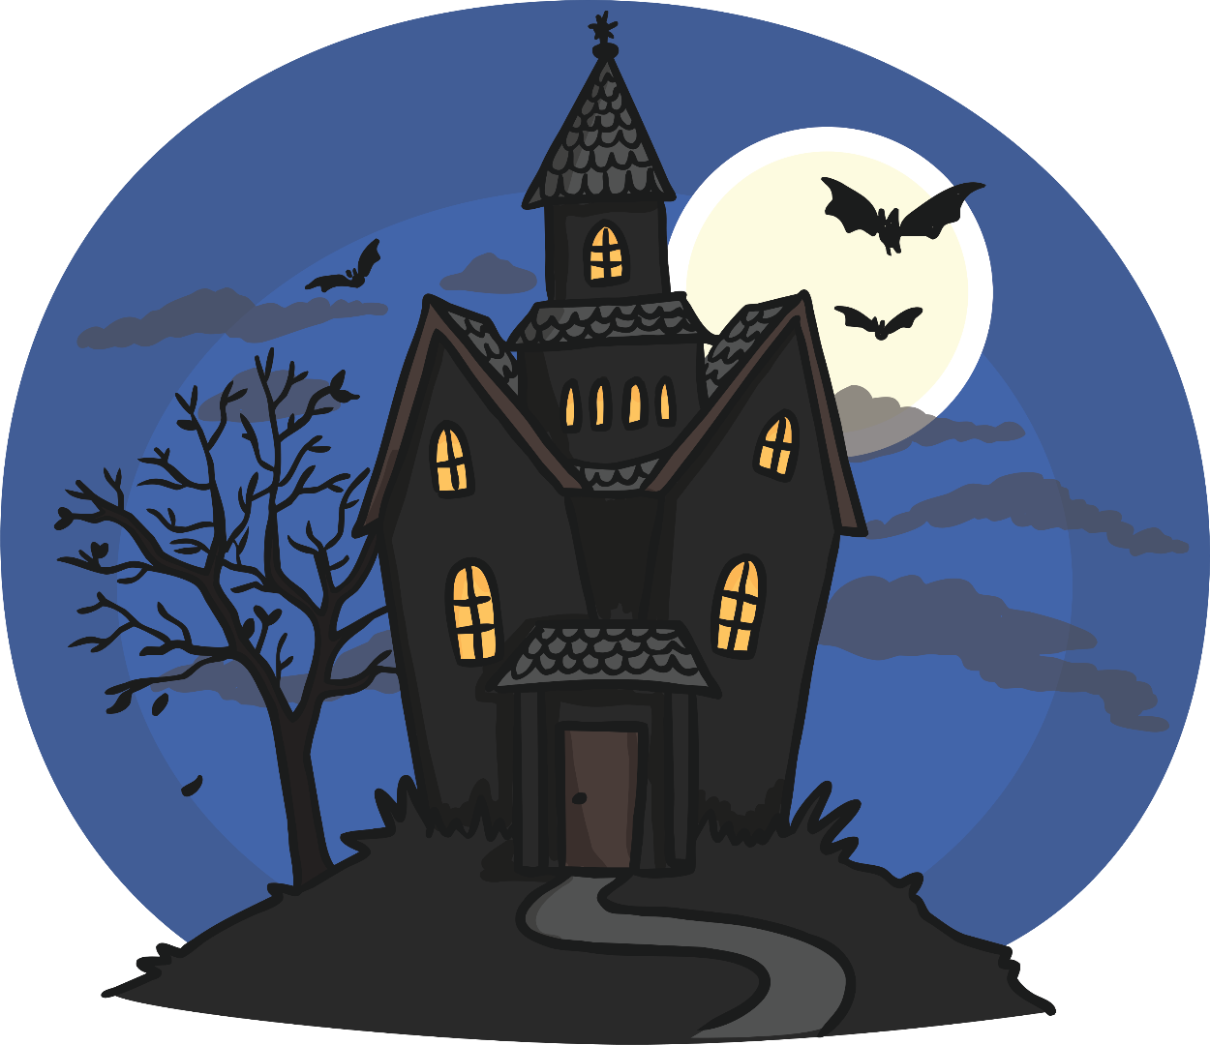
au
Play Sound

Slide 70

ey
Play Sound

Slide 71

a-e
Play Sound

Slide 72
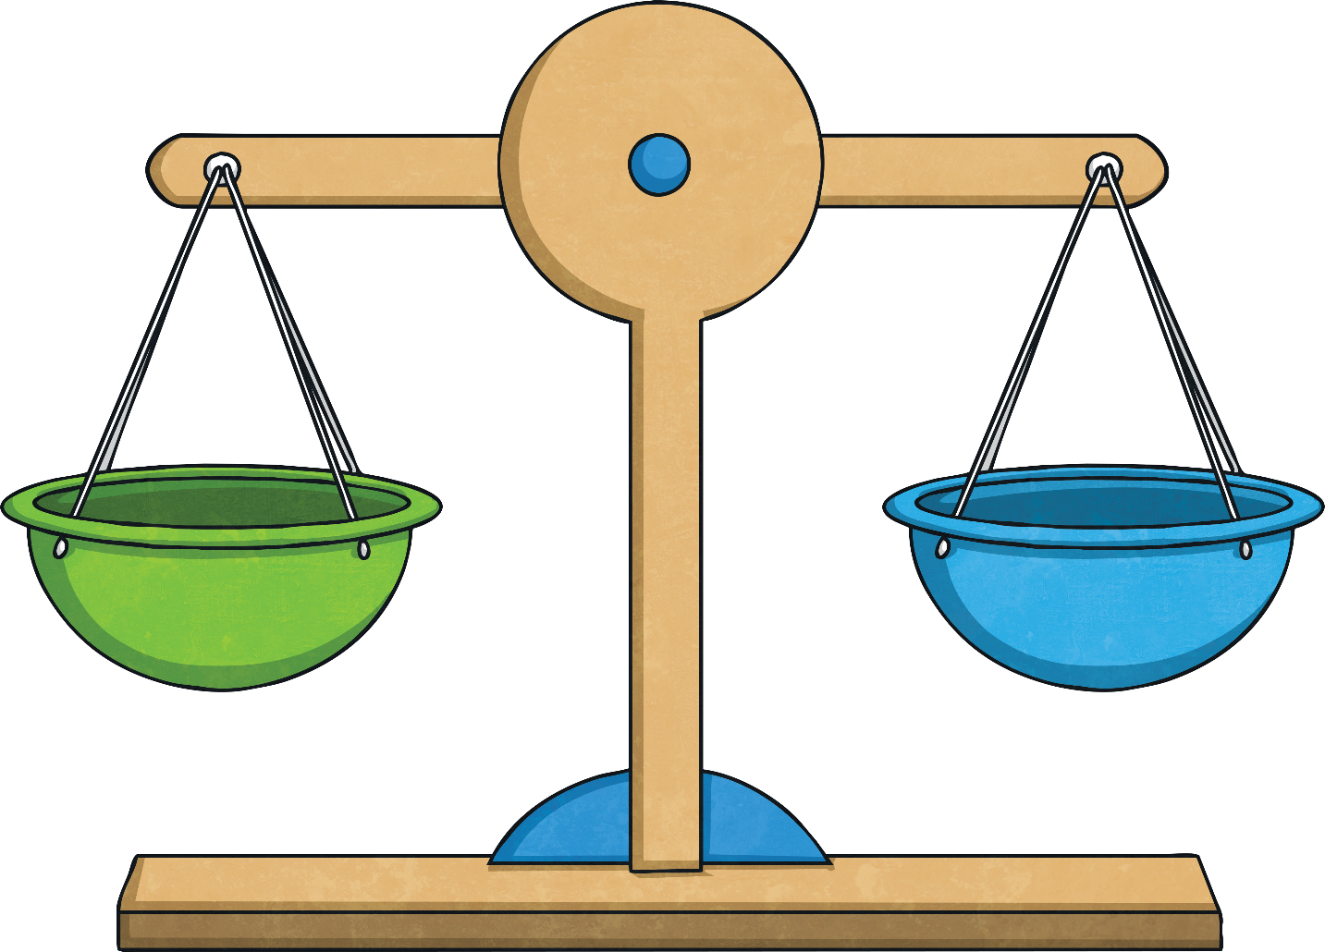
e-e
Play Sound

Slide 73
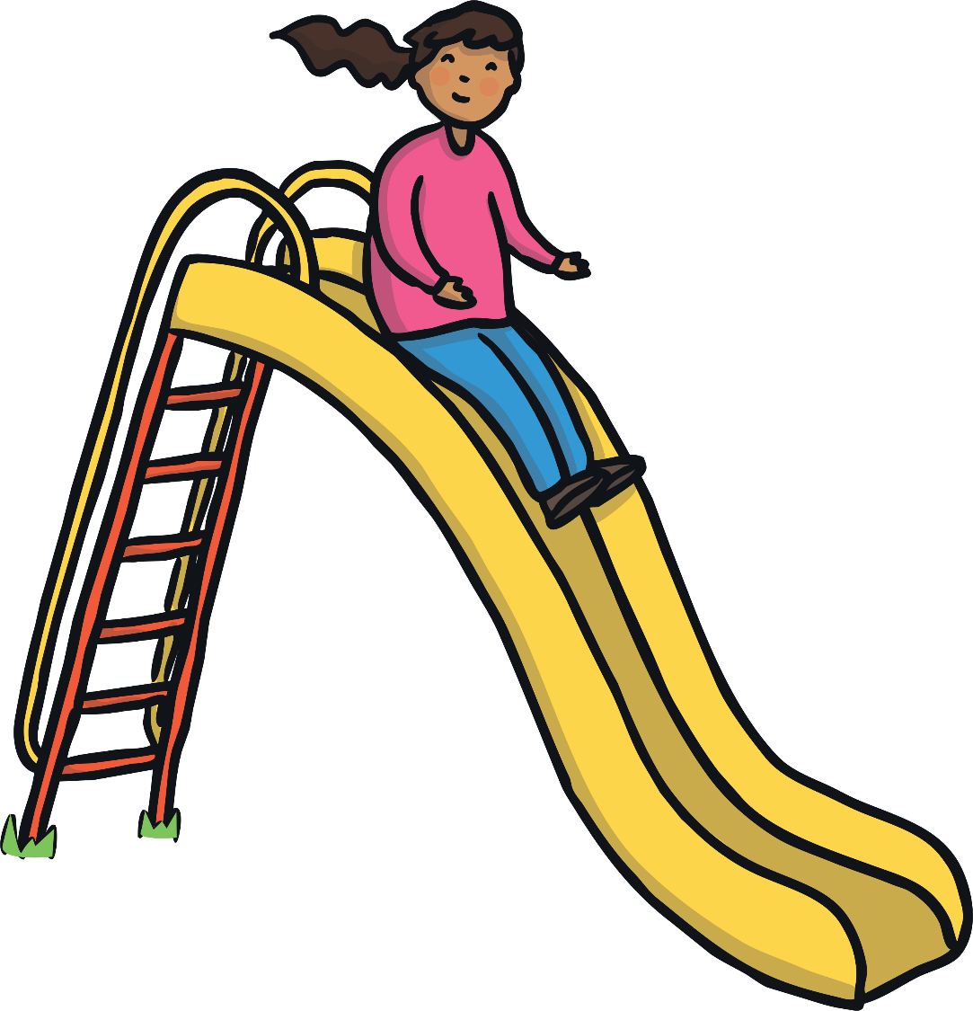
i-e
Play Sound

Slide 74

o-e
Play Sound

Slide 75
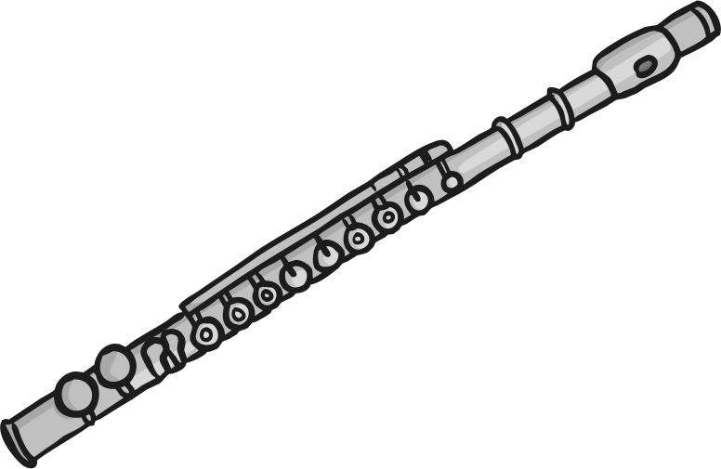
u-e
Play Sound

Slide 76

u-e
Play Sound

