Slide 1
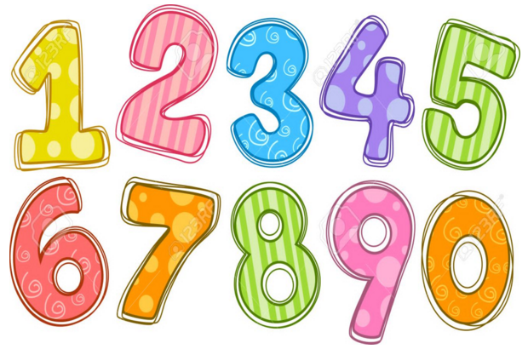
Maths Gym
Spring 1 - week 1

Slide 2
11 + 20 =
20 – 7 =
Double 4 =
Half of 16 =
Order 4000, 400, 4, 40
Write in digits:
Two hundred and one
Tuesday

Slide 3
20 + 14 =
30 – 3 =
Double 10 =
Half of 10 =
Order 2, 2000, 20, 200
Write in digits:
Three thousand
Wednesday

Slide 4
19 + 10 =
50 – 20 =
Double 13 =
Half of 12 =
Order 70, 7, 7000, 700
Write in digits:
Four hundred and forty
Thursday

Slide 5
30 + 40 =
20 – 14 =
Double 25 =
Half of 30 =
Order 3, 300, 30, 3000
Write in digits:
Five hundred and ten
Friday

Slide 6
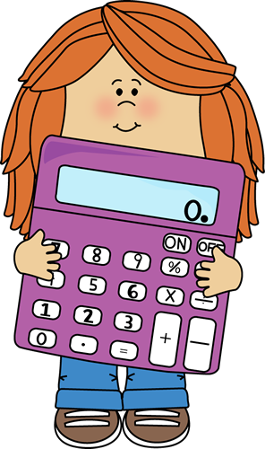
Daily
This week, maths warm ups will include:
recall and use multiplication and division facts for the 2, 5 and 10 multiplication tables, including recognising odd and even numbers

Slide 7
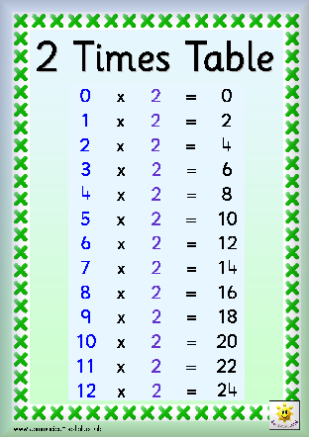
Say together:

Slide 8
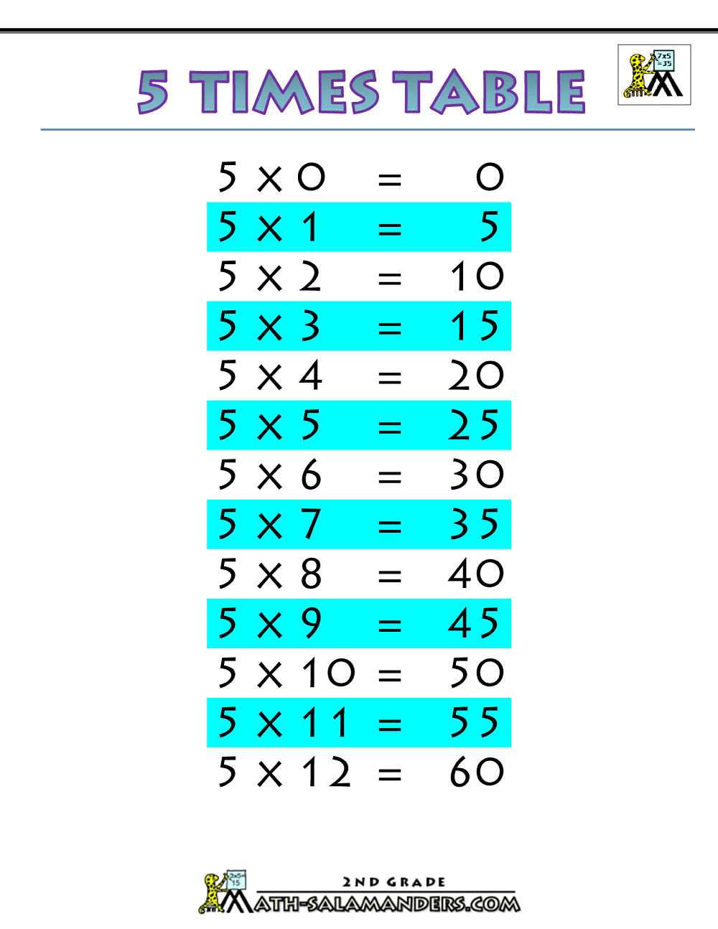
Say together:

Slide 9
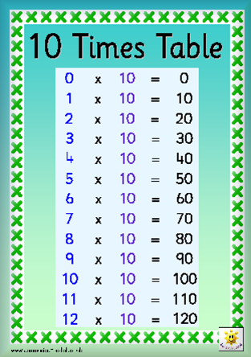
Say together:

Slide 10

Use your tables to calculate the total:

Slide 11
Use your tables to calculate the total:

Slide 12
Use your tables to calculate the total:

Slide 13
Use your tables to calculate the total:
Can you write this as a multiplication sentence?

Slide 14
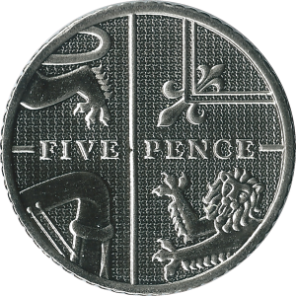
Use your tables to calculate the total:

Slide 15
Use your tables to calculate the total:

Slide 16
Use your tables to calculate the total:

Slide 17
Use your tables to calculate the total:
Can you write this as a multiplication sentence?

Slide 18
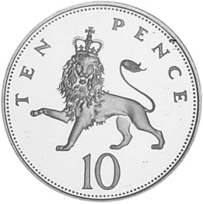
Use your tables to calculate the total:

Slide 19
Use your tables to calculate the total:

Slide 20
Use your tables to calculate the total:

Slide 21
Use your tables to calculate the total:
Can you write this as a multiplication sentence?

