Slide 1
To find half of a quantity.
Maths
Miss Sidhu

Slide 2

Welcome to today’s lesson!
You will need…
Item 1

Slide 3
Lesson agenda
Here is the outline for this lesson. We are going to look at:
Key vocabulary
Identifying equal and unequal quantities
Using a part-whole model to find half
An Independent task and answers
A final quiz to see what we learnt

Slide 4

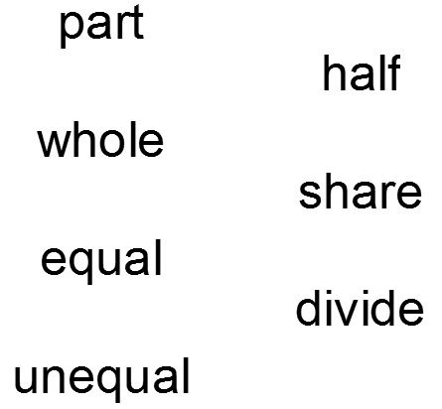
Star Words!

Slide 5
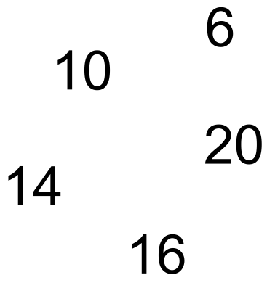

Brain teaser!
Select a number and then find half.

Slide 6
Brain teaser!
3
5
Select a number and then find half.
10
7
8

Slide 7
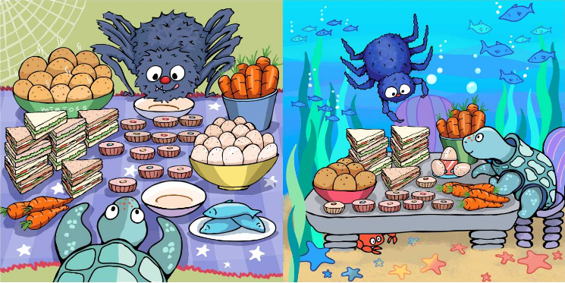
Identifying equal and unequal quantities

Slide 8
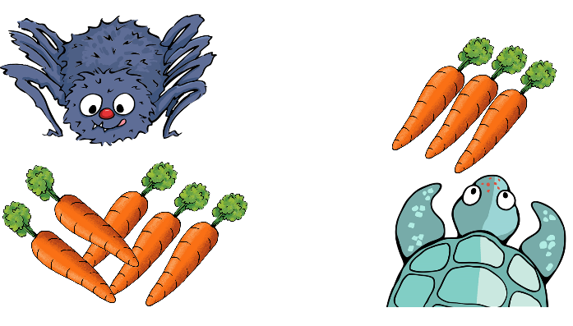
Do they have an equal share of carrots?

Slide 9
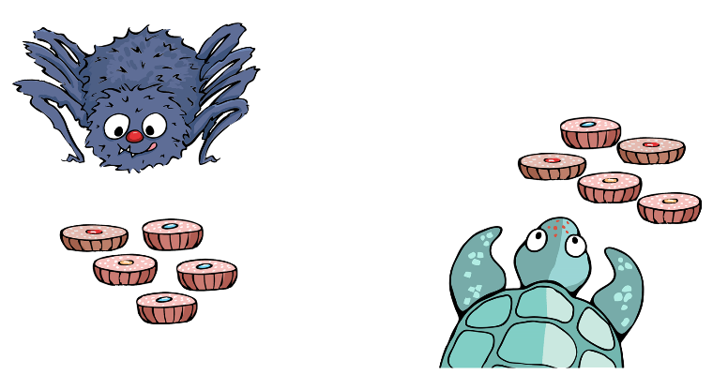
Do they have an equal share of cupcakes?

Slide 10
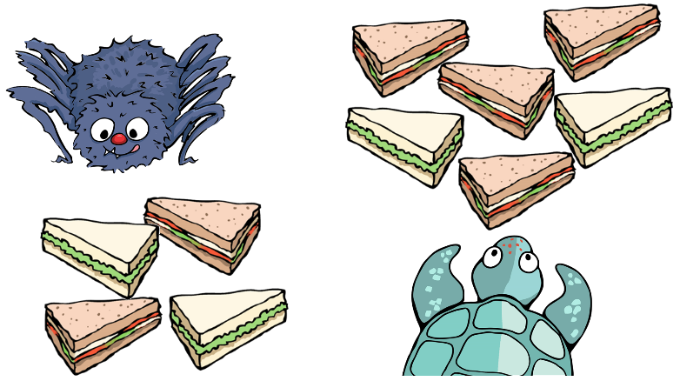
Do they have an equal share of sandwiches?

Slide 11
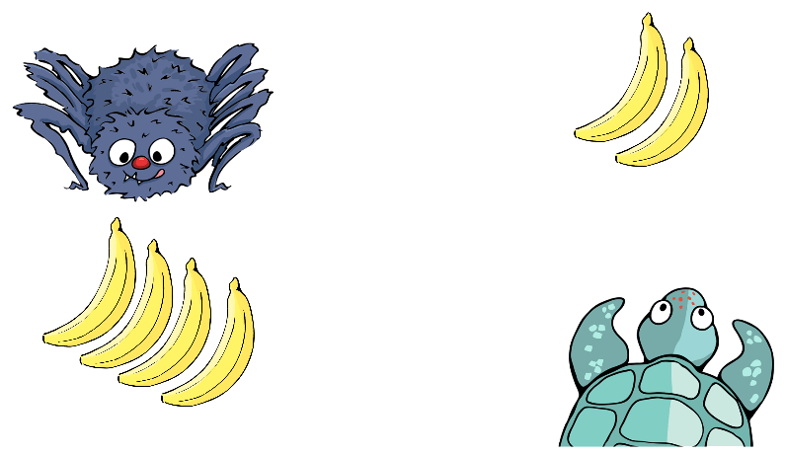
Do they have an equal share of bananas?

Slide 12
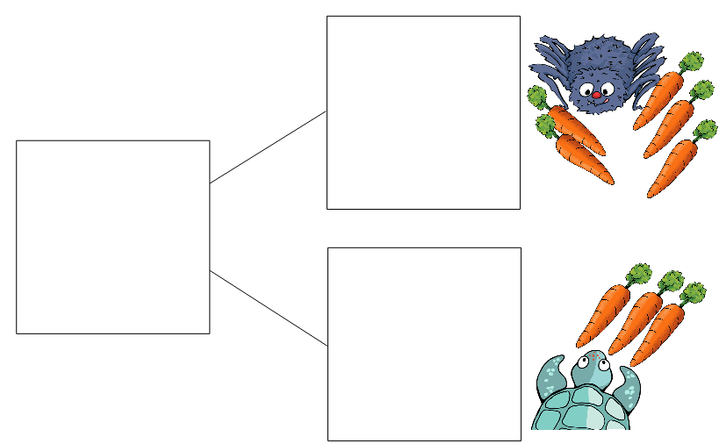
Do they have an equal share of carrots?

Slide 13
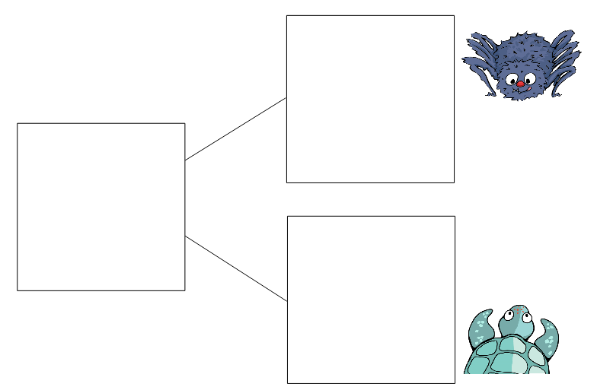
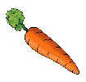
How can we make sure they have half each?

Slide 14
How can we make sure they have half each?

Slide 15
Half of 8 is 4.
4
8
4

Slide 16
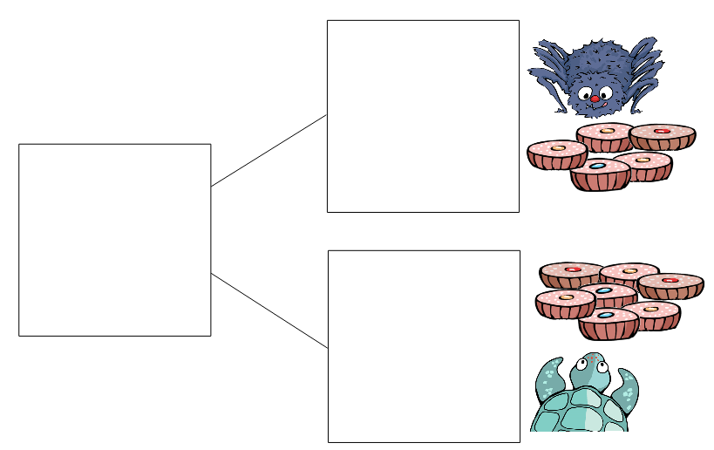
Do they have an equal share of cupcakes?

Slide 17


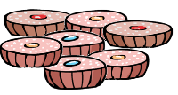
How can we make sure they have half each?

Slide 18
How can we make sure they have half each?

Slide 19
Half of 12 is 6.
6
12
6

Slide 20
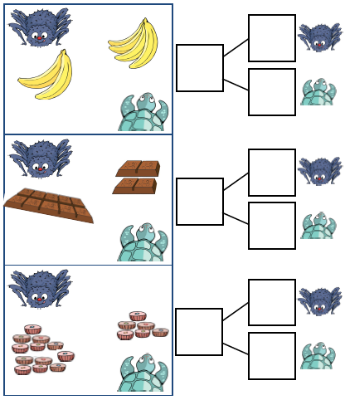
Independent Task
Can you help Anansi and Turtle to share the food evenly in half?

Slide 21
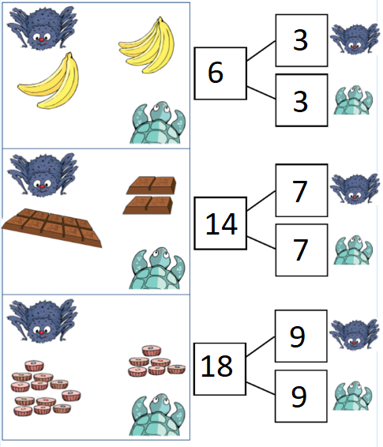
Answers
Can you help Anansi and Turtle to share the food evenly in half?

Slide 22

Share your work with Oak National
If you'd like to, please ask your parent or carer to share your work on Twitter tagging @OakNational and #LearnwithOak

Slide 23
You were amazing today at making different amounts equal and finding half.
Don’t forget to complete your end of lesson quiz.

