Slide 1
To find one quarter of a shape.
Maths
Miss Sidhu

Slide 2
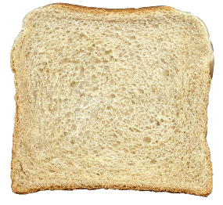


Welcome to today’s lesson!
You will need…
Item 1
Item 2
Item 3
Source: Pieces of paper - Creative Commons: Free vector graphic on Pixabay
.

Slide 3
Lesson agenda
Here is the outline for this lesson. We are going to look at:
Key vocabulary
Finding one quarter
Exploring parts to find a quarter
An Independent task and answers
A final quiz to see what we learnt

Slide 4

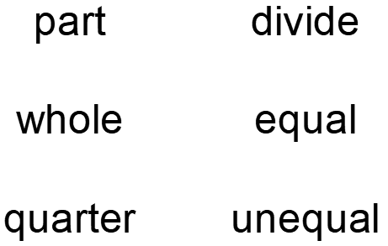
Star Words!

Slide 5
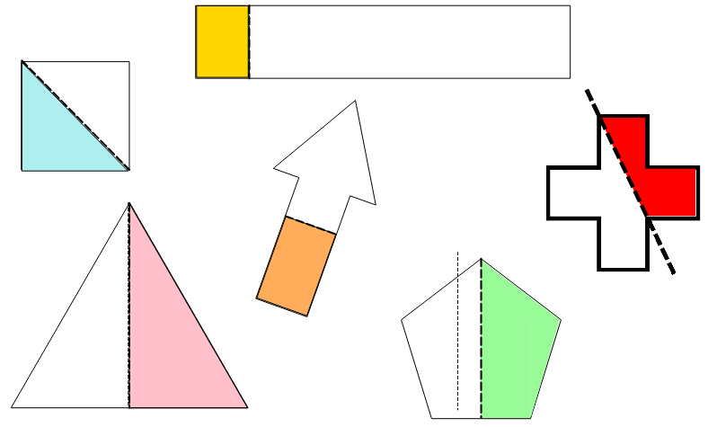

Brain teaser!
Are the shapes split in half?
.

Slide 6
Brain teaser!
No
Yes
Are the shapes split in half?
No
No
Yes
Yes
.

Slide 7
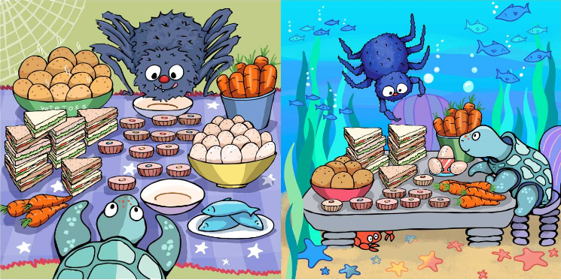
Finding one quarter
.

Slide 8
What is the same? What is different?
Equal parts
Unequal parts

Slide 9
How many equal parts are there?
The whole has been divided into four equal parts.

Slide 10
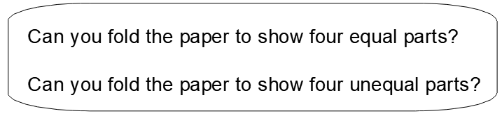
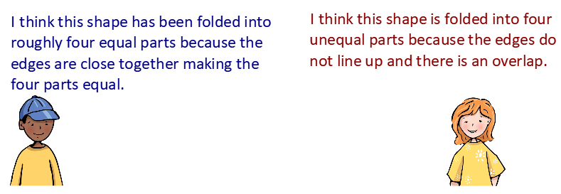
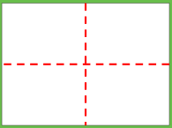
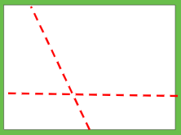
.

Slide 11
.

Slide 12
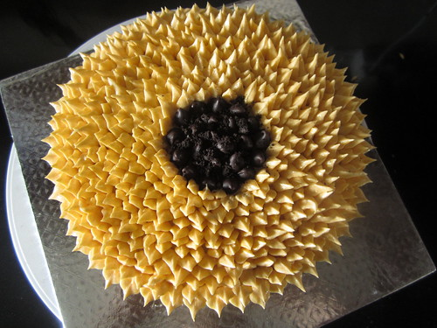
We can cut the cake into four equal parts.
The whole has been divided into two equal parts. One part is half of the whole.
Source: Cake image - Creative commons: Divyascookbook - CC BY-NC-ND

Slide 13
Have we got four equal parts?
We have now got four equal parts.
The whole is cut into four quarters.
Source: Cake image - Creative commons: Divyascookbook - CC BY-NC-ND

Slide 14
Independent Task
How many ways
can you divide a slice of bread into quarters?
How many ways
can you show the
slice not being divided into quarters?
How do you know?

Slide 15
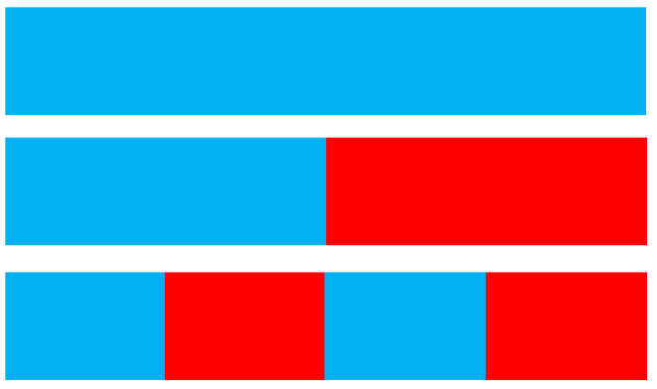
Challenge
Can you describe the bar models using our star words?
.

Slide 16
Answers
Here are some of the ways you can show quarters.

Slide 17
Challenge answers
Whole
Part
Half
Part
Half
Can you describe the bar models using our star words?
Part
Quarter
Part
Quarter
Part
Quarter
Part
Quarter
.

Slide 18

Share your work with Oak National
If you'd like to, please ask your parent or carer to share your work on Twitter tagging @OakNational and #LearnwithOak

Slide 19
You were great today at finding a quarter.
Don’t forget to complete your end of lesson quiz.

