Slide 1
To identify half, quarter and three quarter turns
Maths
Miss Sidhu

Slide 2


Welcome to today’s lesson!
You will need…
Item 1
Item 2

Slide 3
Lesson agenda
Here is the outline for this lesson. We are going to look at:
Key vocabulary
Exploring half, quarter and three quarter turns
Using clockwise and anti-clockwise direction
An Independent task
A final quiz to see what we learnt

Slide 4

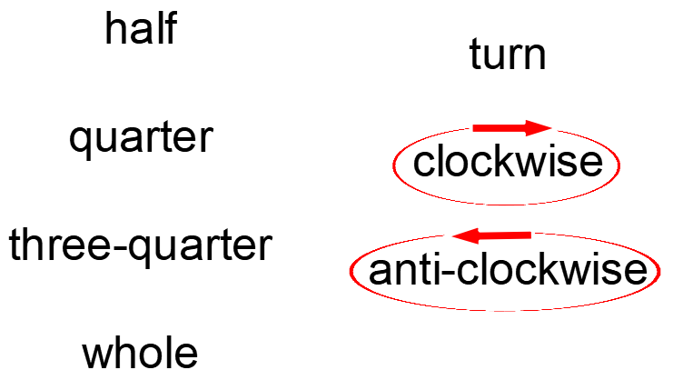
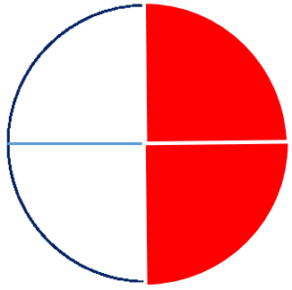
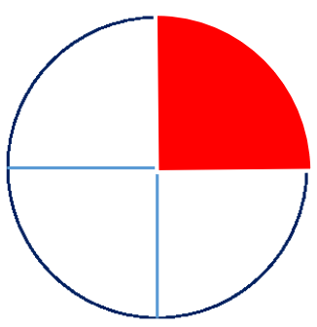


Star Words!

Slide 5




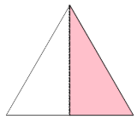
Brain teaser!
Halves or quarters
How do you know?

Slide 6
Brain teaser!
Halves
Halves or quarters
How do you know?
Quarters
Quarters
Halves
Halves
Quarters

Slide 7
Whole turn
Door

Slide 8
Half turn
Door

Slide 9
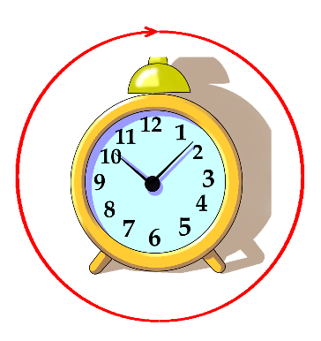
Clockwise

Slide 10
Anti-clockwise

Slide 11
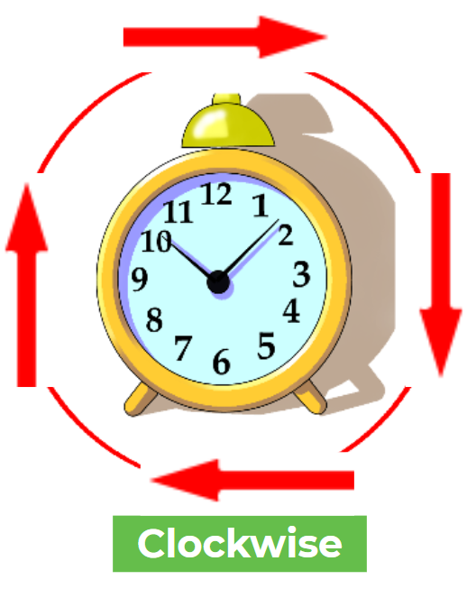
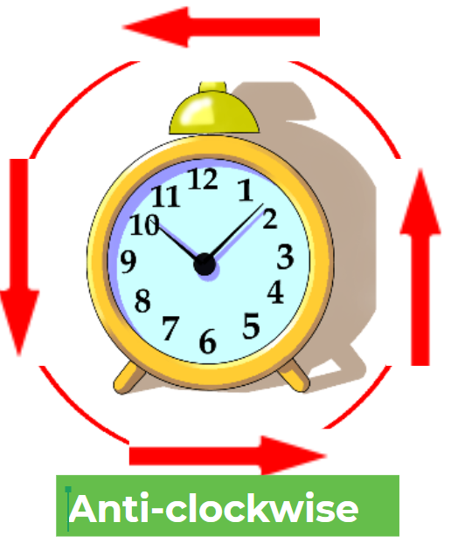
Explore half turns, turning clockwise and anti-clockwise.

Slide 12
Quarter turn
Anti-clockwise
Clockwise

Slide 13
Three-quarter turn
Anti-clockwise
Clockwise

Slide 14
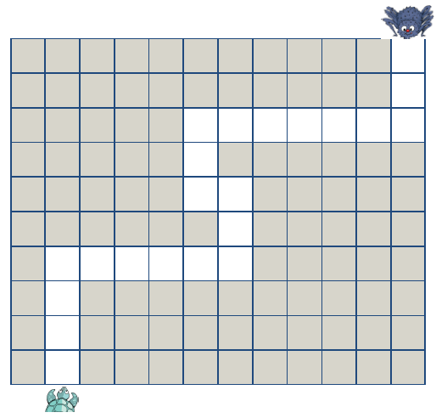
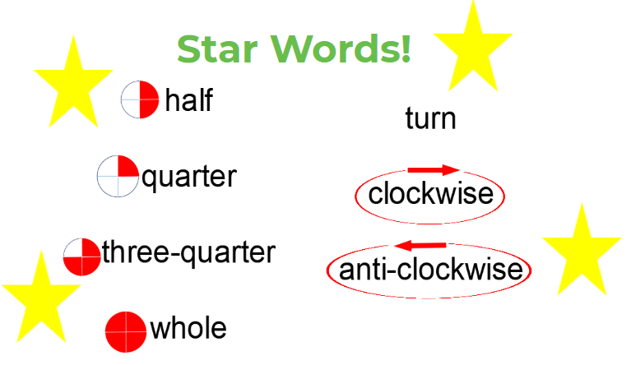
Instructions to guide Turtle to Anansi for dinner.

Slide 15
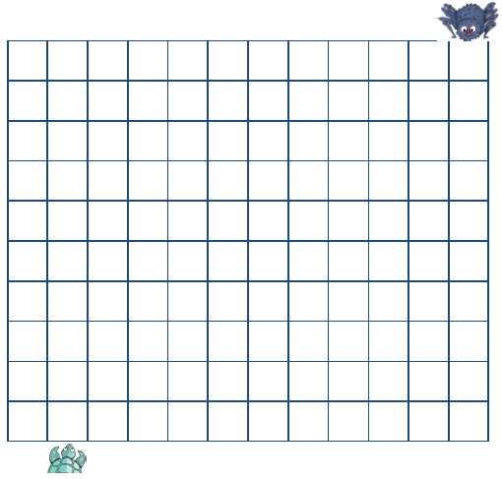
Independent Task
Design and write instructions to guide Turtle to Anansi for dinner.

Slide 16

Share your work with Oak National
If you'd like to, please ask your parent or carer to share your work on Twitter tagging @OakNational and #LearnwithOak

Slide 17
You were amazing at exploring half, quarter and three quarter turns.
Don’t forget to complete your end of lesson quiz.

