Slide 1
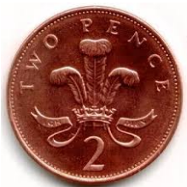
56 - 21 =
8 x 2 =
Place these numbers on a number line…
0, 50, 100
____________________________
How much money?
Thursday Maths Gym
What is this shape?

