Slide 1
Using doubles to calculate near doubles
Mathematics
Mrs Bramble and Miss Charlton

Slide 2
Lesson agenda
To recap doubles within 20
To calculate near doubles
Independent Task
End of Lesson Quiz

Slide 3

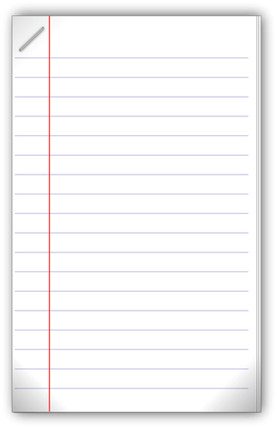
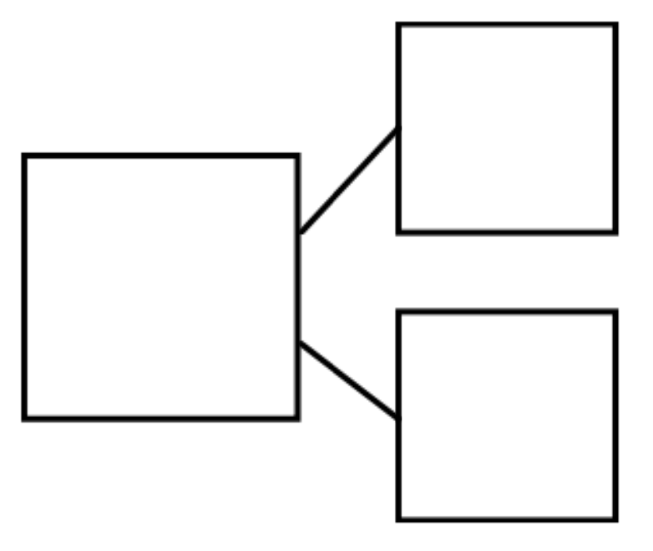
You will need…
Item 1
Item 2
Item 3
Pencil
Paper
Part, whole model
Source: Free SVG
Source: Free SVG

Slide 4
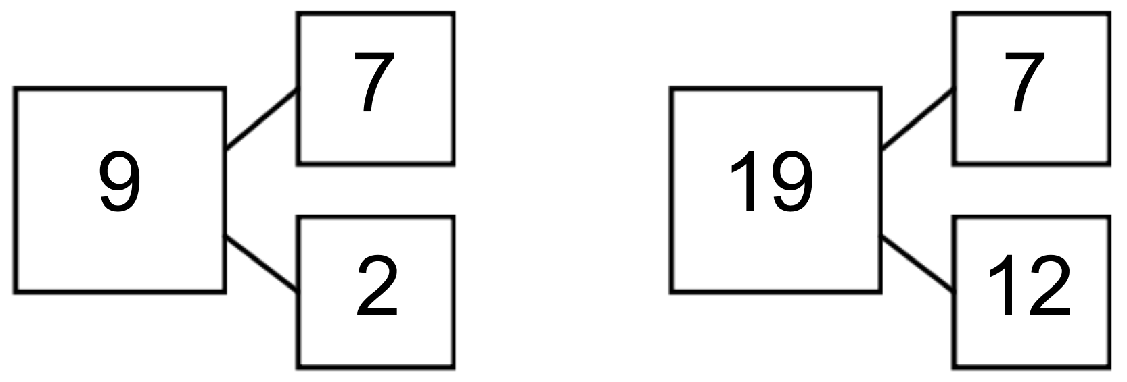
If I know…, Then I know...

Slide 5
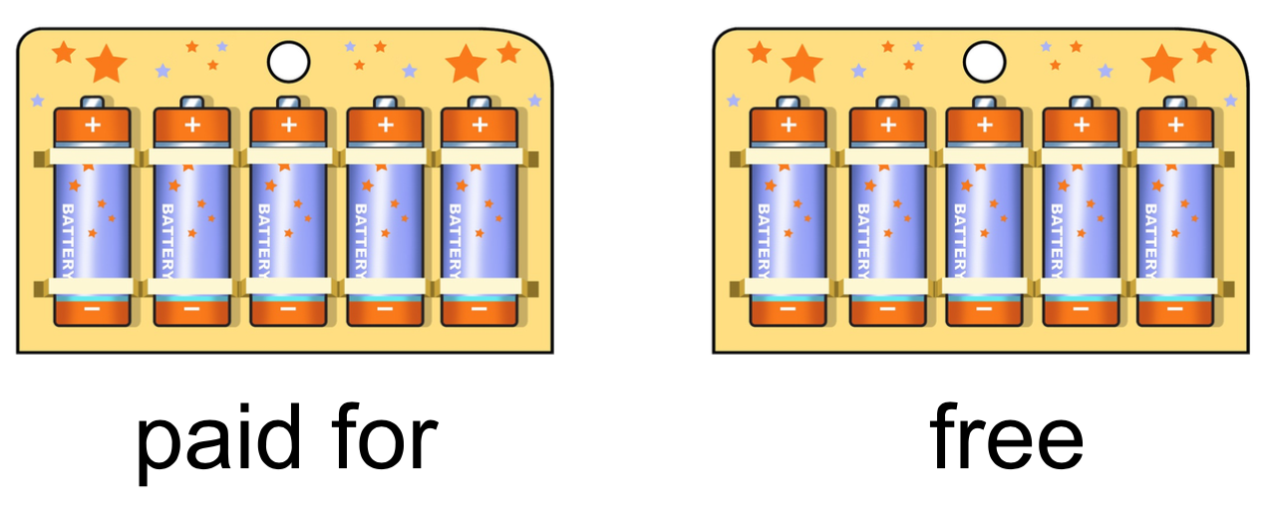
New Learning
How many batteries did I get altogether?
Buy one get one free.

Slide 6
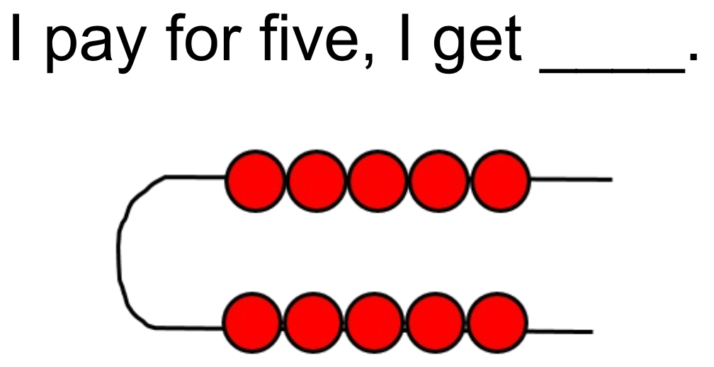

Slide 7
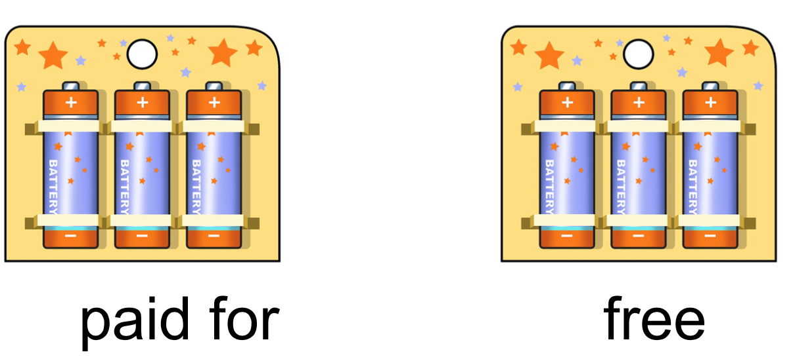

New Learning
six
I pay for three but I get _______.

Slide 8
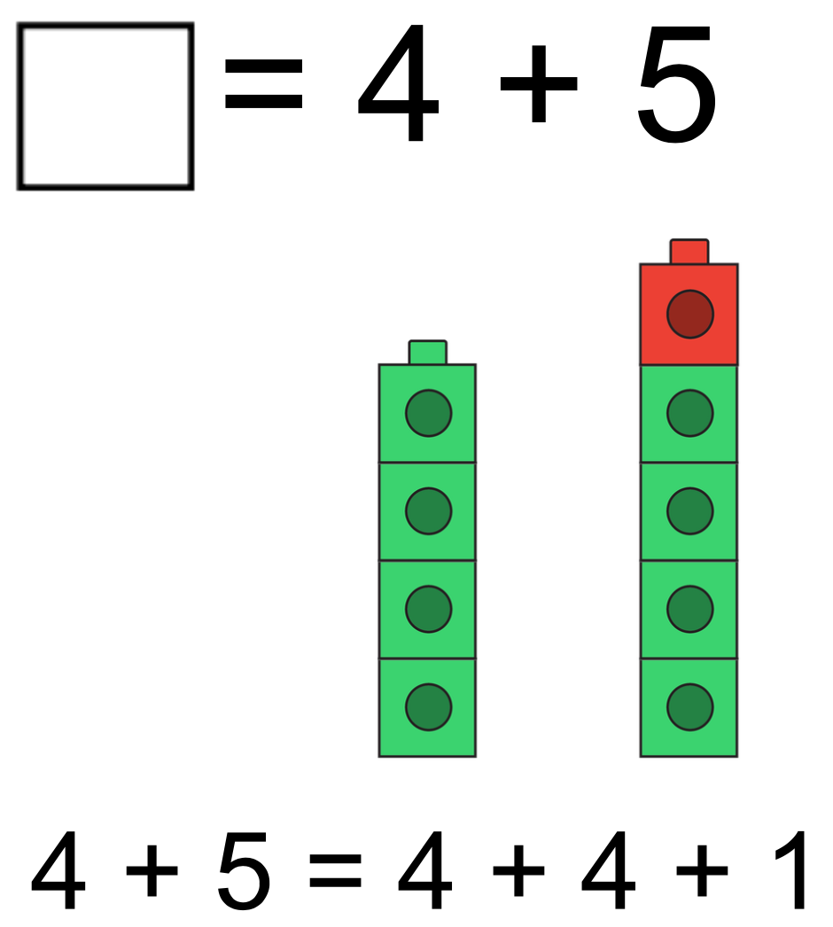
Develop Learning
9

Slide 9
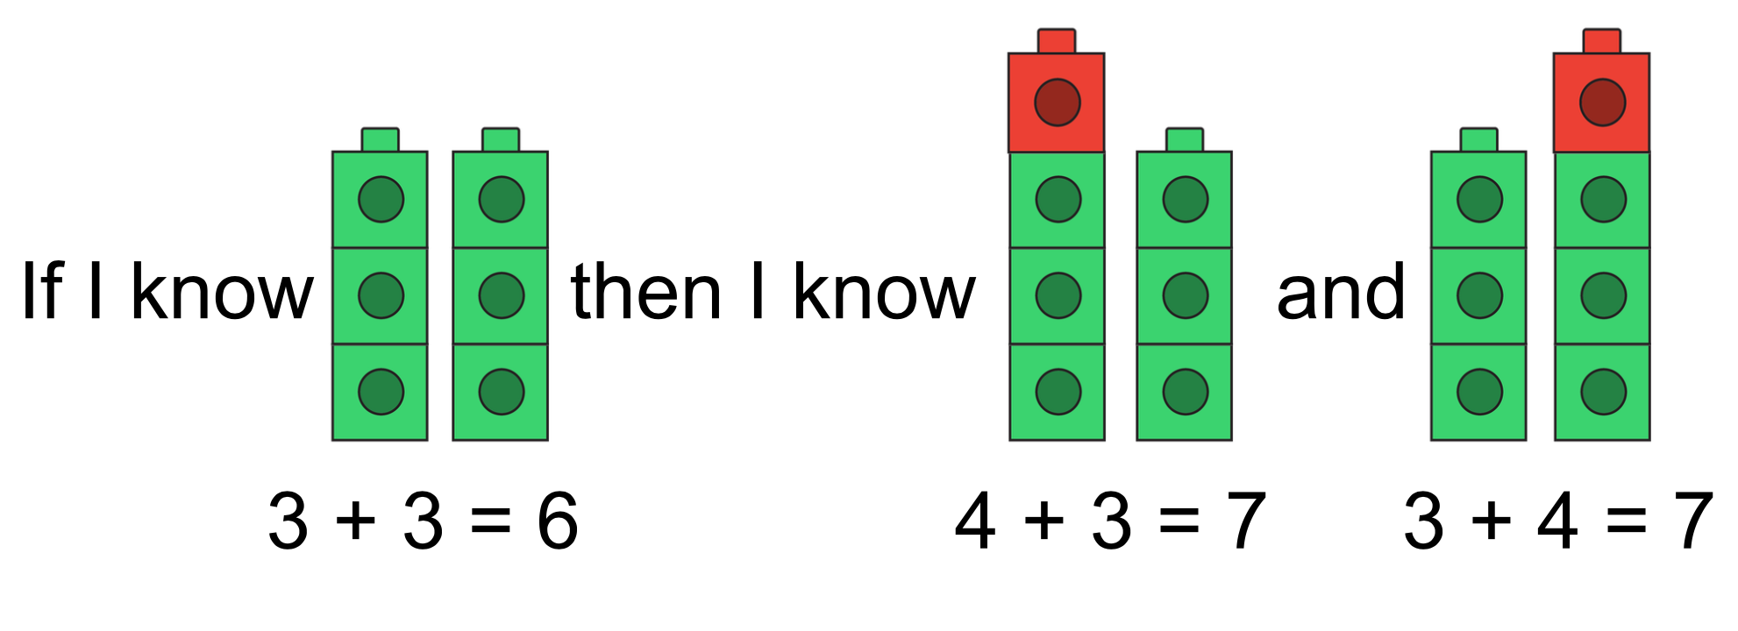

Slide 10
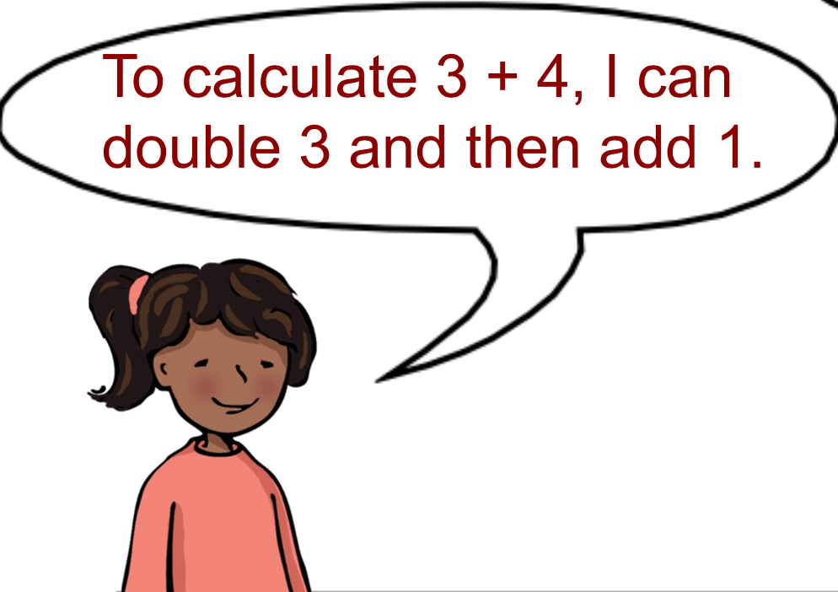
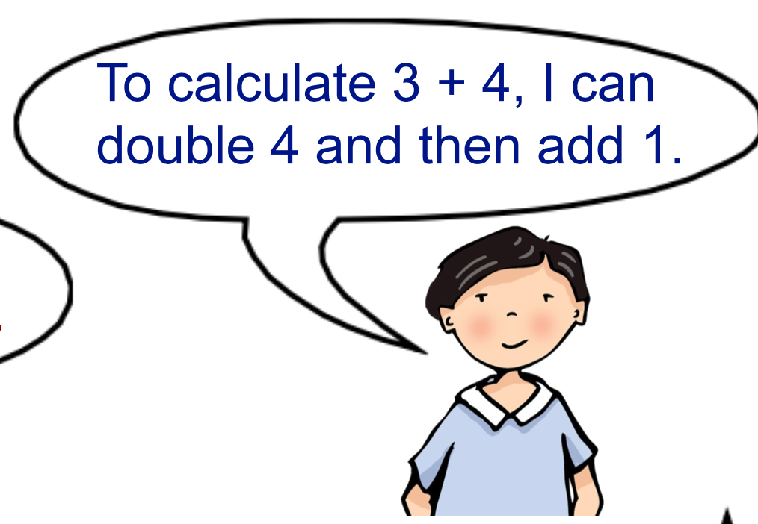

Slide 12
Independent Task
Pick a number from below, double it and add 1. What number do you have?
2
3
4
5
6
7
8
9

Slide 13

Pause the video to complete your task
Resume once you’re finished

Slide 14
Answers
2
3
4
5
6
7
8
9
2 + 2 + 1 = 5
5 + 5 + 1 = 11
8 + 8 + 1 = 17
3 + 3 + 1 = 7
6 + 6 + 1 = 13
9 + 9 + 1 = 19
4 + 4 + 1 = 9
7 + 7 + 1 = 15

Slide 15

Share your work with Oak National
If you'd like to, please ask your parent or carer to share your work on Twitter tagging @OakNational and #LearnwithOak

Slide 16
Now complete the quiz!

