Slide 1
Using number bonds when subtracting
Mathematics
Mrs Bramble and Miss Charlton

Slide 2
Lesson agenda
To use the part,whole model for subtraction
To predict the answers of the
subtraction calculations
Independent Task
End of Lesson Quiz

Slide 3

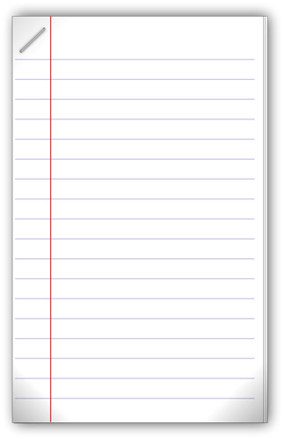
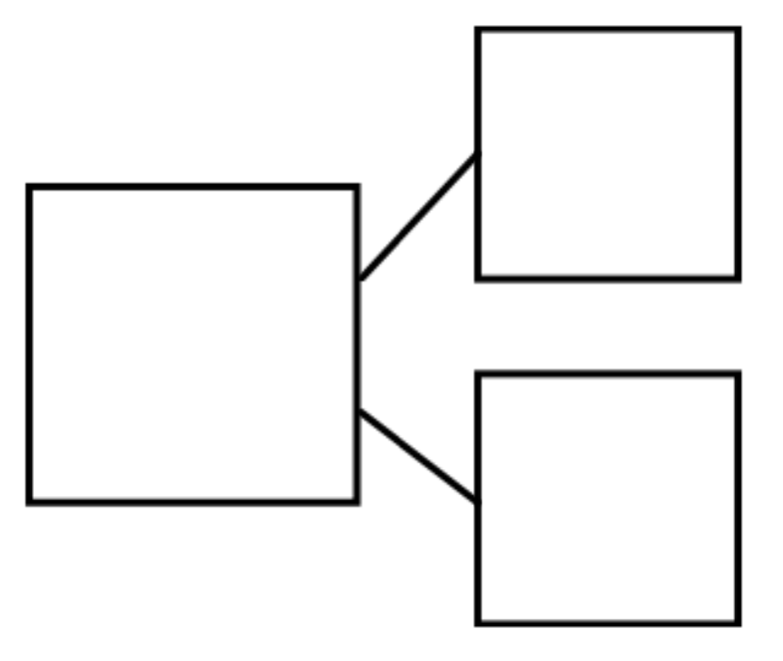
You will need…
Item 1
Item 2
Item 3
Pencil
Paper
Part, whole model
Source: Free SVG
Source: Free SVG

Slide 4
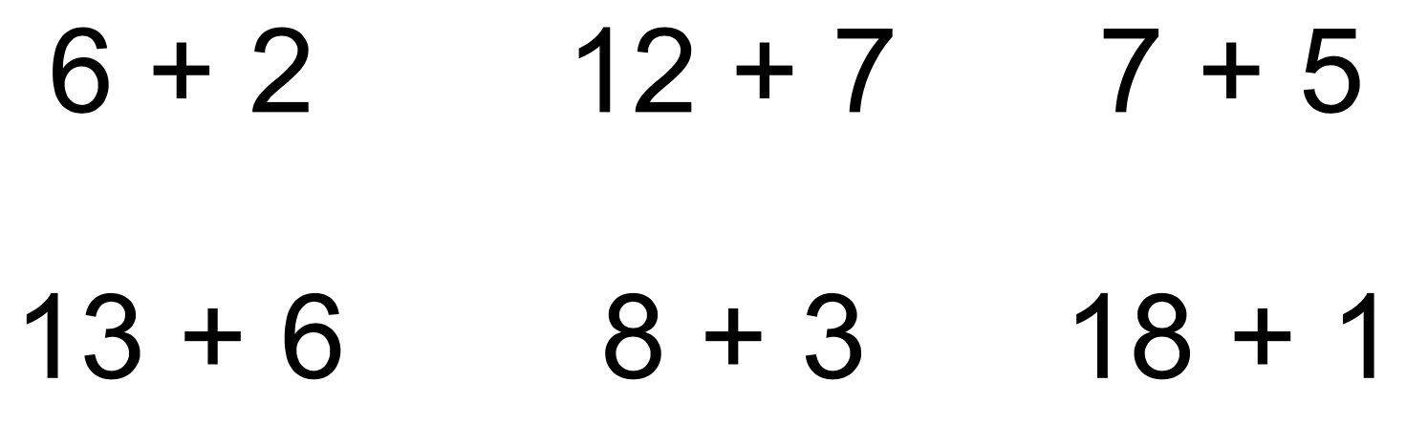
Which strategy would you use?
‘Make ten’
Count on
Number bonds

Slide 5
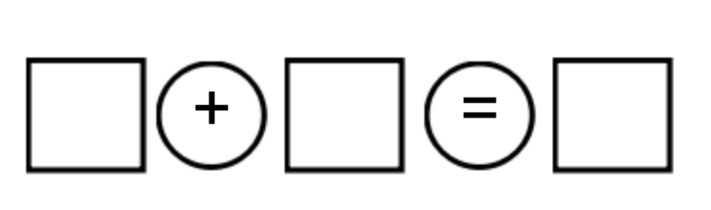
New Learning
2
If I know, then I know…
6
4
2
4
6
4
2
6

Slide 6
If I know, then I know…
3
7
4
3
4
7
4
3
7

Slide 7

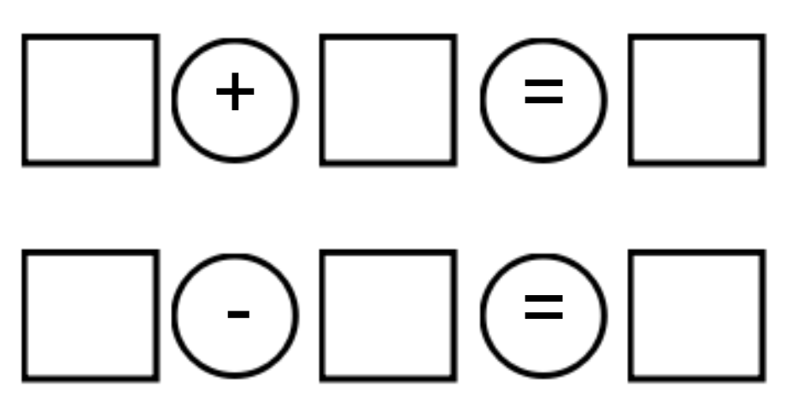
New Learning
5
2
7
2
7
5
2
7
5

Slide 8
Develop Learning
2
7
10
5
12
17
5

Slide 9
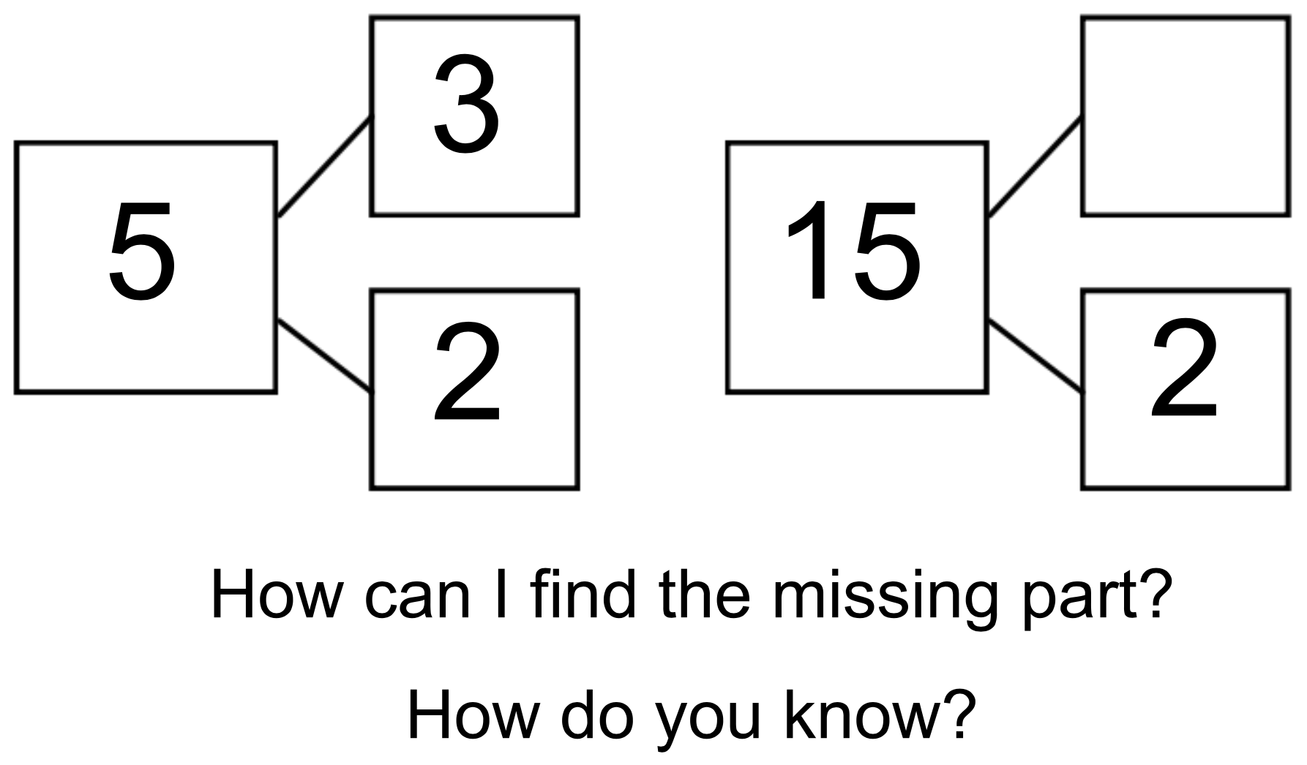
13

Slide 10
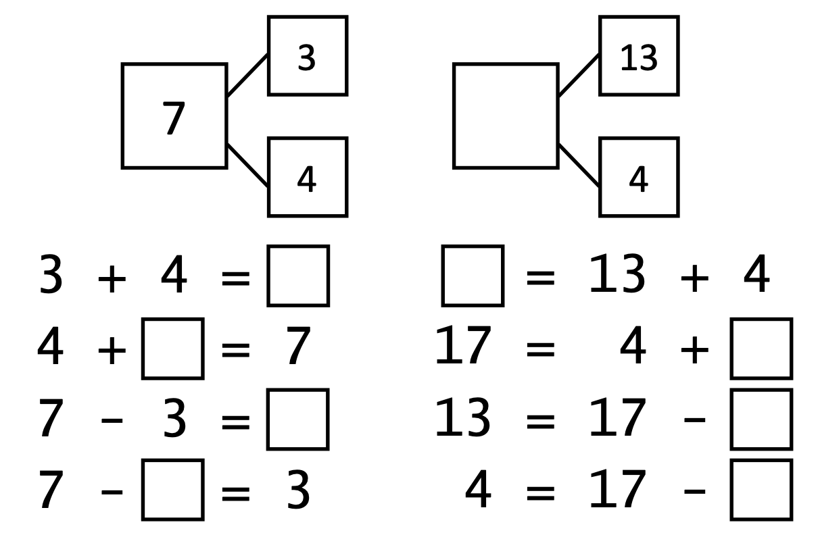
Independent Task

Slide 11

Pause the video to complete your task
Resume once you’re finished

Slide 12
Answers
17
7
17
3
13
4
4
4
13

Slide 13

Share your work with Oak National
If you'd like to, please ask your parent or carer to share your work on Twitter tagging @OakNational and #LearnwithOak

Slide 14
Now complete the quiz!

