Slide 1
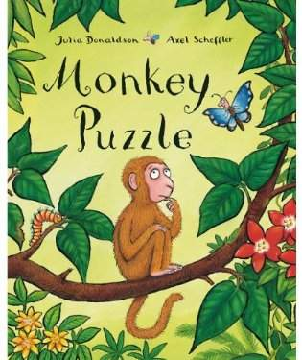


Slide 2
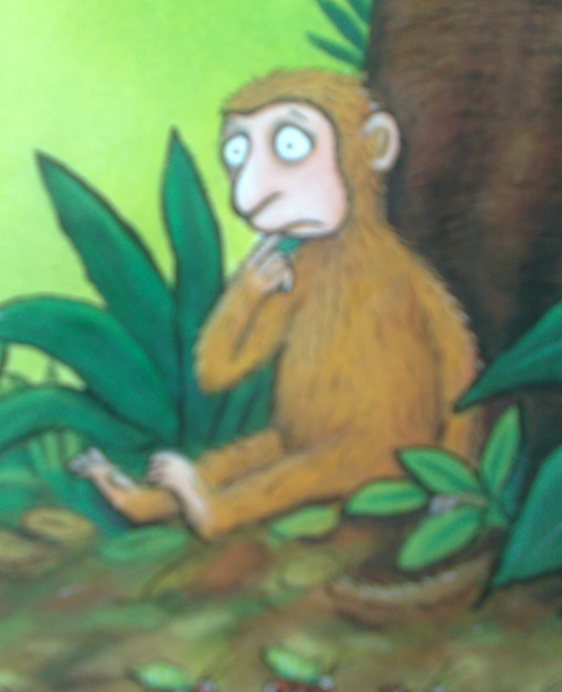
“I`ve lost my mum!”

Slide 3
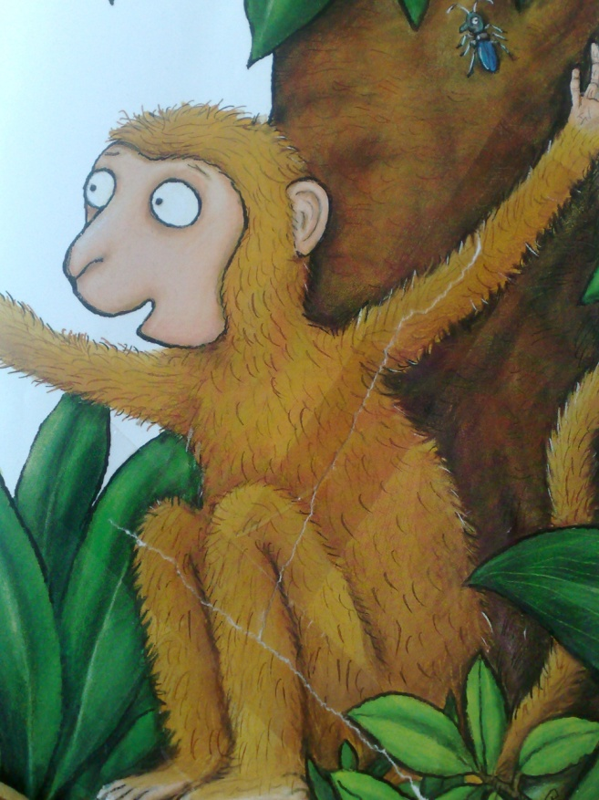
“Hush, little monkey, don`t you cry.
I`ll help you to find her,” said butterfly.
“Let`s have a think. How big is she?”
“She`s big!” said the monkey. Bigger than me.”
“Bigger than you? Than I`ve seen your mum.
Come, little monkey, come, come, come.”

Slide 4

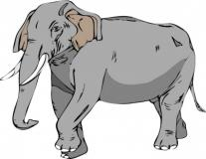
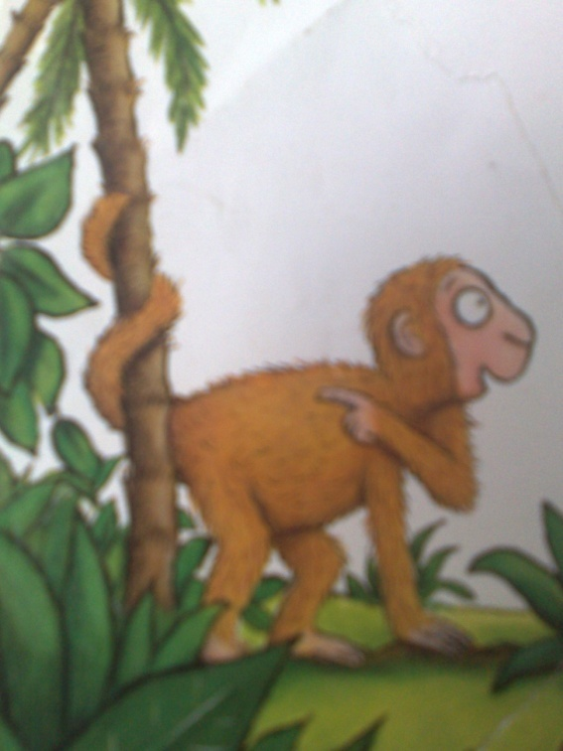
“No, no, no! That`s an elephant.
“My mum isn`t a great grey hunk.
She hasn`t got tusk or a curly trunk.
She doesn`t have great thick buggy knees.
And anyway, her tail coils round the trees.”
“She coils round the trees? Than she`s very near.
Quick, little monkey! She`s over here.”

Slide 5
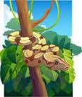

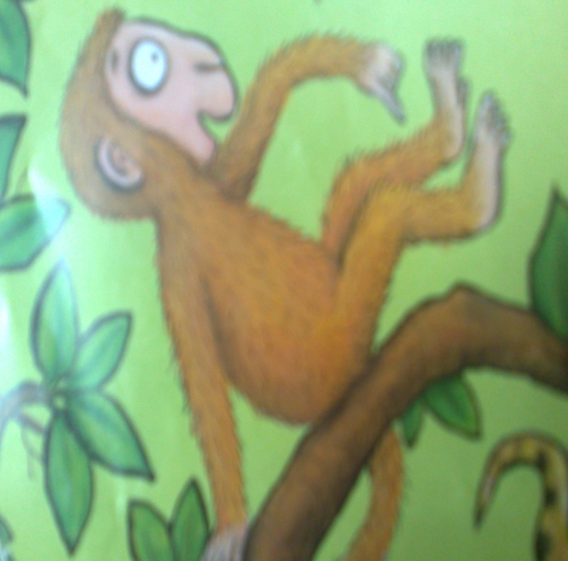
“No, no, no! That`s a snake.
“Mum doesn`t look a bit like this.
She doesn`t slither about and hiss.
She doesn`t curl round a nest of eggs.
And anyway, my mum`s got more legs.”
“It`s legs we`re looking for now, you say?
I know where she is, then. Come this way.”

Slide 6
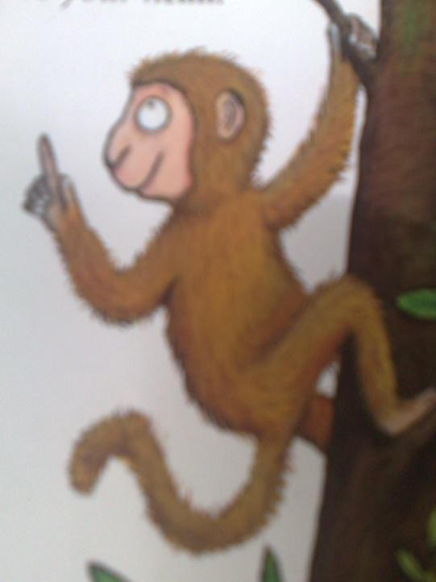
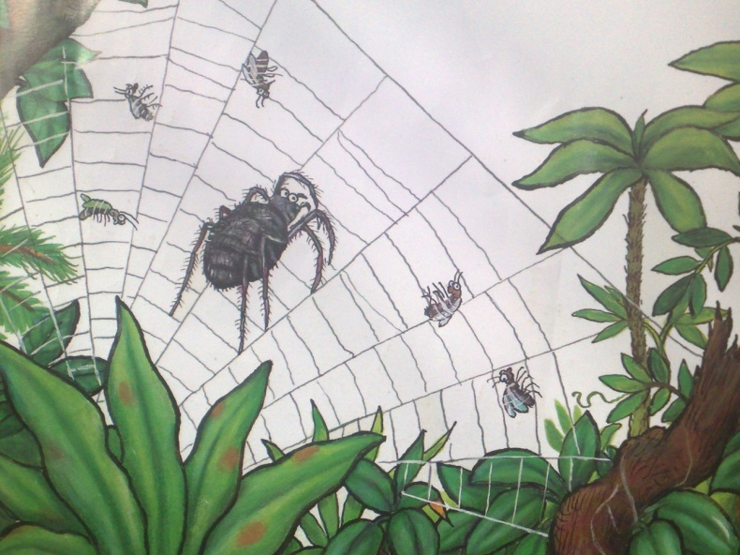
“No, no, no! That`s a spider.
“Mum isn`t black and hairy and fat.
She`s not got so many legs as that!
She`d rather eat fruit than swallow a fly,
And she lives in the treetops, way up high.”
“She lives in the trees? You should have said!
Your mummy`s hiding above your head.”

Slide 7
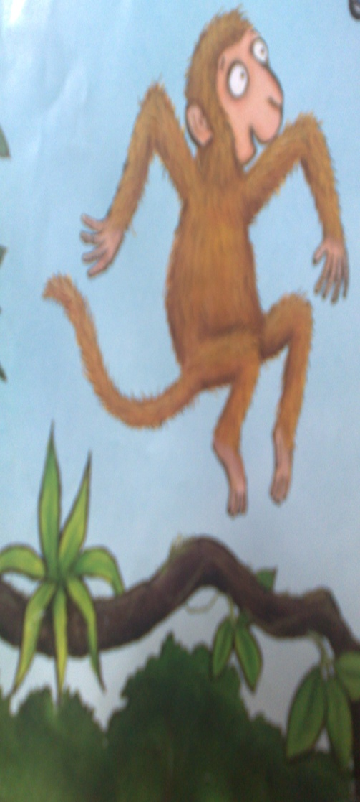

“No, no, no! That`s a parrot.
“Mum`s got a nose and not a beak.
She doesn`t squawk and squabble and shriek.
She doesn`t have claws or feathery wings.
And anyway, my mum leaps and springs.”
“Aha! I`ve got it! She leaps about?
She is just round the corner, without a doubt.”

Slide 8
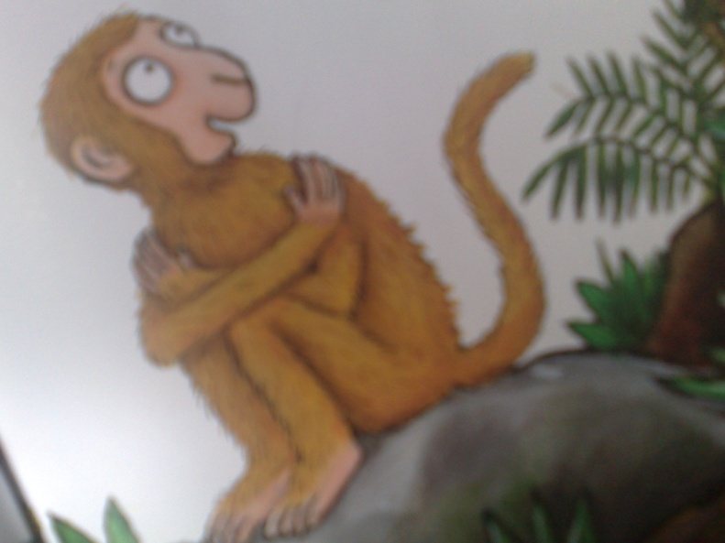
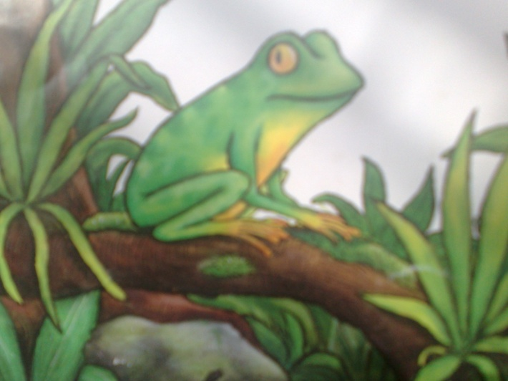
“No, no, no! That`s a frog!
“Butterfly, butterfly, please don`t joke!
Mum`s not green and she doesn`t croak.
She`s not a slimy. Oh dear, what`s a muddle!
She`s brown and furry and nice to cuddle.”
“Brown fur – why didn`t you tell me so?
We`ll find her in no time – of we go!”

Slide 9
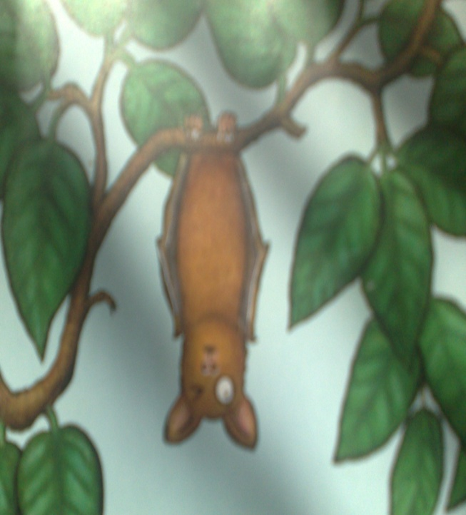
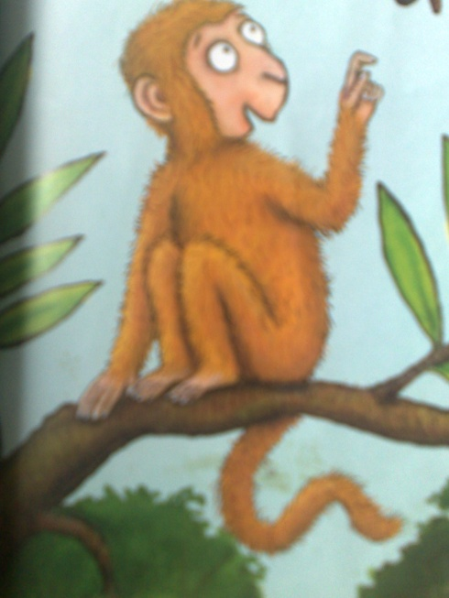
“No, no, no! That`s a bat.
“why do you keep on getting it wrong?
Mum`s doesn`t sleep the whole day long.
I told you, she`s got no wings at all,
And anyway, she`s not nearly so small!”
“Your mum`s not little? Now let me think.
She`s down by the river, having a drink!”

Slide 10
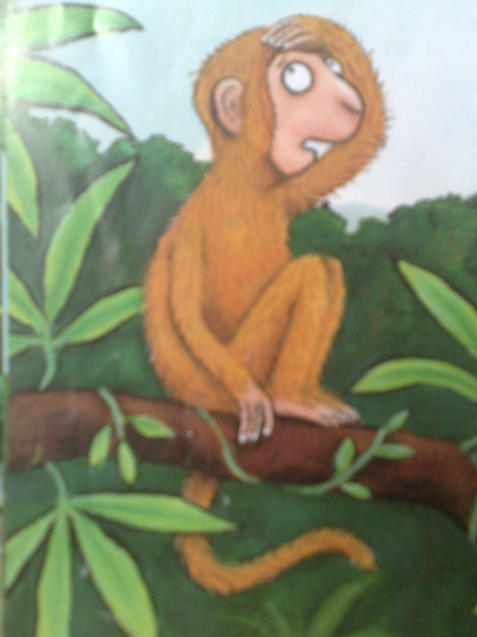
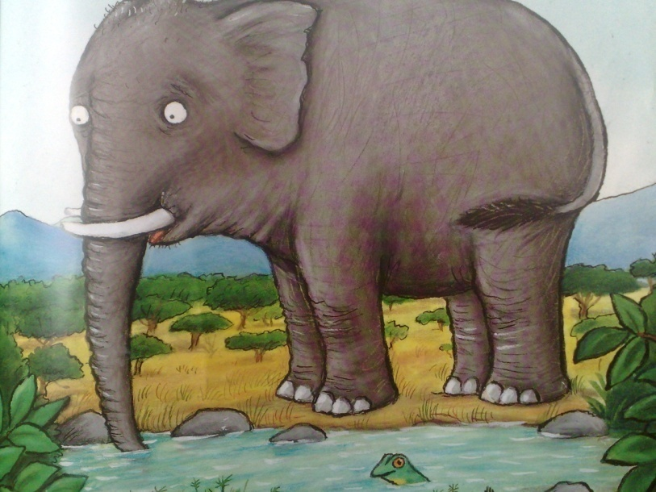
“NO, NO, NO!
That`s the elephant again!
“Butterfly, butterfly, can`t you see ?
None of the creatures looks like me!”
“You never told me she looks like you!”
“of course I didn`t I thought you knew!”
“I didn`t know. I couldn't! You see...

Slide 11
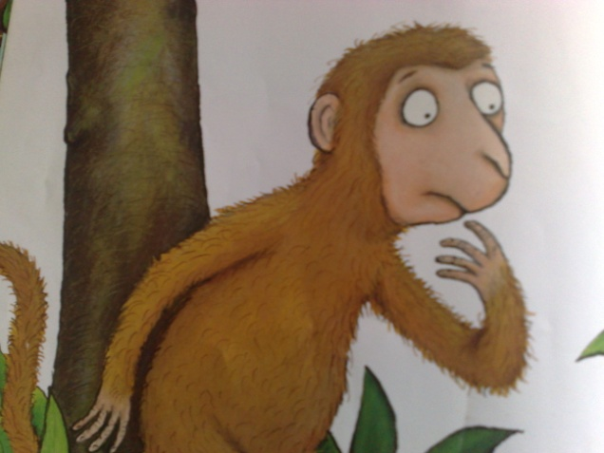
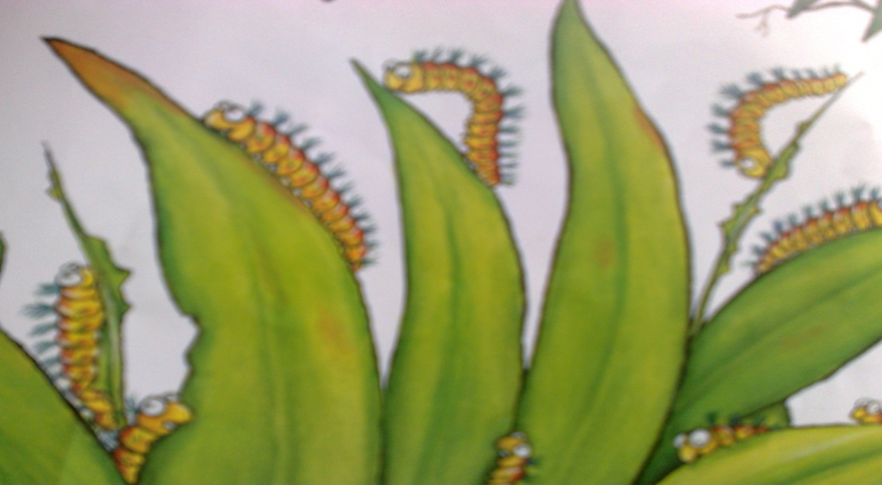
“...None of my babies looks like me.
So she looks like you! Well, if that`s the case
We`ll soon discover her hiding place.”

Slide 12
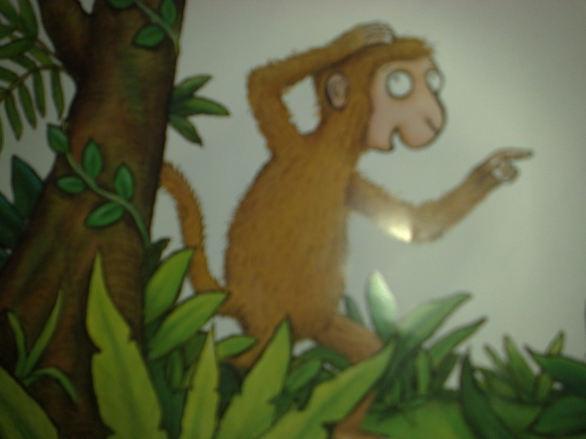
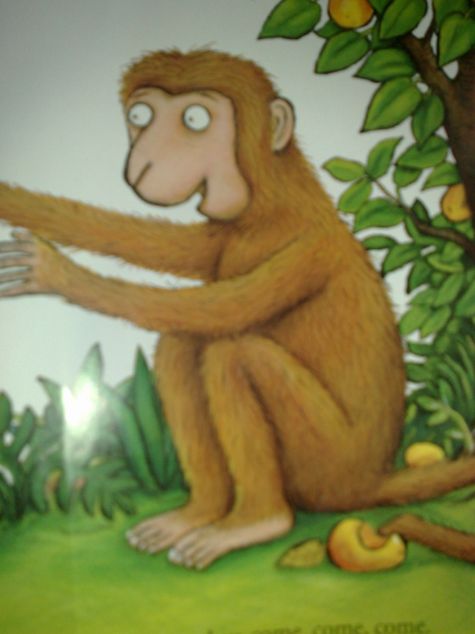
No, no, no! That`s my dad!”
“Come little monkey, come, come, come.
It`s time I took you home to ...”

Slide 13



