Slide 1





What am I?

Slide 2
I only come out at night.
I hang upside down to give you a fright.
If you come too close, you might get a vampire bite!
What am I?

Slide 3

A bat!

Slide 4
My body is long and round.
In the jungle I am found.
When I move I make no sound.
As I slither on the ground.
What am I?

Slide 5

A snake!

Slide 6
I have 4 legs.
I’m covered in fur.
If you stroke me, then I might purr!
What am I?

Slide 7
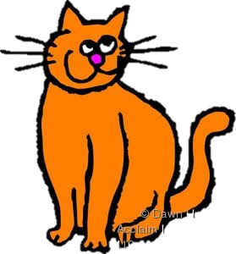
A cat!

Slide 8

Can you make your own animal riddles?
Remember:
  Don’t give too much information away straight away!
  Think about your animal
    Where does it live?
    What does it look like?
    What does it like doing?
EXTRA CHALLENGE!
Can you make your riddle rhyme?

Slide 9

Share your riddles with your friends. Can they guess your animal?
Can your teacher guess it?

