Slide 1
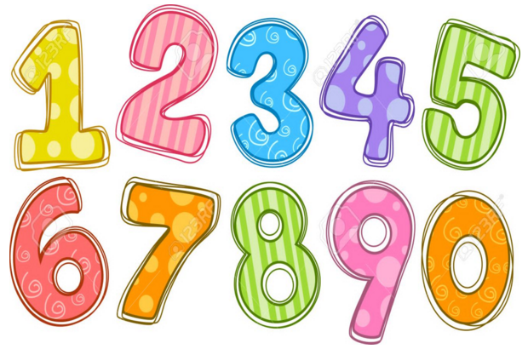
Maths Gym
Week 5

Slide 2
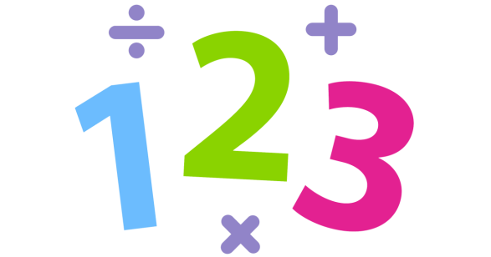
Fill in the missing numbers
6 8 10 __ __ __ 18
15 20 25 ___ 35 ___ ___
26 ___ 24 ___ ___ 21 ____
2. Solve the calculations
7 + 3 = 17 – 12=
9 + 7 = 18 + 3 =
9 – 5 =``` 20 + 9 =
Double 8 =
Half of 12 =
Order 17, 27, 37, 7 starting with smallest
Monday

Slide 3
1. Fill in the missing numbers
7 9 __ __ __ 17
35 30 25 ___ 15 ___ ___
16 ___ 14 ___ ___ 11 _
_2. Solve the calculations
5 + ? = 7 17 + 2 =
5 - ? = 1 18 + 3 =
3 - ? = 0 21 – 7 =
Double 6 =
Half of 20 =
Order 30, 20, 14, 21 starting with largest
Tuesday

Slide 4

80 70 ___ 50 ___ 30 ___
79 ___ 81 ___ 83 ___ ___
2. Solve the calculations
12 – 0 = 27 + 4 =
13 = 6 + ? 21 – 10 =
Double 4 =
Half of 22 =
Write a number with 0 ones
Write a number with 5 tens
Fill in the missing numbers
Wednesday

Slide 5
8 + 11 =
16 - 9 =
10 + ? = 13
? + 6 = 12
5 + 5 = 3 + ?
18 – 6 = 20 - ?
Thursday
Check each calculation is correct.
Look at the signs!

Slide 6
Fill in the missing numbers
12 ___ 16 ___ 20 ___ 24 ___
___ 65 70 ___ 80
2. Solve the calculations
9 – 2 = 3 + ? 1 + 17 =
12 – 1 = 11 - ? 24 – 6 =
Double 7 =
Half of 18 =
Order 18, 81, 80, 28- smallest to largest
A number greater than 75
Friday

Slide 7
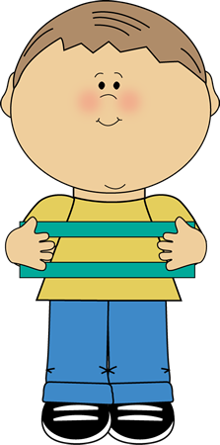
Daily
Can you recall and use number bonds to 5?
Can you read and interpret < and >? (Y1 NC)

Slide 8


GREATer than
Or
Less than

Slide 9

<
61
60

Slide 10
<
21
12

Slide 11
72
27
<

Slide 12
63
36
<

Slide 13
<
95
59

Slide 14
Other daily activities to support this objective
Your teacher will show you two number cards.
Can you choose the right symbol? <, > or =
Your teacher will show you a symbol – either <, > or =.
Can you write two number either side to make it correct?

Slide 15
Daily
Can you recall and use number bonds to 5?
Can you recognise and name common 3d shapes? (Y1 NC)

Slide 16
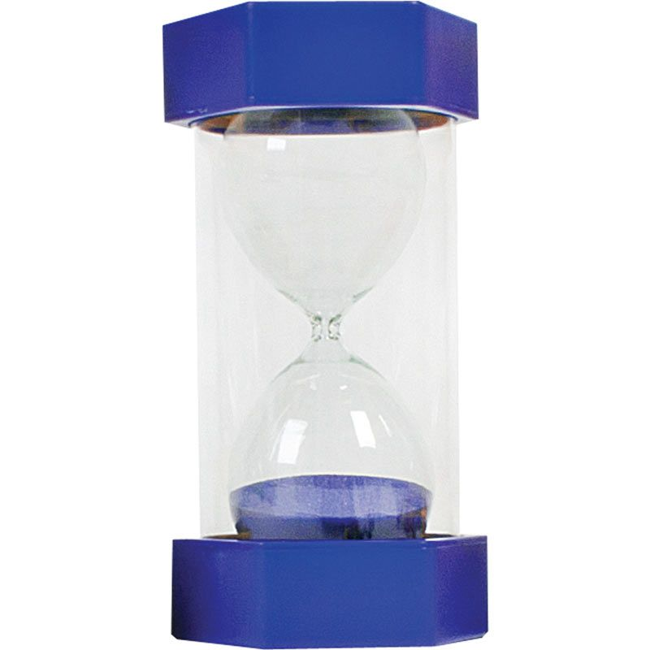
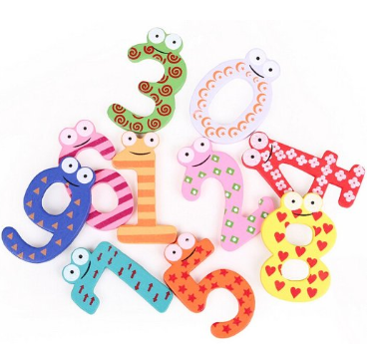
3d shapes

Slide 17


Slide 18


Slide 19


Slide 20


Slide 21


Slide 22


Slide 23


